Slide 1


WASH Safety and Accessibility Audit Toolkit – intro presentation
Month/year
https://washcluster.net

Slide 2
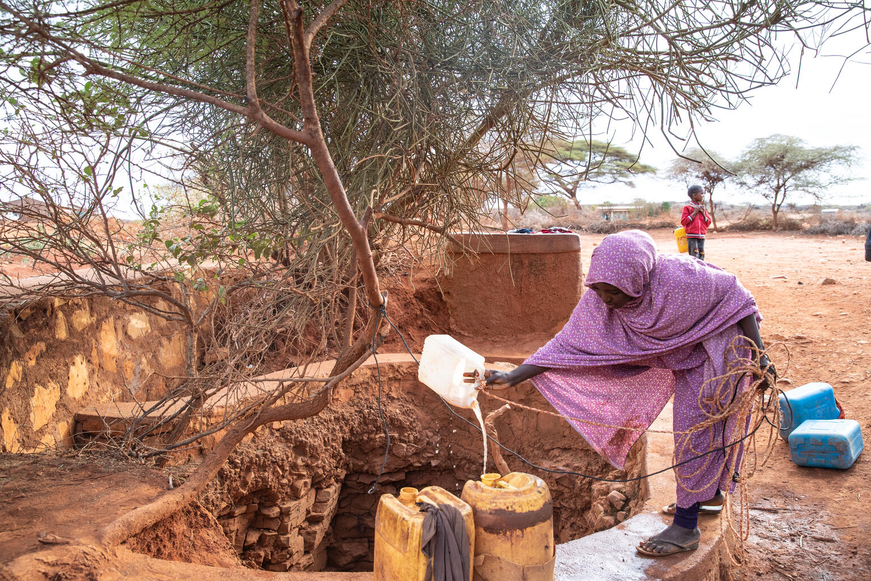
Agenda
What is Gender–based violence (GBV)?
What is Disability Inclusion and Accessibility monitoring?
WASH Safety and Accessibility Toolkit: content
Key Resources
© UNICEF/UN0694036/Bizuwerk

Slide 3
Key concepts for GBV
GBV: “An umbrella term for any harmful act that is perpetrated against a person’s will, and that is based on socially ascribed differences between males and females”
(IASC)
GBV is based on gender inequality and the abuse of power.
The root causes of GBV is abuse of power, lack of respect for human rights and gender inequality
Contributing factors to GBV include poverty and lack of access to income generating activities, history of abuse and addiction, limited participation (of women), weak law enforcement, victim blaming attitudes etc.
GBV includes different types of violence:
Sexual;
Physical;
Harmful practices (e.g., Female Genital Mutilation)
Socio-economic;
Emotional and psychological.
This includes:
Intimate Partner Violence (IPV)
Early and Forced Marriage
Sexual exploitation and abuse (SEA)
GBV

Slide 4
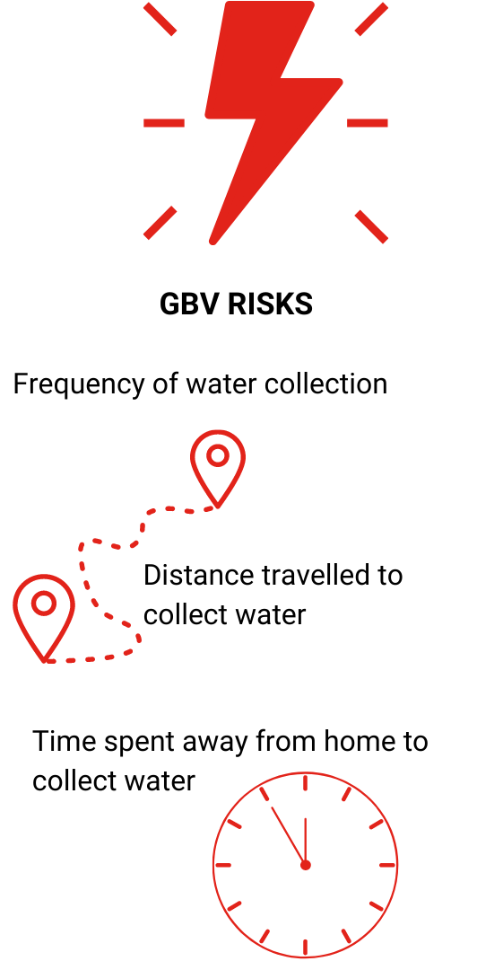
GBV in emergencies
GBV increases in emergencies due to:*
Lack of privacy & overcrowding
Changes is family structures- more women may become heads of households and are taking more risks to access food and NFIs
Unsafe routes to WASH services, distributions and facilities
Lack of privacy at WASH (and other) facilities
Separation from family members
Increased care/housework for women and girls
Breakdown of protective social mechanisms
Increased vulnerability and dependence on assistance; sexual exploitation and abuse (SEA)
Negative coping mechanisms (e.g., Survival Sex)
* non-exhaustive list: these risk factors are context specific

Slide 5
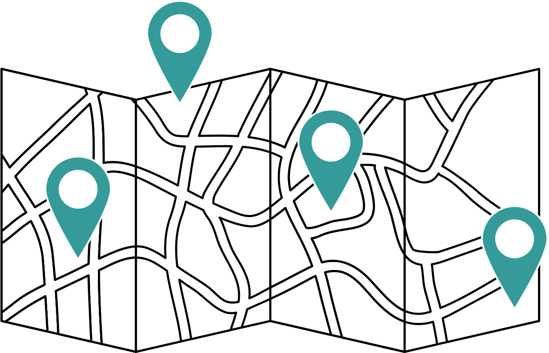


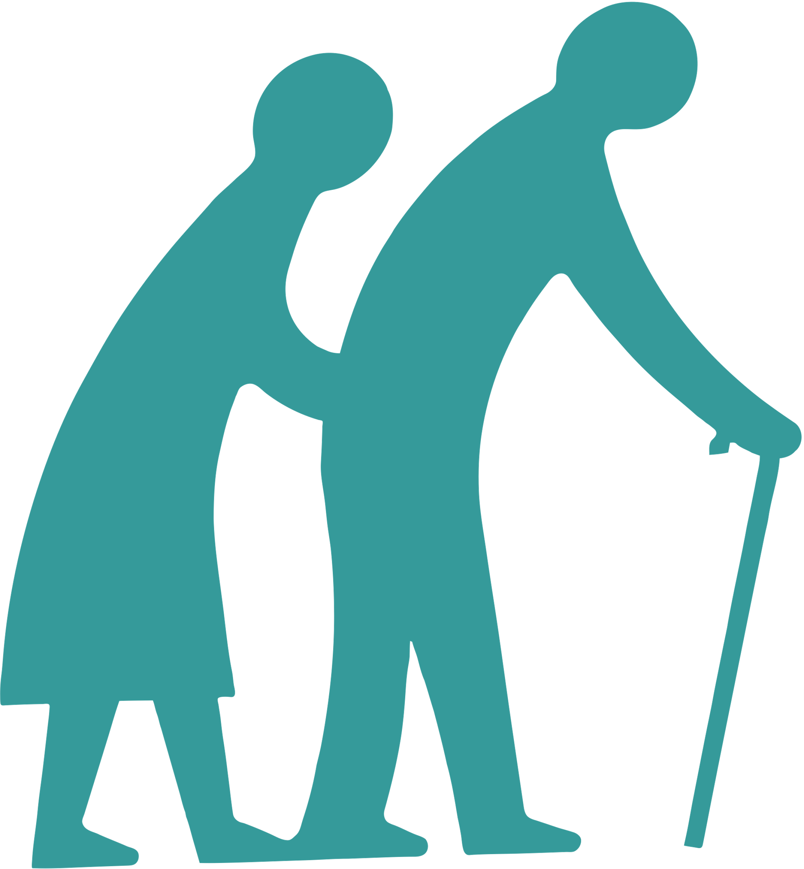
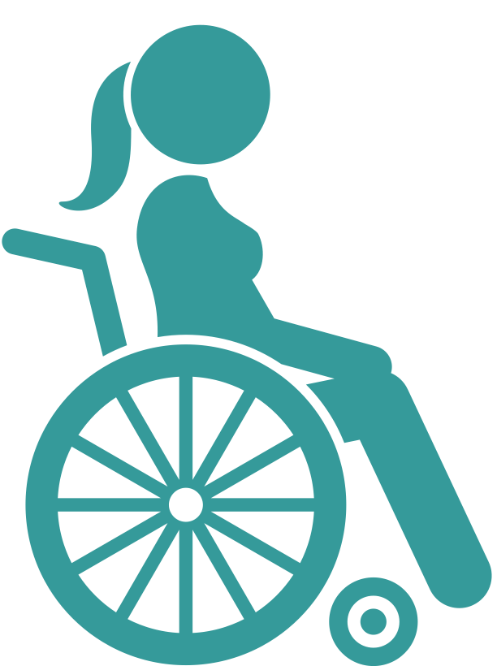
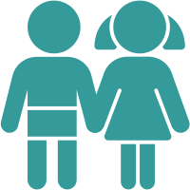

GBV risk mitigation is the process to ensure that humanitarian interventions (across all sector/clusters):
Does not cause or increase the likelihood of gender-based violence (GBV)
Seeks to identify and takes action to mitigate GBV risks in the environment and in programming
Links to GBV services
Proactively facilitates and monitors vulnerable groups’ access to services

Slide 6
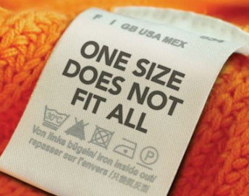
Why do WASH actors have to mitigate GBV risks?
All humanitarian organizations and all their staff, consultants, volunteers etc. are responsible to mitigate GBV risk in their work. Such actions are in keeping with the Centrality of Protection and principle of Do No Harm.
To ensure access to life-saving WASH services for all vulnerable population groups
To ensure your programmes do not create any additional GBV risks

Slide 7
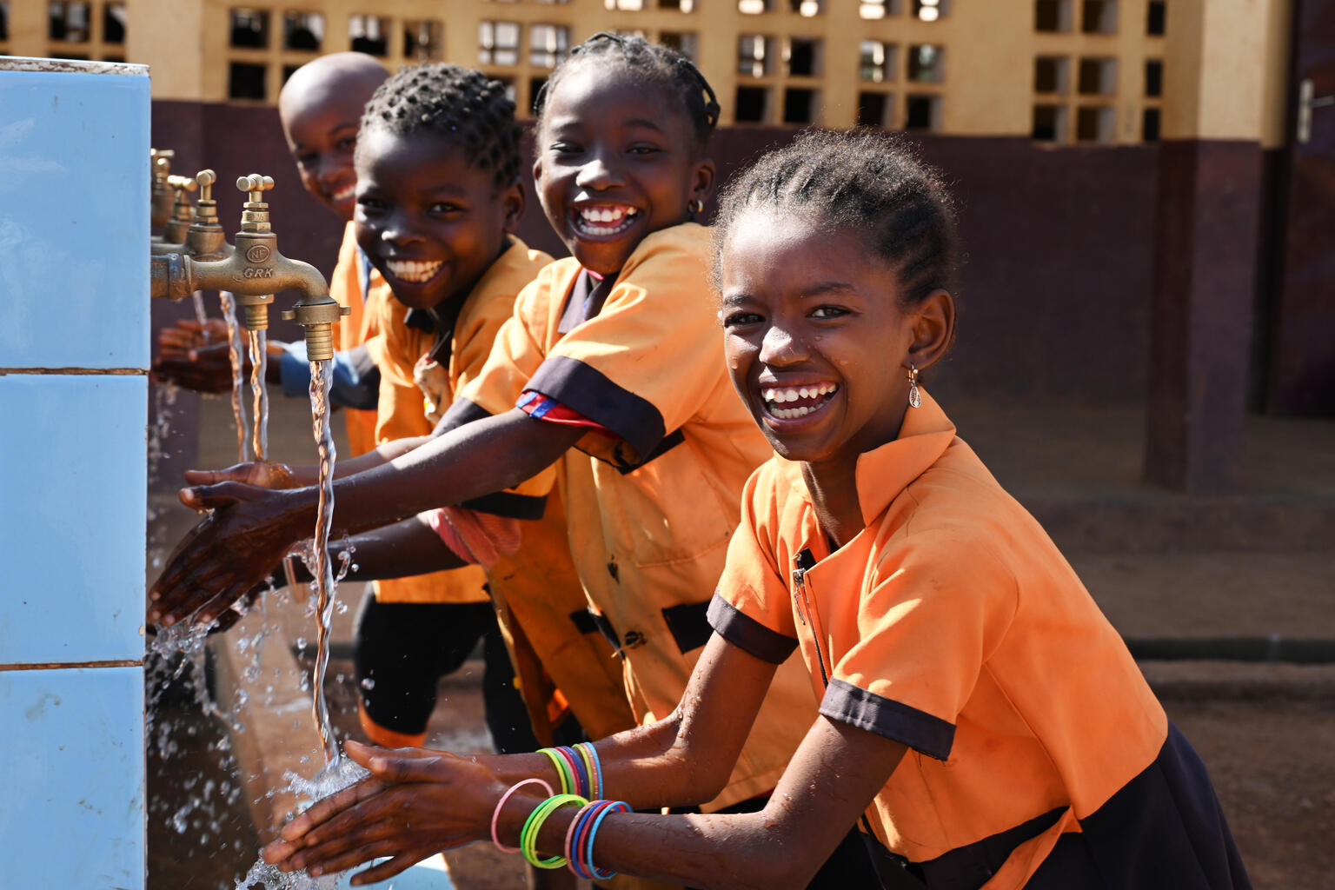
GBV Mitigation in WASH – what can we do to reduce risks ?
First and foremost- consult women and girls of different age groups, including women and girls with disabilities, on their needs, concerns and priorities for WASH support! They are the experts on their own situation. Act on their feedback and recommendations.
Use the Safety and Accessibility Audit toolkit to conduct FGD to understand any safety concerns with current or planned WASH programming and to monitor any visible GBV risks and access issues on the route to and around WASH facilities
Make sure there is a feedback mechanism in place
Be up to date about GBV referral pathways: talk to the GBV sub-cluster coordinator (insert names and contact details)
Recruit and involve women in assessment teams and as WASH frontliners as much as possible

Slide 8
What shall we do if someone discloses GBV?
Do not try to solve the issue/find solution yourself
Talk to a GBV specialist/GBV sub-cluster to understand what services/referral pathways exist
Provide up-to-date information and contact details of specialized service(s) and support that may be available to the survivor.
Listen, but do not pressure the survivor to talk
Maintain confidentiality and keep the safety of the survivor as priority. Meaning: do not share this information with anyone, unless the survivor consents
This video explains well how to act when someone comes forward and tells you about a GBV incident:
https://www.youtube.com/watch?v=n_YhXzMv1E4
For more info: check the GBV pocket guide (available in many languages)

Slide 9
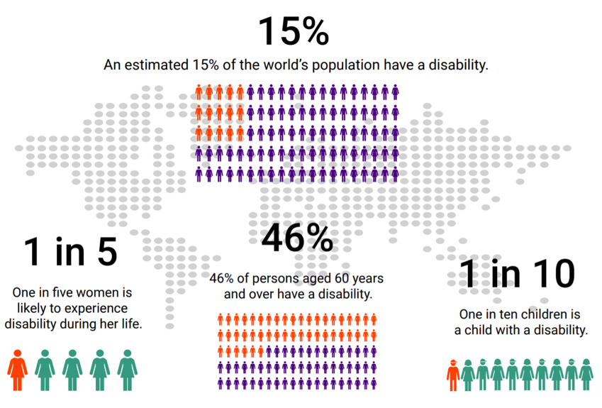
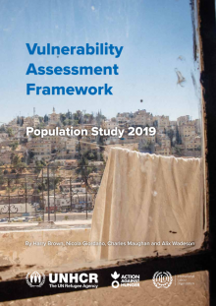
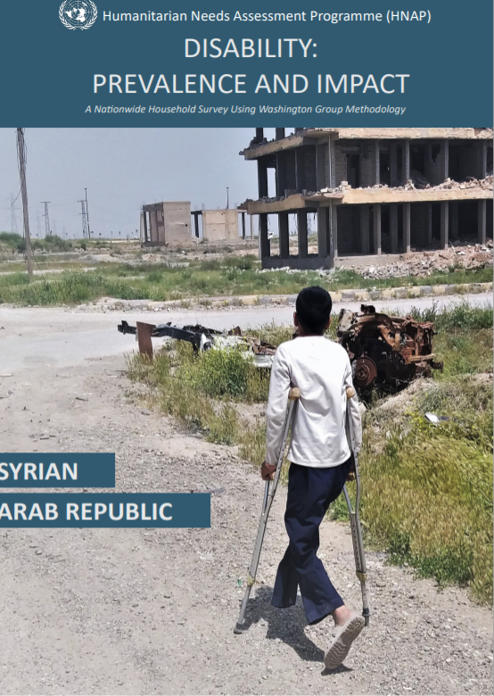
How many people have disabilities?
Jordan 21%
Syria 27%

Slide 10
Who are people with disabilities?
Persons with disabilities include those who have long-term physical, mental, intellectual or sensory impairments which in interaction with various barriers may hinder their full and effective participation in society on an equal basis with others (UN CRPD 2006)
Person with impairment
(physical, sensory, intellectual and
psychosocial)
Environment
(institutional, attitudinal,
physical, communication barriers)
Interaction
=
Obstacles to Participation and Inclusion
Notes:
Key points:
A person does not have a disability because of their impairment alone. Disability arises due to an environment that does not accommodate diverse needs
Persons with disabilities include those with physical, hearing, visual, intellectual and psychosocial impairments
Disability results in obstacles to participation and access to services and facilities

Slide 11

Key risks faced by persons with disabilities
More than twice as likely as their peers without disabilities to experience violence, with a higher likelihood of all forms of violence
Girls with disabilities up to three times more at risk of rape than girls without disabilities and twice as likely to experience other forms of GBV
24% of children with more than one functional difficulty are out of primary school
47 per cent more likely to be underweight and 34 per cent more likely to be stunted compared to children without disabilities
22% less likely (compared to children without disabilities) to have improved sanitation facilities in their households; and 26% less likely to have improved drinking water sources in their households.
Risks are created by barriers to accessing services, facilities and opportunities for participation

Slide 12
Barriers to accessing WASH services and facilities for Pwd?
WASH related information in inaccessible formats
Stigma preventing persons with disabilities from safely using communal facilities
Distribution of WASH items using heavy or bulky packaging
Long distances to WASH facilities or rough/ uneven paths
Stairs or narrow doorways at WASH facilities
Lack of supplies required by some persons with disabilities (e.g., commodes)
Inability to squat or activate a handpump
Notes:
Examples only- barriers will vary by context and by individual (including with consideration for age, gender and other diversity factors)

Slide 13
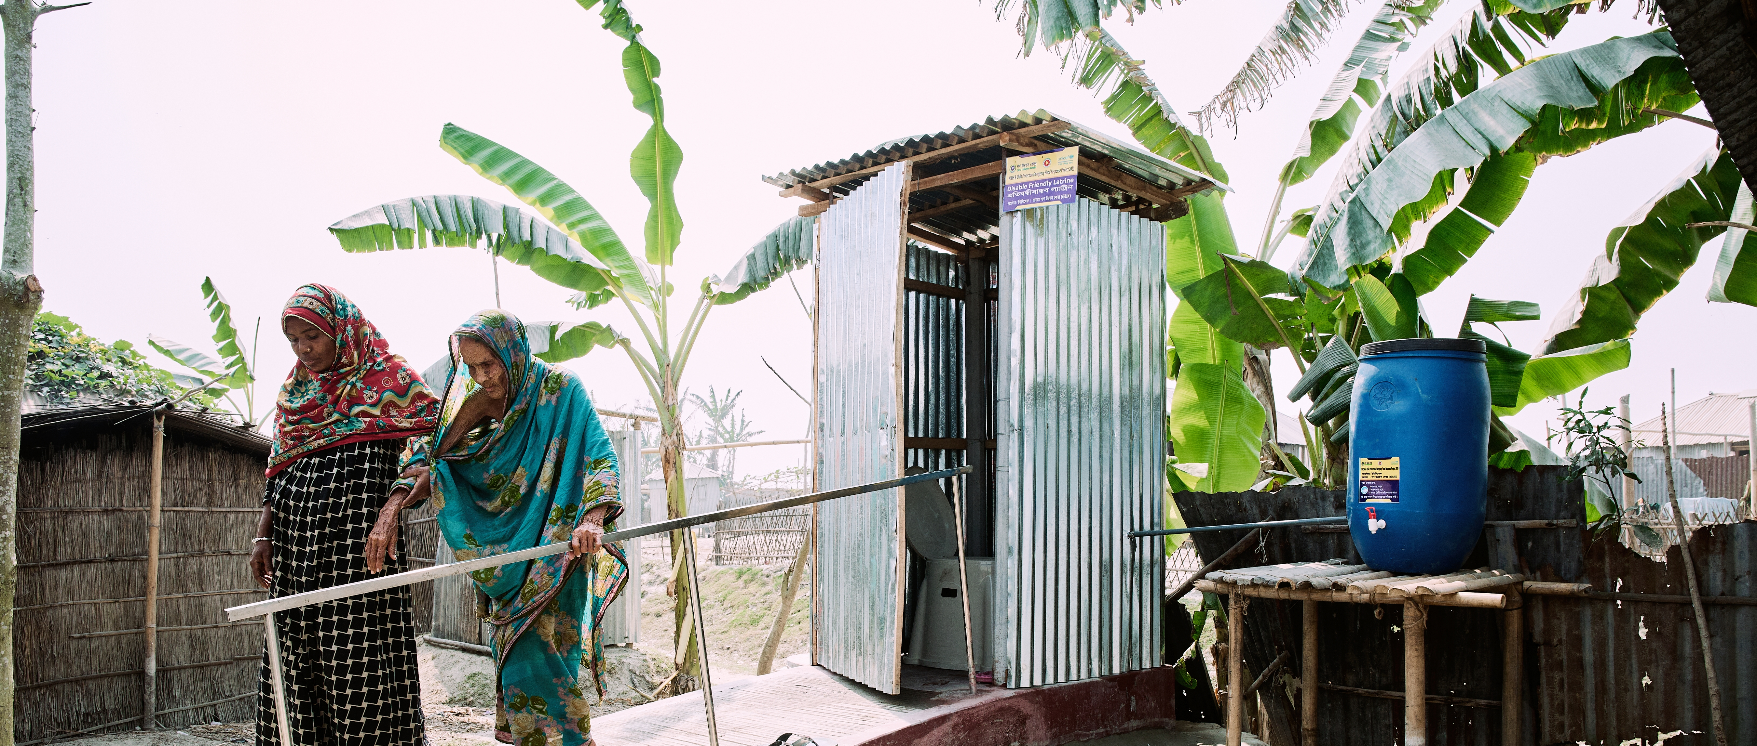
Disability Inclusion= the process of identifying and addressing barriers to access that create heightened risk for persons with disabilities
Notes:
Vulnerability of persons with disabilities is not inherent- it arises out of barriers that create exclusion. So, we need to identify and address those barriers (not the impairment). This is what we mean by ‘disability inclusion’, and this is how we address the risks faced by persons with disabilities in humanitarian emergencies.

Slide 14
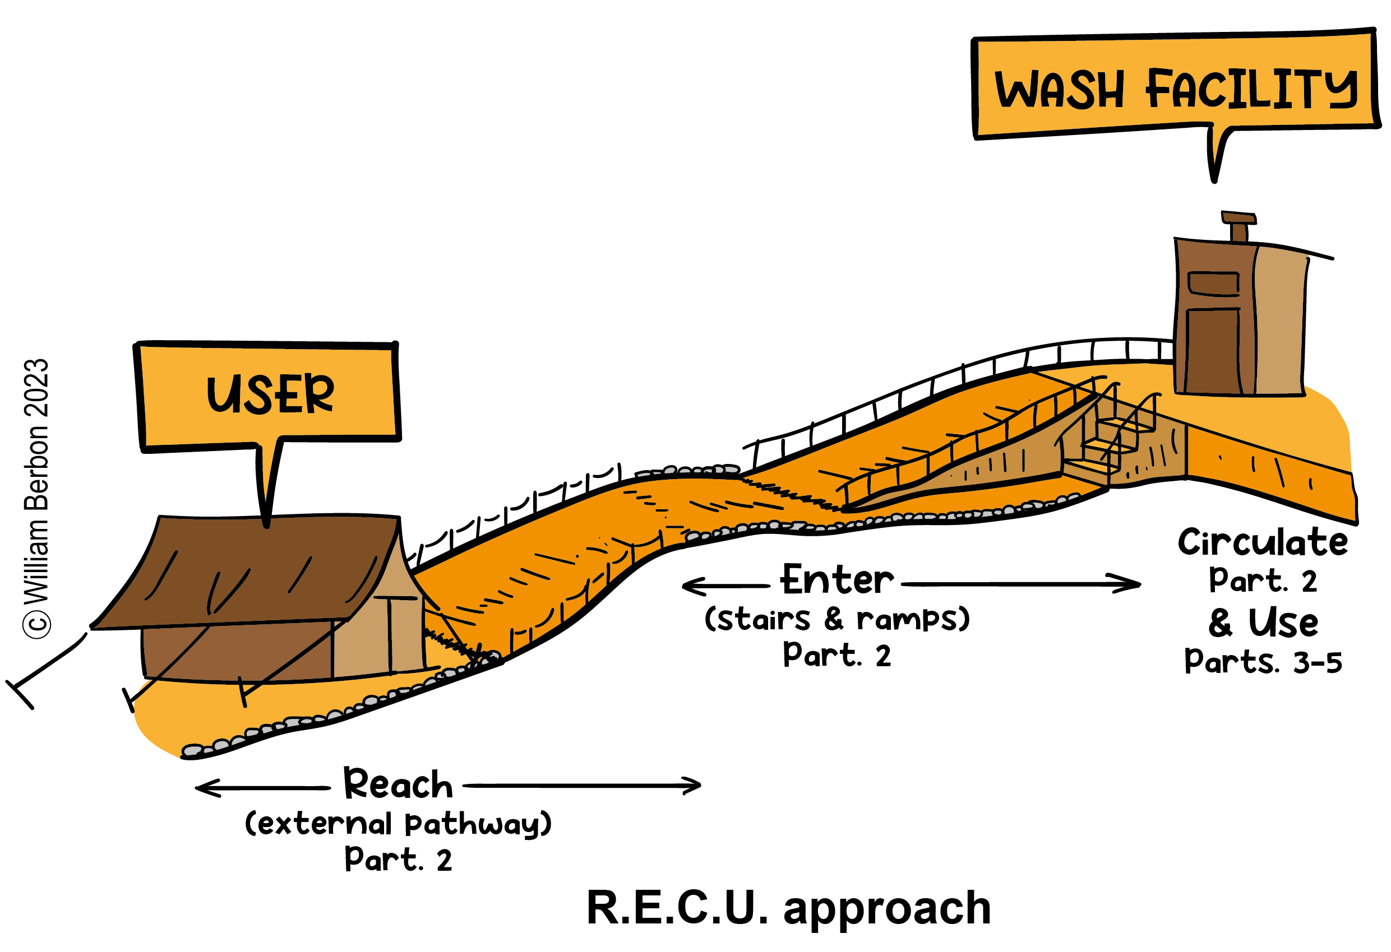
The Safety and Accessibility audit toolkit will help you identify GBV risks AND access barriers for persons with disabilities in WASH facilities
Part 1: Guidelines
Part 2: Common Core*
Part 3: Water Points
Part 4 : Latrines / toilets
Part 5: Bathing Facilities
* Reaching, circulating and entering the facility

Slide 15
WASH Safety and Accessibility Audit toolkit; steps for use
Start with reading Part 1 carefully, here you will find all instructions needed to implement the toolkit
Make sure you have all equipment needed ( see Part 1
Read Part 2 (applicable to all facilities) and select among part 3-5 depending on type of facility to be audited
Start with the visual observation checklist in Part 2 and continue with the visual observation checklist in Part 3,4 or 5
Validate your findings through FGD or KII ( see Part 1 for instructions and Part 3,4 or 5 for relevant questions per type of facility
ADD IMAGES OF TOOLKIT
Part 1
Part 2
ADD IMAGES OF TOOLKIT
Part 3
Part 4
Part 5

Slide 16
Relevant tools and guidance
Global WASH cluster: Minimum Commitments to dignity and safety of affected populations
IASC GBV Guidelines Reference Group: GBV Pocket Guide:
IASC: Gender in Humanitarian Action Handbook - WASH Sectoral Chapter.
IASC Guidelines for GBV Interventions in Humanitarian Action – WASH.
IRC and Columbia University: Toolkit for Integrating MHM into Humanitarian Response.
UNICEF Gender-responsive WASH: Key elements for effective WASH programming.
UNICEF MHM Materials
Washington Group: Short Set of questions on Functioning (WG-SS)
UNICEF: Engaging with OPDs in Humanitarian Action
UNICEF: Engaging children with disabilities in decisions that affect their lives

Slide 17
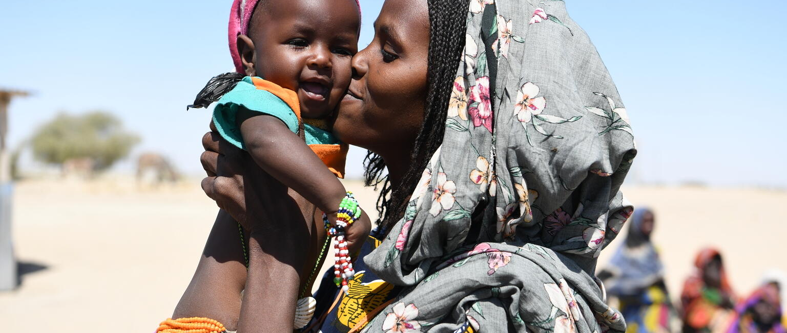
THANK YOU
THANK YOU!

