Slide 1
Infographic Basics
Notes:
Purpose of the presentation: basic guidance on DOs and DONTs

Slide 2
Infographic basics
Purpose of an Infographic
Representing Data: Design principles
Table, Bar charts, Line charts, Pie charts
Text
Notes:
Purpose of the presentation: basic guidance on DOs and DONTs

Slide 3
Purpose of an Infographics
D
AT
A
Boring
Useless
GOOD
INFOGRAPHIC
S
T
O
R
Y
DESIGN
Unreliable
Notes:
Data + Story = Boring: Reliable data and a compelling story are not enough to captivate readers’ attention. Convert data and text into visually stimulating design by using different design technics described in this book.
Data + Design = Useless: If you create nice charts using good data but it does not state an issue or deliver a message, then, what is the point of having it? Work with the public information/reporting officer in getting the key messages.
Story + Design = Unreliable: If you have a good story nicely visualized but the information is not accurate, then the graphic is unreliable and misleading. Dig up up-to-date and reliable data.

Slide 4









Representing Data:
Design Principles
Tables, Charts, Maps, Photos, Text

Slide 5

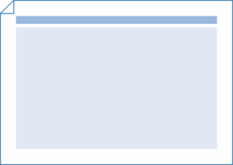
Layout
Use portrait for publication (WASH Bulletin)
Use landscape for presentation (WASH Dashboard)
Notes:
First, the layout: use the same banner
Portrait for publication; Landscape for presentation
Also mention: Font, Colour, Logo
Highlight the use of colours if no official guidance available in cluster for templates / colorschemes. Ideally, no more than 3 colors – use different shades of same color if necessary. The human eye easily becomes overloaded if there are too many colors.

Slide 6
    Determine the medium that tells the story best
Line chart?
… or something else?
Table?
Bar chart?
Pie chart?

Slide 7
Regardless of which chart you decide to use please keep one thing in mind…

Slide 8
Fundamental rule of chart design
Reduce non-data ink
Remove chart elements that are decorative or ornamentals
Increase data ink ratio
Make every pixel tell a story about your data
Notes:
Reduce chart-junk and increase data-to-ink ratio. These are the first two commandments of world-renowned data visualization expert Edward Tufte. Reduce chart junk by removing elements that are decorative or ornamental. Three dimensional chart effects, for example, add nothing of value to your chart. Increase data-to-ink ratio by making every pixel tell a story about your data.

Slide 9
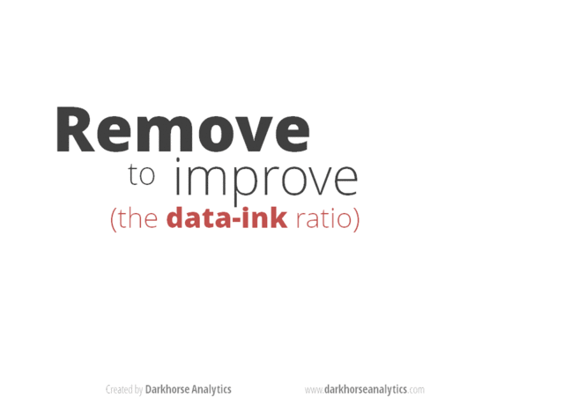
Notes:
http://darkhorseanalytics.com/blog/wp-content/uploads/2013/08/data-ink.gif
http://darkhorseanalytics.com/blog/data-looks-better-naked/

Slide 10
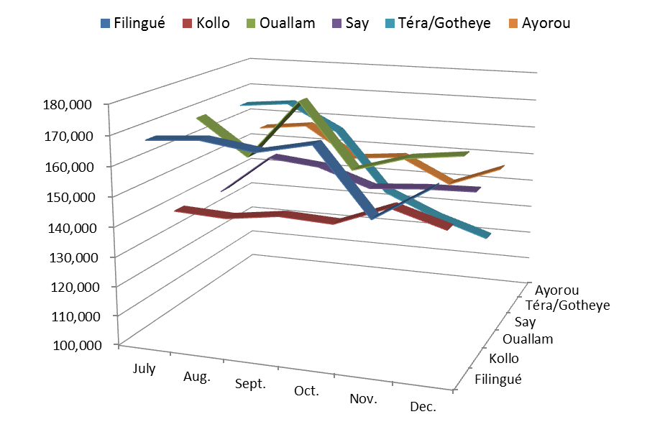
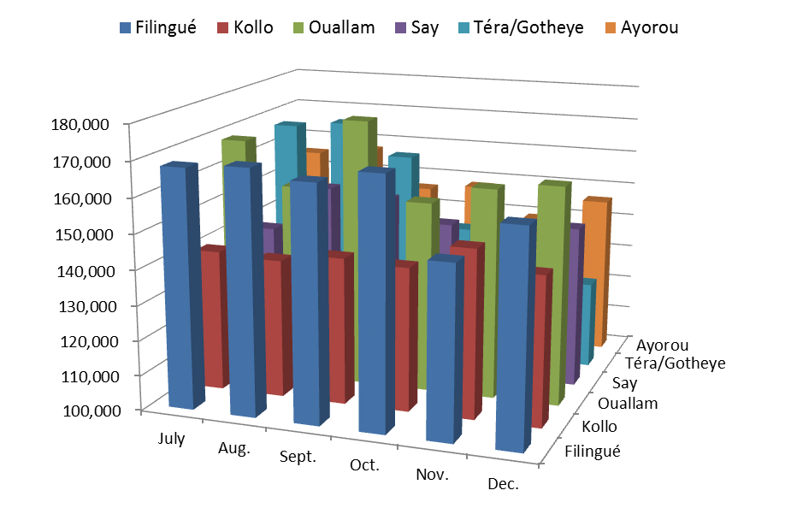
Avoid 3D
Notes:
The 3D rendering obscures the data. Avoid using 3D; it only confuses readers and never facilitate readability.

Slide 11
Contrast
OR
Notes:
http://www.dashboardinsight.com/articles/digital-dashboards/fundamentals/a-guide-to-creating-dashboards-people-love-to-use-part-3.aspx?page=6
Maximize contrast. Maximize the contrast between your data and the background. The standard Excel default chart, for example, makes it more difficult than necessary to distinguish the line from the background. A white background emphasize the data.

Slide 12
Table

Slide 13
OR
Notes:
Avoid using the default table using black grid lines. Black is the strongest colour and the busy grid lines distract the reader from the data. In a small table, alternating background or grid lines for every entry is unnecessary. The eyes can easily follow the numbers across the table.

Slide 14
Tables work best when…
… comparing individual values
… including multiple units of measure
 | 0-4 years old |  | 5-11 years old |  | 12-17 years old
Camps / Sites | F | M | F | M | F | M | Total | % Male
Gaoudel | 157 | 129 | 260 | 212 | 86 | 75 | 919 | 45%
Intadabdab | 42 | 35 | 51 | 36 | 22 | 19 | 205 | 44%
Mbeidoun | 43 | 38 | 48 | 42 | 16 | 15 | 202 | 47%
Tabareybarey | 926 | 914 | 1581 | 1291 | 291 | 219 | 5222 | 46%
Tidirgalene | 11 | 15 | 15 | 5 | 5 | 4 | 55 | 44%
Tinfagate | 64 | 54 | 108 | 127 | 31 | 21 | 405 | 50%
Total | 1,243 | 1,185 | 2,063 | 1,713 | 451 | 353 | 7,008 | 46%

Slide 15
Bar charts
The most common infographic

Slide 16
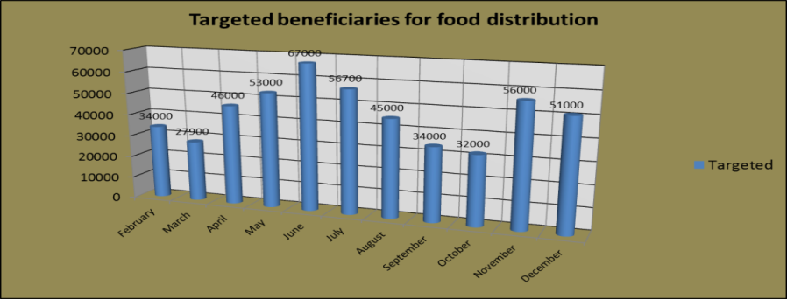
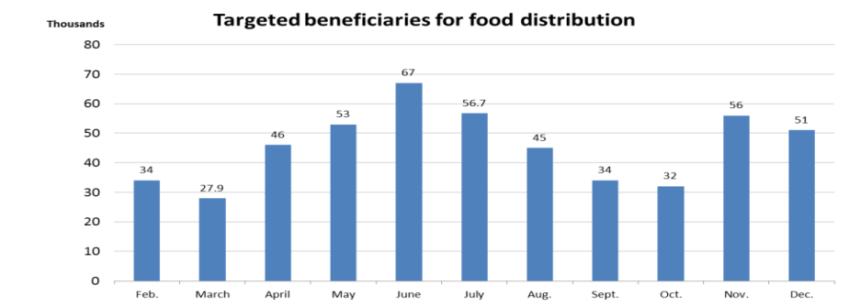
OR

Slide 17
Notes:
Chart titles should be clear and accurate, includes time increment and units
Start at the zero baseline! No exception. Do not clip the axis in order to highlight disparities at the top of the axis. Instead, try recalculating your data as percentages, or try another type of chart.
Ensure numerical axis labels are aligned with the decimal point.
Clearly denote currency or units.
When axis lines are present, it is not necessary to label each data value. However, it can be useful to highlight the final value or other important data points.
Include data source
Don’t use a 3D effect!

Slide 18
Notes:
Convert your data to rounded, easily digestible values for chart labelling.
Omit axes and baselines when data values are labeled. Simpler is better!
When the range of your data crosses natural numerical milestones, such as from millions to billions, set the entire chart in the larger milestone. A chart should never reflect more than 1,000 million. etc.
Ensure labels fit neatly under the bars in no more than two lines. Alternatively, use a horizontal bar chart.

Slide 19
Horizontal bars
OR
Notes:
Long and/or large numbers of categorical labels fit better along the vertical axis.
Readable labels. Whenever possible, avoid rotated labels; they are hard for people to read and distract from focusing on the numbers.
Horizontal bar charts help compare long lists of values or categories. They allow you to write long labels without using two lines or vertical text, as would be required for a vertical bar.
Remember to sort your data before charting so that readers can easily compare.
Labeled values eliminate the need for grid lines, while rounding is done to make the values easy to digest.

Slide 20
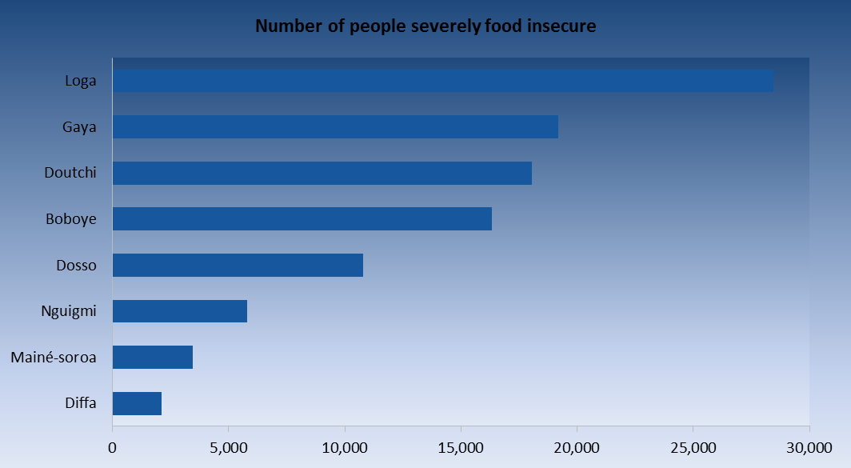
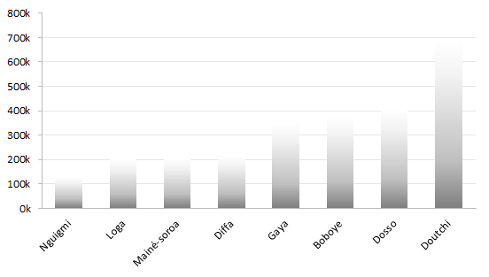
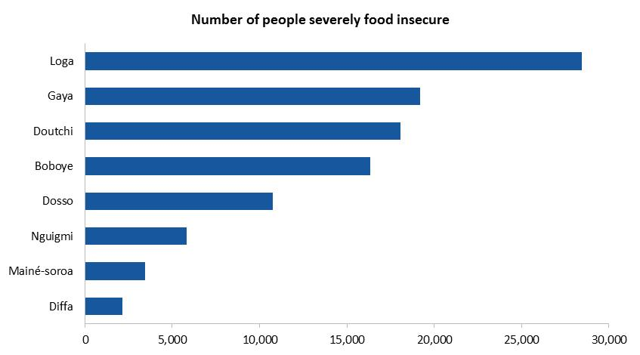
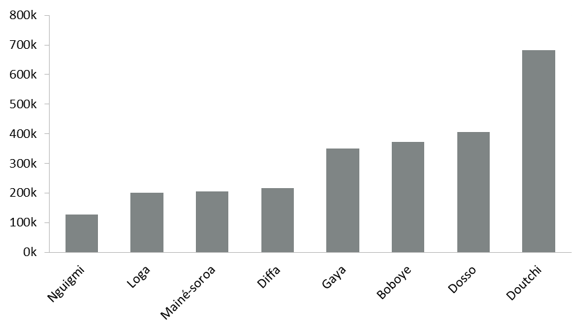
Less is more
OR
OR
Notes:
The background should be open, spacious, and simple.
Avoid the trend to make the background ornamented, crowded, and distracting. Keep the background as simple and intentionally clean as possible. Your background is there to host your objects, not to be an object. Backgrounds should never compete with content.
Careful use of gradients. Use flat colors or a bare minimum gradient. Ensure that the bar endpoint is visible. When the gradient fades toward the endpoint, it reduces the ability to clearly see the length of the bar.
Also mention to stay away from dashed lines, etc. in line charts.

Slide 21
Don’t try to show all your data
Notes:
Sometimes we try to display too many values at once, and it simply overwhelms the reader so that the meaning of the data is lost.

Slide 22
Line charts
Best solution for showing a time series referring to a single value that changes at regular intervals

Slide 23
Visual hierarchy
Graphs make trends, patterns and exceptions visible
Notes:
By expressing this same information visually, giving shape to the data, the trends come alive.
In this graph (based on the same data as in the slide before) you can quickly spot a similar shape of price evolution for 4 regions, and that one particular region does not follow a similar pattern (Bouza).
Visual hierarchy is the order in which the human eye perceives what it sees. This order is created by the visual contrast between forms in a field of perception. Objects with highest contrast to their surroundings are recognized first by the human mind and provide an entry point to reading your graph. In this case, the red line is emphasized compared to the others one, suggesting that the message is in this particular category, not in the others.
Also mention that 4-5 lines are the absolute maximum for a line chart.

Slide 24
Clear titles, legends and labels
Notes:
Annotating visualization is an important features of your design. Annotation can help explain and facilitate the viewing and interpretive experience. It is the challenge of creating a layer of user assistance and user insight. A compelling title or subtitle can help to attract an audience and articulate the focus of the visualization subject matter. Use of data point labelling can also drive the attention of your reader in the right direction and where the story is.

Slide 25
Axes
Notes:
The purpose of the line chart is to show a trend. It is often the best solution when the data presents a time series referring to a single value that changes at regular intervals.
Choose the y-axis scale appropriately so that we can see the trend. If it is too flat, the message is obscured; if it is too exaggerated, you will overstate the trends. The right height is two-thirds of the chart area.
The weight of the line should be thick enough to stand out against the grid line but still thin enough to show the twists and turns of the line. Keep the grid lines thin.
Unlike a bar chart, a fever line does not necessarily require a zero baseline. Some data trends won’t be discernible starting from a zero baseline.
Annotations help to clarify the message.
Avoid putting labels a long distance away. A legend separated from the line requires the readers to do extra work cross-referencing between the key and the line. Label the lines directly. Direct labelling allows the reader to identify the lines quickly and focus on comparing and contrasting the patterns.
Use the legend only when the space is tight and the lines intersect extensively. The order of the legend should match the ranking of the end points since they are the most current data points.

Slide 26
Pie chart
Popular choice to help readers understand the relative sizes of similar values
Notes:
Pie chart section should take 3-4 min

Slide 27
SMALLER
Notes:
Start at 12 o’clock, not 3 o’clock
Never chart segments clockwise from smallest to largest otherwise, the least important segment has the most prominent position. Place the largest segment at 12 o’clock on the right to emphasize its importance.
The best way to order the rest of the segments is to place the second biggest slice at 12 o’clock on the left; the rest would follow clockwise. The smallest slice will fall near the bottom of the chart, in the least significant position. This way, there is also more room for labeling the smallest slices.
A pie chart should not have more than five slices. If there are more than five, combine the smaller and less significant segments to create a fifth slice and label it “Other”. If the segments have to be represented separately, use a stacked or segmented bar chart instead.
Just like in bar and line charts, direct labeling helps the reader to quickly identify individual segments and focus on the comparison between them.
Keep the shading simple. The goal is for the reader to compare the size of any segment to the whole pie efficiently.

Slide 28
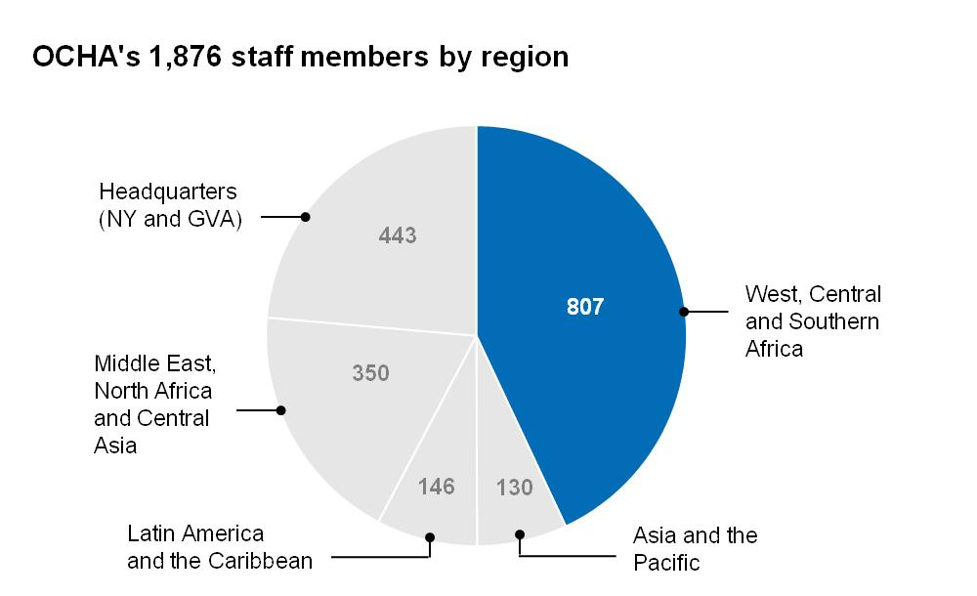
Notes:
Use different shading to highlight one or two important segments, depending on the message.
Don’t use 3D!

Slide 29
Maps
useful for showing geographical extent

Slide 30
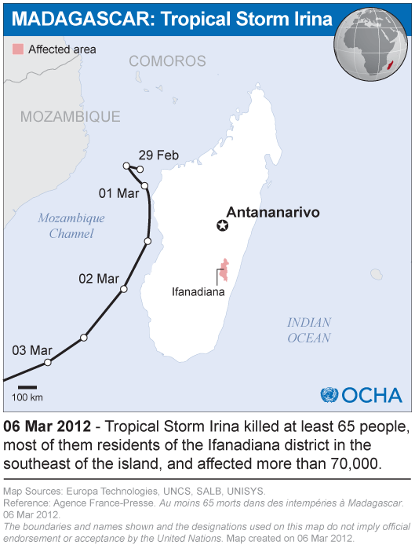
Notes:
Maps help people see the geographical location and extension, especially for areas with which the reader is not familiar.
Keep the map simple and readable. Limited use of colour will be an important design choice for base maps, both to ensure quality printing and facilitate easy layering of information.
Consider the size of document. If it will be part of report, make half page size map. Don’t shrink the map otherwise it won’t be readable anymore.

Slide 31
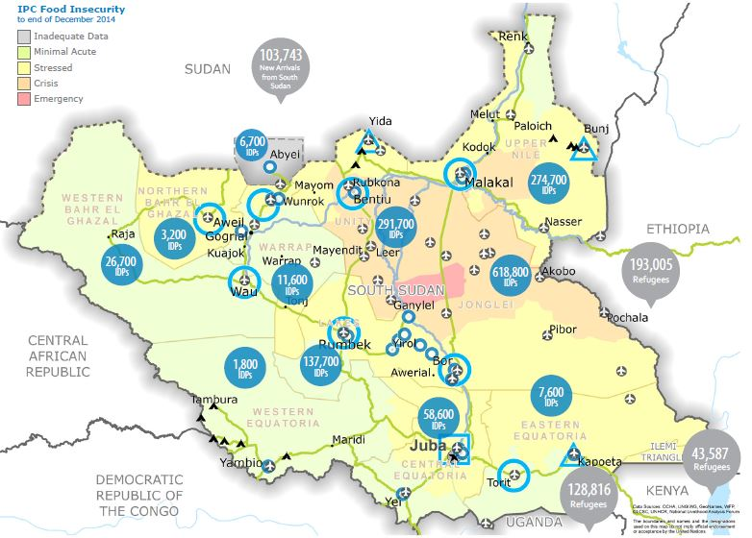


Slide 32
Text
Yes, you do need to write

Slide 33
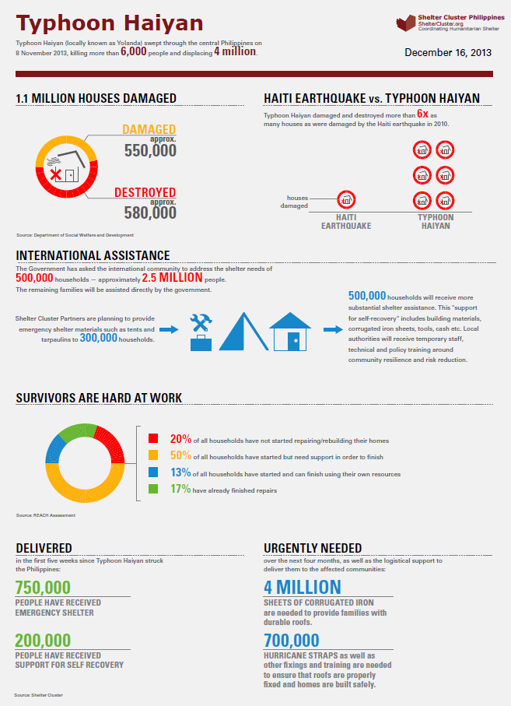

Slide 34
Remember…
Who is your audience?
What story do you want to tell?
Notes:
Make reference to Writing Guidance in training package

Slide 35
Writing Guidelines
Keep it short, don’t bury your key message
Structure
Sources and dates
Acronyms
Reviewing & proofreading
Notes:
Make reference to Writing Guidance in training package

Slide 36

“An image is more than a 1000 words”
Migrants return to Niger after fleeing unrest in Libya in April 2011
Credit: IOM
Notes:
“An image is more than a 1000 words”

