Slide 1
Kobo mobile data collection

Slide 2
1. Introduction

Slide 3
What is Kobo?
Notes:
Just completed data collection for the 13th round.

Slide 4
Why using Kobo?
Paper-based data collection
Digitalizing data – entering data from paper form into Excel or any online form;
Merging all data from different localities into master one;
Cleaning data, validating data and beginning of analysis.
Kobo-based data collection
Digitalizing data – entering data from paper form into Excel or any online form;
Merging all data from different localities into master one;
Cleaning data, validating data and beginning of analysis.
Notes:
Just completed data collection for the 13th round.

Slide 5
2. Data Collection

Slide 6
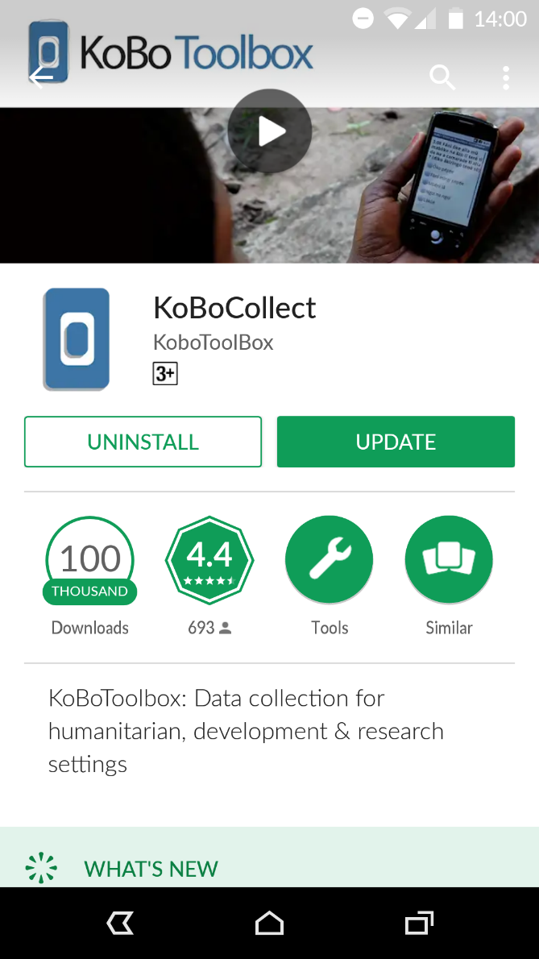
Download Kobo app
Open Google Play Store
Search for the application KoBoCollect
Download and install the application KoBoCollect
Notes:
Just completed data collection for the 13th round.

Slide 7
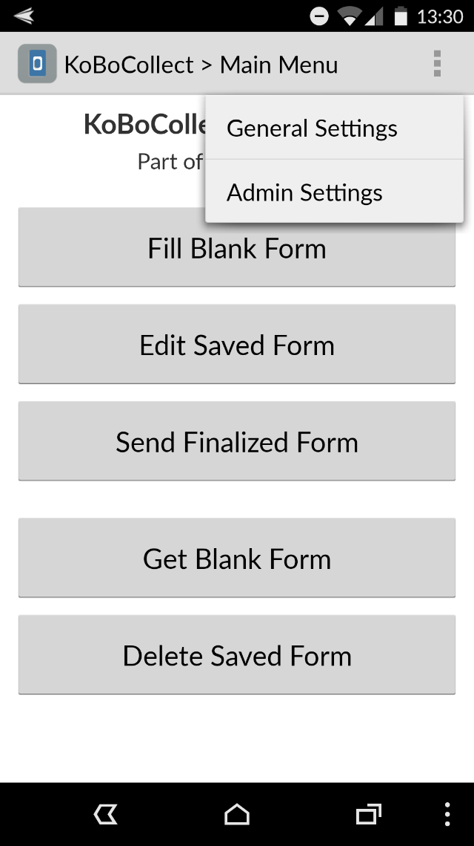
Install the questionnaire (1)
Click on “General Settings” on the upper right corner
Click on “Server” in the small windows that will appear
Notes:
Just completed data collection for the 13th round.

Slide 8
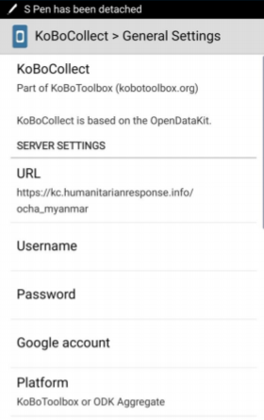
Install the questionnaire (2)
Go to the URL and change it to:XXX
Make sure to avoid spelling mistakes or typos, otherwise it will not work
Notes:
Just completed data collection for the 13th round.

Slide 9
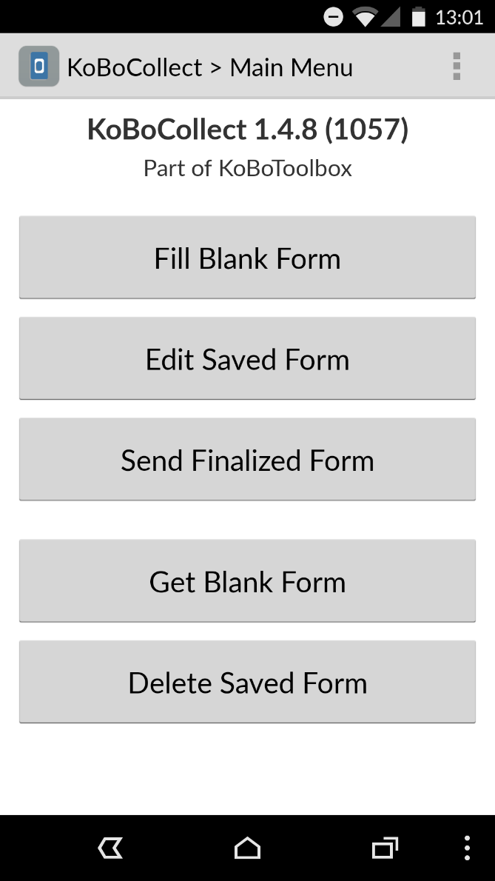
Get a blank form
Press “Get Blank Form” to see which forms are available from the server
Tick (√) check box beside the form you want to select
Press “Get Selected” in the bottom.
Notes:
Just completed data collection for the 13th round.

Slide 10
Filling a form
Press “Fill Blank Form” to enter the data to respective form
Swipe the screen to see the questions
Some of the questions are required. So, you can not continue without entering them.
Notes:
Just completed data collection for the 13th round.

Slide 11
Edit a saved form
“Edit Saved Form” allows you to go back to saved forms (only the non finalized ones) and edit them as necessary.
Choose the form you want to edit and fill the missing information in the form.
Notes:
Just completed data collection for the 13th round.

Slide 12
Send finalized forms
All forms you saved as finalized are stored in the lists.
You can select individual forms to send only select forms or “Toggle all”, to send all forms.
Press “Send Selected” to send the forms
Notes:
Just completed data collection for the 13th round.

Slide 13
3. Download Data

Slide 14
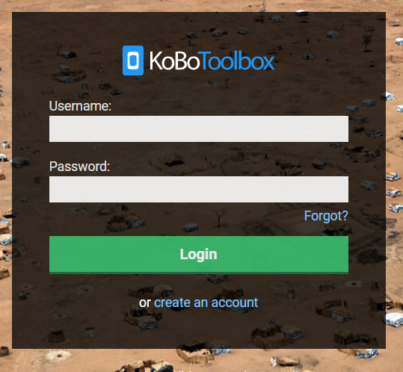
Log in @kobotoolbox.org
WASH Vietnam Kobo account details:
Username: vietnam_wash_assessment
Password: givemekobo
Notes:
Vietnam.WASH.assessment@gmail.com // givemekobo

Slide 15
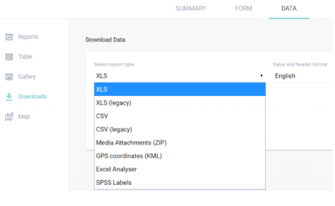
Download data
Simply click “Download data” at the project management form and select format: XLS, CSV, ZIP, KML…
Notes:
Just completed data collection for the 13th round.

Slide 16
4. Questions?

