Slide 1
Enumerator training: Infrastructure Mapping Round 9

Slide 2
Introduction to REACH
REACH Is a joint initiative of two international non-governmental organizations, ACTED and IMPACT Initiatives, and the United Nations Operational Satellite Applications Programme (UNOSAT).
REACH was created in 2010 to provide humanitarian aid actors with information on needs, in emergency, recovery and development contexts.
Since then, REACH has been conducting assessments and research around the world.
REACH has a large number of projects across the Middle East and Africa, with smaller missions in Asia.
REACH was created in response to two critical gaps in the humanitarian system:
1/ Aid actors have limited information at the onset of an emergency
2/ Aid actors have limited knowledge of the communities they support
Notes:
REACH Is a joint initiative of two international non-governmental organizations, ACTED and IMPACT Initiatives, and the United Nations Operational Satellite Applications Programme (UNOSAT).
REACH was created in 2010 to provide humanitarian aid actors with information on needs, in emergency, recovery and development contexts.
Since then, REACH has been conducting assessments and research around the world.
In contexts of conflict and disasters, aid actors face serious challenges in collecting data in a systematic and comprehensive way. As a result, there are often critical gaps in the information required for designing and planning aid. REACH supports aid actors to address these gaps through coordinated assessments and information management.
Emergencies are highly dynamic environments. Aid actors often do not take into account the broader context in which communities reside. Reach promotes the use of socio-economic units as a basis for planning and delive­ring aid. This area-based approach facilitates community engagement and therefore greater accountability.

Slide 3
Introduction to REACH Bangladesh
In Bangladesh, REACH has been deployed by the Global WASH Cluster (GWC), hosted by UNICEF, to conduct camp infrastructure mapping.
REACH has been working in the camps in Cox’s Bazar district (Ukhia, soon to expand to Teknaf), to map infrastructure in the camps.
Camp infrastructure mapping
Objective: create infrastructure maps of all sites with newly arrived refugees from Myanmar.
Fieldwork: mapping all the points in the camps/sites using mobile data collection.

Slide 4
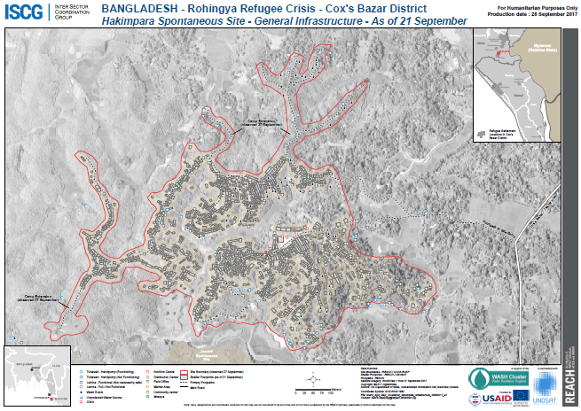
Introduction to REACH Bangladesh

Slide 5
Using ODK Collect

Slide 6
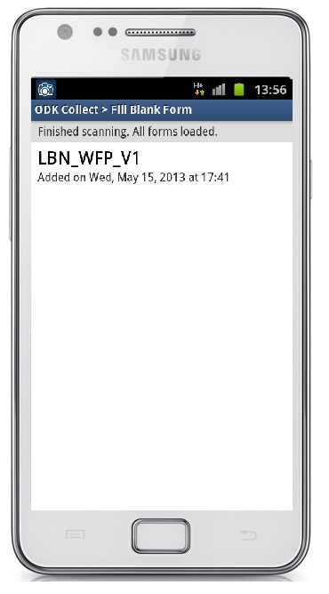
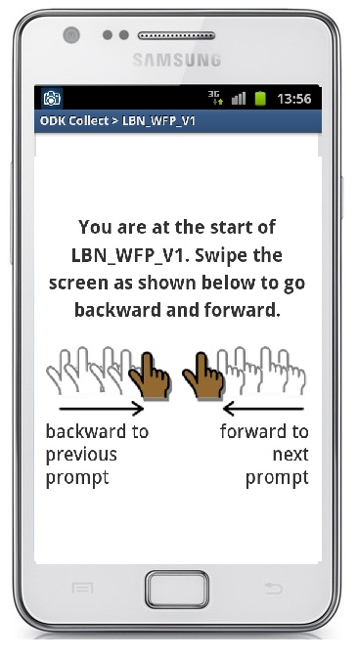
Starting a new household assessment
1 – After you click “Fill Blank Form”, select the correct form.
2 - Swipe right to left to move forward in the assessment form

Slide 7
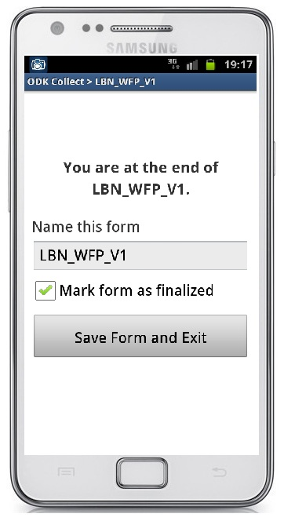
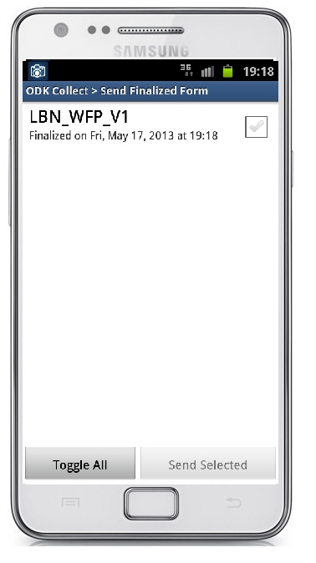
Saving a completed household assessment
1- At the end of the form, Click on ‘Save Form and Exit’ YOU MUST DO THIS
To make sure it’s right:
2- On the main screen click
‘Send Finalised Form’
3-Check your form has been saved (verify the form has been “finalized”)

Slide 8
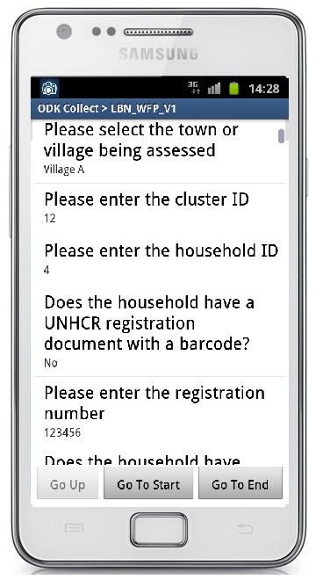
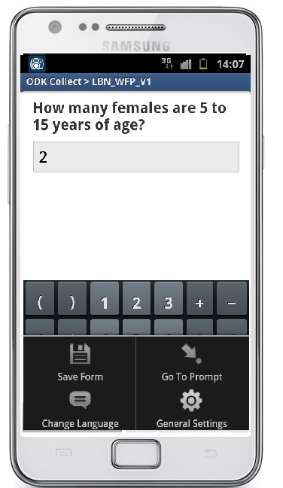
Editing an ongoing assessment
In the event that wrong information is entered, you will need edit the response. If the question is 1 or 2 behind swipe backwards, if the question is further back use the following:
1 - Click on settings
2 – Select
‘go to prompt’
3 – Select the question you wish to edit

Slide 9
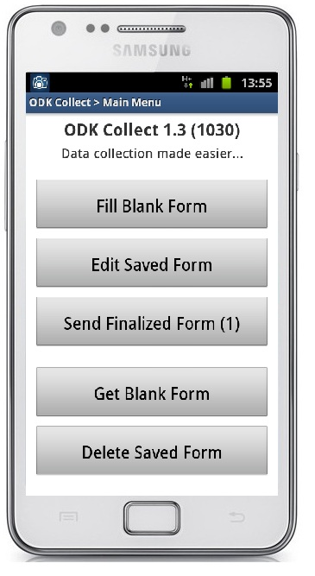
Editing a previously completed household assessment
In the event that 1) the ODK application crashes or 2) you need to change an answer previously recorded you will need to use the ‘edit saved form’ function.
1 - Click on ‘Edit Saved Form’
2 – Scroll down (swipe from bottom to top) and select the question you want to start at / edit

Slide 10
Frequently Asked Questions
Frequently asked questions
Q: What if I accidently move away from the Kobo application or form?
A: Go back to the application/form, the application will automatically start from where you left off.
Q: What if the application crashes?
A: Turn the mobile off then back on again. Verify that all responses have been saved. Return to where you left off.
Q: The GPS point isn’t loading?
A: Be patient. Wait, and if it still doesn’t load, exit the application and start again. If you think the phone is broken, call someone in the field.
Q: What if the screen goes black?
A: The device has gone to sleep. Press the button once to wake the device up.

Slide 11
Data collection in the field

Slide 12
Basic Task Outline: Data collection by enumerators
Enumerators: 5 key tasks
Look for infrastructure in the camp – focusing on finding all latrines, wash rooms, and water sources; but also other things like markets, NGO clinics, mosques etc
Fill in an ODK form for each piece of infrastructure
Take a GPS point for each piece of infrastructure
Take a photo of each piece of infrastructure
Make sure all infrastructure in your area is mapped

Slide 13
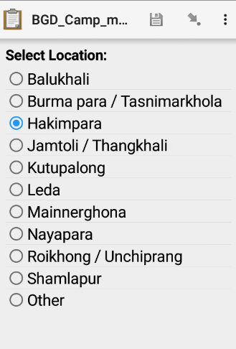
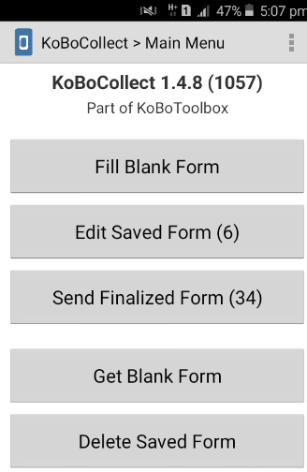
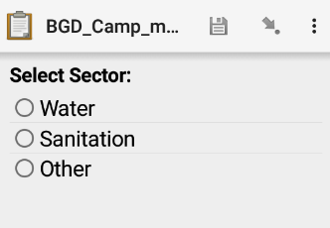
Definitions and filling in the form
Select location: make sure you know the name of the site you are going to
Select sector:
Water – water sources – in the camp, this is mostly tubewells, but can also be rivers, water tanks etc.
Sanitation – facilities – latrines, washrooms, open defecation points.
Other – anything else in this list should be collected, as well as other things of interest in the camp that are not in the list.

Slide 14
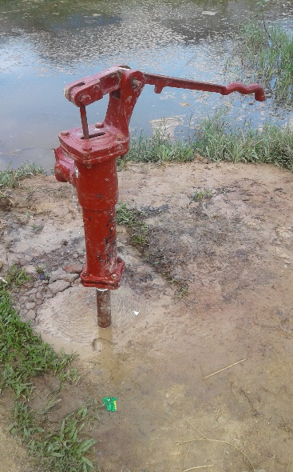
Definitions and filling in the form
Water
Structure
→Hand Pump-Tubewells are the most common sources
→Sometimes, people also get water from rivers
(unimproved water sources), taps or water tanks.
→Implementing partner: sometimes, the tubewell has a label with the name of an organization, e.g. ‘Brac’, or the name of a private donor. This should be entered here.
→Functioning vs. not functioning: check to see if water can come out of the tubewell

Slide 15
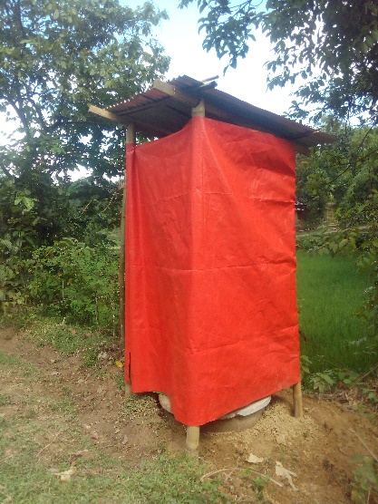
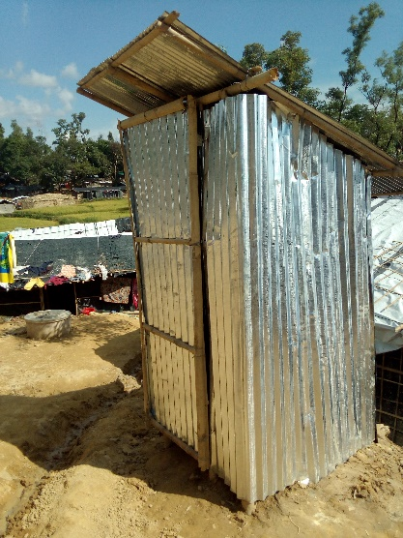
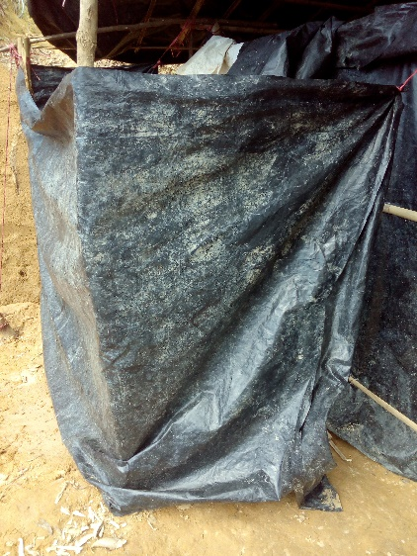
Definitions and filling in the form
Sanitation
Latrines
→Implementing partner
→Number of latrines
→Full latrines:
→Safe latrines:
→Latrine lights:
Washrooms
→What is the difference between latrines and washrooms?
Latrines have holes or pits – you should always check this. Even if people use a space for urinating or say a structure is a latrine, if there is no hole or pit, it is still counted as a washroom.
→If there is a group of washrooms near to each other, if they are within 5m distance and you can capture them all in one picture, you can fill in one form for these.
Open defecation
→This should be a designated point which people commonly use for going to the bathroom

Slide 16
Definitions and filling in the form
Other
→Implementing partner: sometimes, the building has a label with the name of an organization, e.g. ‘Brac’, or the name of a private donor. This should be entered here and is particularly important for the ‘other’ options.
Usually, all structures except for shops have an implementing partner.

Slide 17
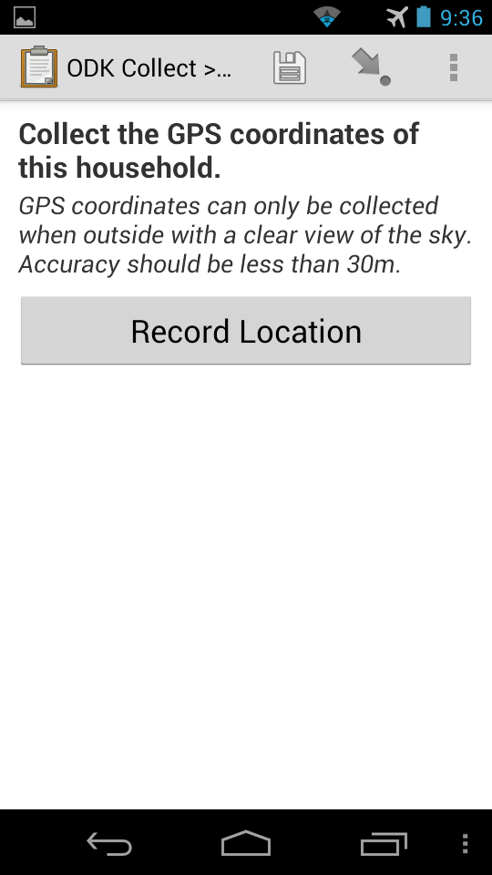
Definitions and filling in the form
Taking geopoints
→This is the most important part of the form – without a
geopoint, the data collected is useless.
Taking photos
→Avoid photos with people’s faces if possible.
→If you feel it is necessary, ask before taking a photo
of a structure such as a clinic or mosque.

Slide 18
Interactions with people in the field
Authorities
If approached by authorities:
Explain that we are conducting mapping on humanitarian needs for an international NGO
Explain approvals: REACH is operating under the Global WASH Cluster, hosted by UNICEF
There is an approvals letter in every car, which you can collect and show to them
Direct to Chloe, Francesco or Tom if they have any further questions
Residents
Politely introduce yourself to people in the camp
If someone asks what you are doing, explain that
Notes:
[EDIT]

Slide 19
Daily Work

Slide 20
Daily Schedule
9am
Office and sign-in
9.15am
Travel to camp
4pm
Finish work, meet where dropped off (usually along the road or at the camp entrance)
10.45am
Deploy for field
6pm
Arrive at office, collect payment

Slide 21
In the field - guidelines
Visibility: always make sure you have your ID on you, and wear REACH t-shirt if you have one.
Water: you will be given a bottle of water, make sure to drink throughout the day as it is very hot and the work is very active.
Food: you will not be provided food, make sure you eat breakfast before and if you need snacks in the field, bring them with you.
Clothing: it is often very muddy in the camps. Make sure you wear appropriate shoes and clothing which you do not mind getting dirty. It is also very hot, so you may want to bring a hat and make sure your clothing is comfortable.
Notes:
-do we want visibility?

Slide 22
Thank you!
Any questions?

