Slide 1
Yemen WASH Cluster Humanitarian Needs Overview 2018
19 June 2018

Slide 2
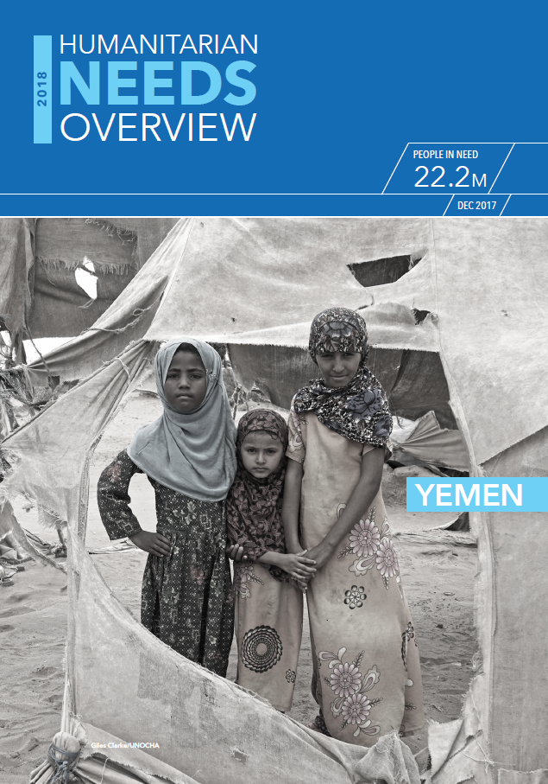
Outline
HNO process and WASH Cluster consultations
HNO indicators and data sources for HNO
Severity scale calculation (moderate and severe)
People in Need calculation (moderate and severe)
Narrative
Intersectoral analysis of need:
IDPs/returnees/host community
Famine prevention
Cholera

Slide 3
HNO process and WASH cluster consultations
Launch HNO process: ICCM agrees on methodology and joint assessments
WASH cluster team drafts indicators (based on data sources and core indicators)
Discussion and agreement in SAG – WASH cluster updated in monthly meeting
OCHA / ICCM conducts assessment mapping / survey of surveys
Include WASH indicators in MCLA – TFPM conducts MCLA
All data is collected – REACH updates SDR and fills HNO data matrix at district level
WASH cluster team develops weighting and draft calculation of severity scores and PIN
Discussion and agreement in SAG on weighting, severity scores and PIN
WASH cluster team finalizes narrative and infographs
WASH cluster partners receive HNO matrix to inform response planning
Delphi workshops at hub level (WASH SNC & partners participate)
Dedicated workshop for partners on HPC, using HNO for planning and YWC strategies

Slide 4
WASH Severity Dimension
Water
Sanitation
Hygiene
Exacerbating Factors
Cholera
Acute Malnutrition
Dengue/ Malaria
Flooding
What we want to know:
Number of people in need of WASH emergency support
Severity of needs (where / who? / what?)
Analysis at district level (333)
Severity Amplifiers
IDP
Returnees
Host communities

Slide 5
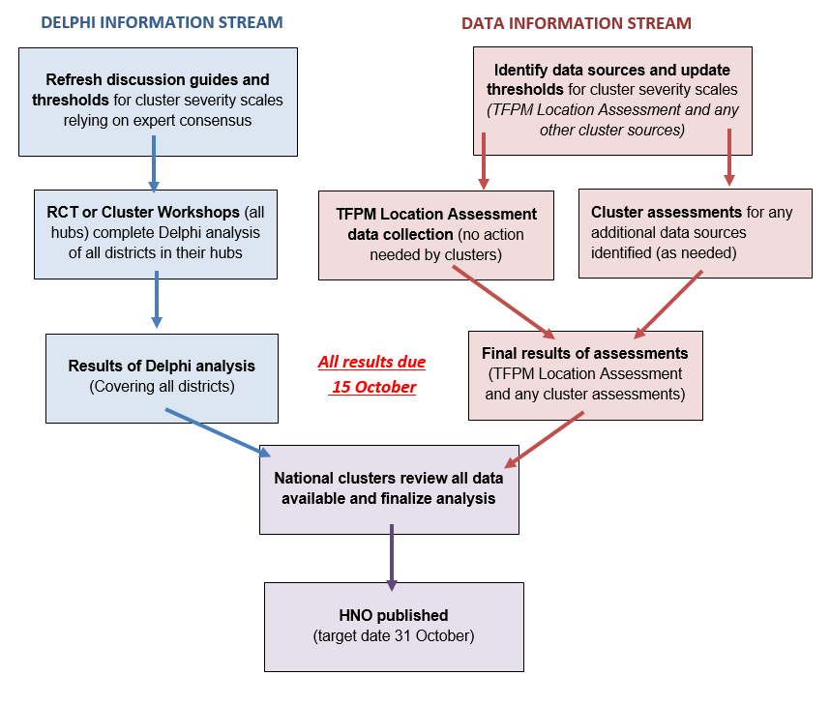
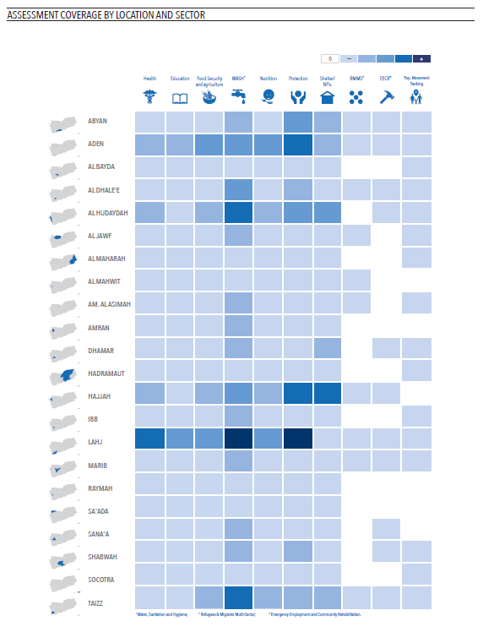
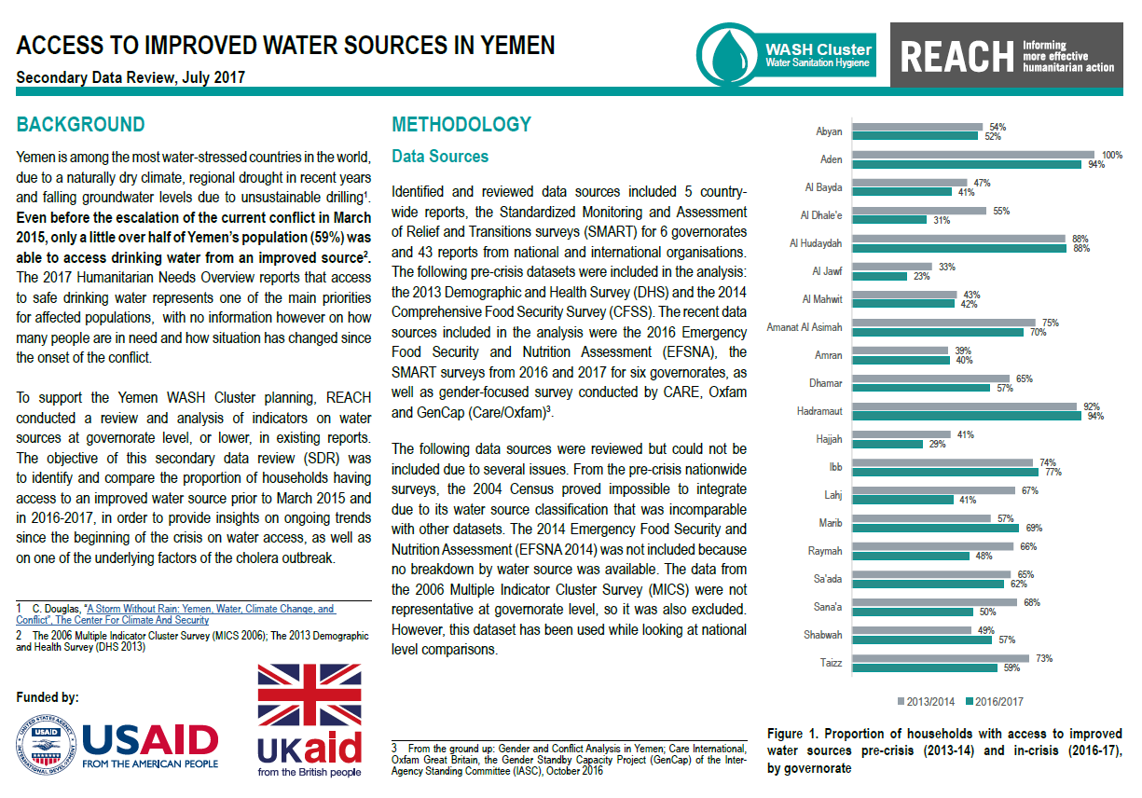
Data sources
Population data (adjusted)
Task Force Population Movement:
Area assessment
Multi Cluster Location Assessment
IDP hosting site Baseline 2017
eDews / cholera line lists
Standardized Monitoring and Assessment of Relief and Transition (SMART) surveys
Emergency Food Security and Nutrition Assessment (EFSNA)
Comprehensive Food Security Survey (CFFS)
Secondary Data Review (SDR) by REACH, GWC and YWC (OCHA SoS)
Sitreps related to flooding
Delphi workshops

Slide 6
Adjustments to SAG approved HNO indicators
Many data gaps due to delayed / cancelled surveys, including TFPM MCLA and SMART
Indicator related to handwashing at critical times with water and soap (no data available – dependent on SMART data) was removed
Indicator related to flooding – only Delphi data was used

Slide 7
2018 HNO WASH Indicators
WASH HNO Indicator | Weight
INDICATOR 1: WASH needs among IDPs and returnees | 20.0%
INDICATOR 2: Attack rate of cholera/acute watery diarrhea (AWD), Malaria and Dengue | 20.0%
INDICATOR 3: Rate of Global Acute Malnutrition (wasting in children) | 10.0%
INDICATOR 4: Proportion of communities accessing an improved water source | 10.5%
INDICATOR 5: Proportion of communities accessing an improved latrine | 5.0%
INDICATOR 6: Proportion of people in district accessing an adequate/sufficient quantity of water | 19.5%
INDICATOR 7: Proportion of communities facing severe environmental hygiene problems (solid waste and waste water) | 10.0%
INDICATOR 8: Occurrence of flooding in the district | 5.0%

Slide 8
Indicator 1: WASH needs among IDPs and returnees Calculation
INDICATOR 1a: IDPs and returnees as percentage of host community CURRENT population
INDICATOR 1f: Proportion of IDPs living in CC/SS out of the total IDP population (HH)
INDICATOR 1b: Proportion of IDP and returnee communities in district accessing an improved water source
Average
Average
INDICATOR 1g: Population of IDPs in CC/SS in need of support to access water
INDICATOR 1c: Proportion of IDP and returnee communities in district accessing a functioning latrine
Max
Max
INDICATOR 1h: Population of IDPs in CC/SS in need of support to sanitation & waste removal services
Max
INDICATOR 1d: Proportion of IDP and returnee communities in district having and using soap
IDPS / returnees in host communities (including CC / SS)
INDICATOR 1e: Proportion of IDP and returnee communities facing severe environmental hygiene problems (solid waste & waste water)
IDPS / returnees in CC / SS only

Slide 9
Indicator 2: Attack rate of cholera/acute watery diarrhea (AWD), Malaria and Dengue Calculation
Indicator 2 | Weight | Weight in the Final Severity Score
INDICATOR 2a:Attack rate of suspected Cholera/acute watery diarrhea (AWD) (/10,000 population) | 60% | 12.0%
INDICATOR 2b: Attack rate of Dengue (/10,000 population) | 20% | 4.0%
INDICATOR 2c: Attack rate of Malaria (/1,000 population) | 20% | 4.0%
Total | 100% | 20%

Slide 10
Severity scale logic
Verbal qualifiers
All
Nearly all
A lot
The majority
Some
Few
Very few
None
% of
people
100%
<90%
<75%
<60%
<45%
<30%
<15%
0%
Impact = Size*
Intensity
Size=Magnitude (number of people affected) or Depth (e.g. % of people affected)
Intensity=Degree of something harmful, harsh, stern, irreversible or not desirable
7. Catastrophic problem
6. Critical problem
5. Severe
problem
4. Major
problem
3. Serious
problem
2. Moderate
problem
1. Minor
problem
Life threatening
Access or availability
Losses and damages
Coping mechanisms
Human access
Normal/near normal
90-100%
Normal/near normal
Normal/near normal
Normal/near normal
Discomfort
75-90%
Light/minor
Sustainable strategies
Light/minor constrains
Low suffering
60-75%
Moderate
Insurance strategies
Moderate constrains
High suffering
45-60%
Serious
Stressed
Serious constrains
Irreversible damages to health
30-45%
Major
Crisis
Major
constrains
Life threatening
15-30%
Severe
Irreversible
Severe
constrains
Death
5-15%
Critical
Critical
Critical
constrains

Slide 11
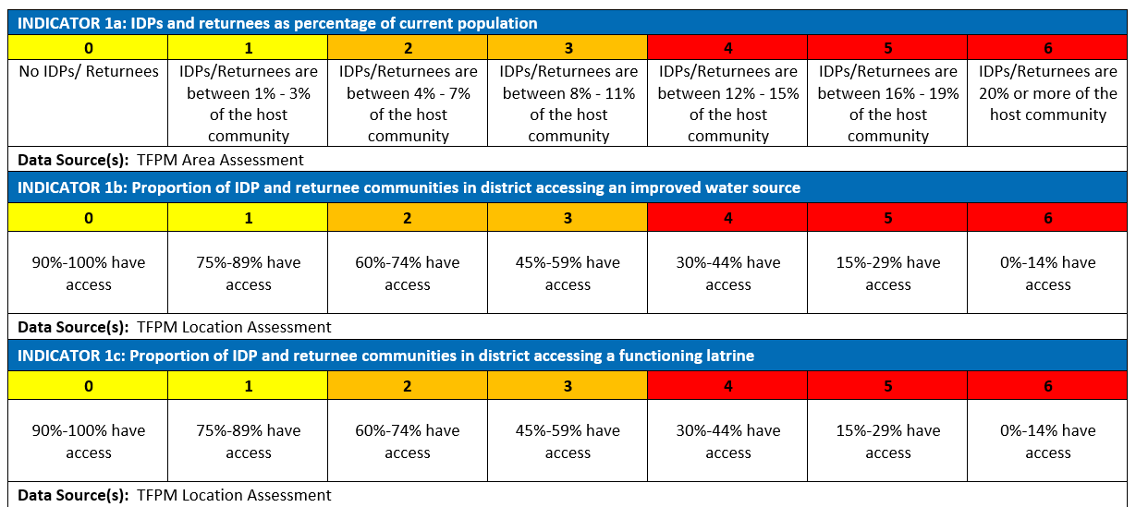
Severity scales WASH – per indicator (with data source)

Slide 12
Severity scales WASH – per indicator (with data source)

Slide 13
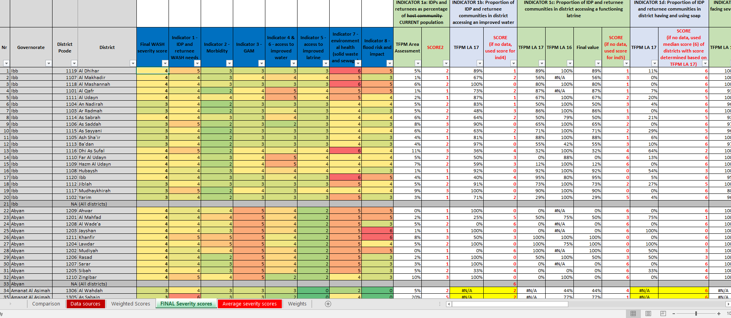
Severity scales WASH – per indicator (with data source)

Slide 14
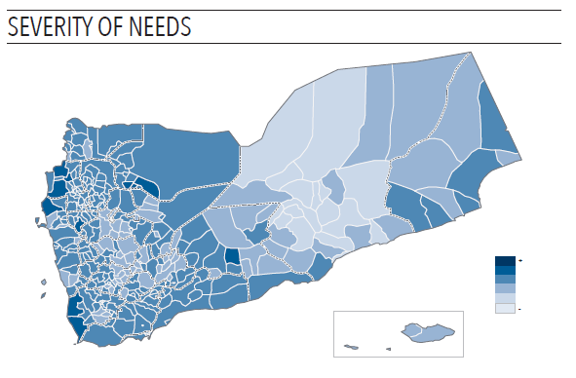
District severity scores – trend since 2017
 | 2017 | 2018
Number of Districts that score 1 | 0 | 1
Number of Districts that score 2 | 19 | 18
Number of Districts that score 3 | 154 | 89
Number of Districts that score 4 | 144 | 209
Number of Districts that score 5 | 16 | 13
Number of Districts that score 6 | 0 | 0
Changes in severity score since last year | # of districts
Districts that reduced 2 grades in severity score | 12
Districts that reduced 1 grade in severity score | 105
Districts with the same severity score | 156
Districts that increased 1 grade in severity score | 55
Districts that increased 2 grades in severity score | 5

Slide 15
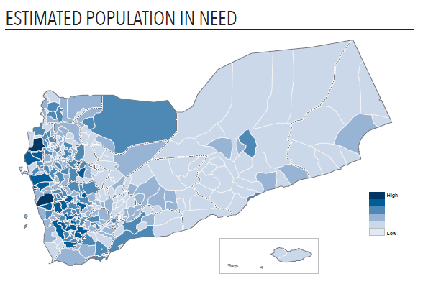
People in Need
 | Total pop | Total PIN | % of pop in need | Moderate PIN | Acute PIN
2017 | 27.7 million | 14.4 million | 52% | 6.3 million | 8.1 million
2017 (mid year review) | 28.5 million | 15.7 million | 55% | 8.4 million | 7.3 million
2018 | 29.3 million | 16 million | 55 % | 4.4 million | 11.6 million
Moderate PIN = severity scores 2 – 3
Acute PIN = severity scores 4 – 5 – 6
Severity score 0 = 0% of district population in need
Severity score 1 = 15% of district population in need
Severity score 2 = 30% of district population in need
Severity score 3 = 45% of district population in need
Severity score 4 = 60% of district population in need
Severity score 5 = 75% of district population in need
Severity score 6 = 90% of district population in need

Slide 16
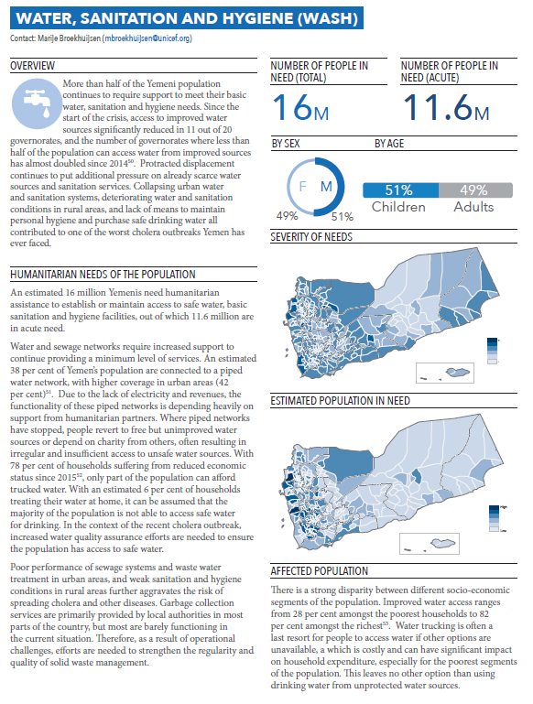
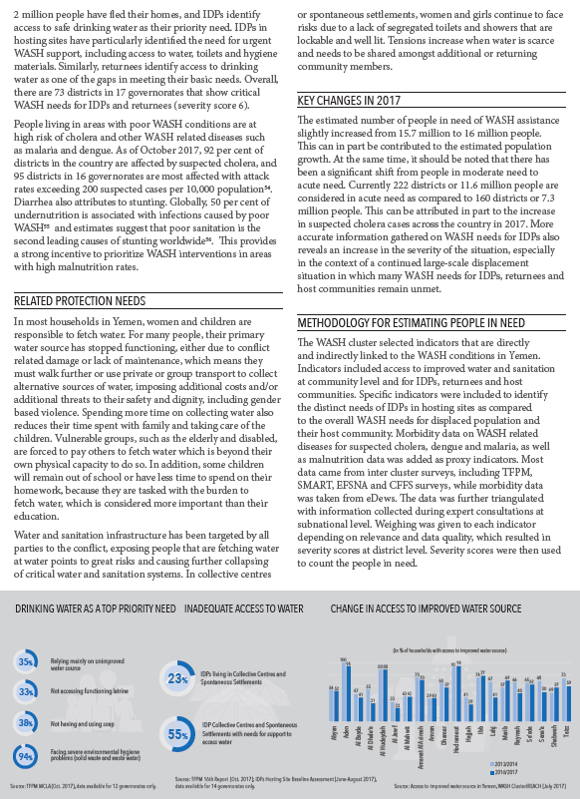
Narrative – Justification
Increase in number of people in need:
Increase in population
Shift from moderate to acute
Shift from moderate to acute:
IDP / returnee WASH needs that remain unaddressed – better data available for hosting sites
Spike in cholera cases since April
Limited resources to fix already poor WASH infrastructure in the country, more systems continue to collapse
Tips:
Use infographs to tell a story
WASH cluster response strategy and plan should be linked to needs

Slide 17
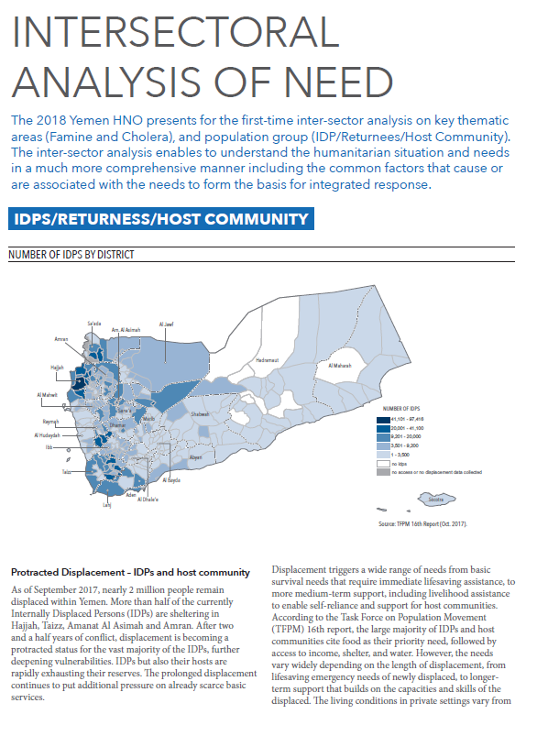
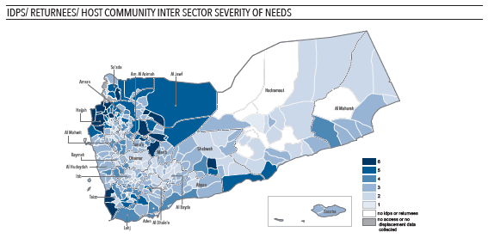
Intersectoral analysis of needs – IDPs / Returnees / Host communities
OCHA & Shelter / NFI / CCCM clusters lead
Protection, WASH, Education, Health, FSAC clusters participate
Only severity, not PIN
Understand different needs & priorities of IDPs / returnees / host communities
Prioritize districts where needs across sectors are high for HRP planning and integrated IDP / returnee / host response
Used by clusters, partners, donors
indicator_code | Indicators | Sector/ cross-sector
ind_1 | IDPs and returnees as percentage of current community population | Cross-sector
ind_2 | % of IDPs in Hosting Sites / total IDPs population | Shelter, NFIs and CCCM
ind_3 | Ratio of persons with vulnerabilities/specific needs to host population | Shelter, NFIs and CCCM
ind_4 | % of IDPs hosting sites under threats of eviction | Protection
ind_5 | Proportion of IDP and returnee communities in the district accessing an improved water source; and Proportion of IDP and returnee communities in district accessing a functioning latrine | WASH
ind_6 | School aged IDPs/returnees as percentage of same age group in the resident community | Education
ind_7 | Proportion of IDPs and returnee communities in the district accessing health services | Health
ind_8 | intensity of conflict in the same governorate | Cross-sector
ind_9 | food security score | FSAC

Slide 18
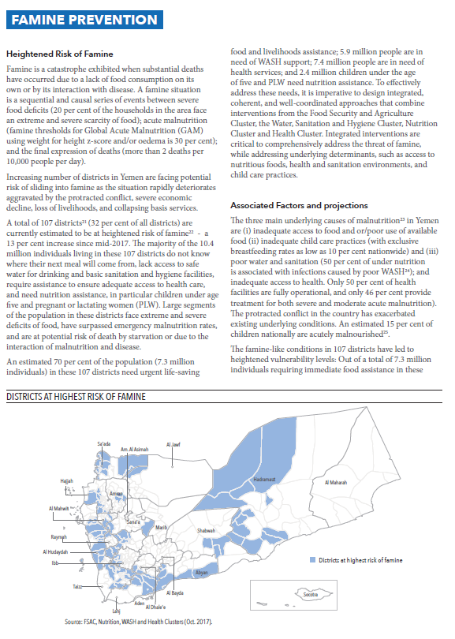
Intersectoral analysis of needs – Famine prevention
Nutrition and FSAC clusters lead
WASH and Health clusters participate
Due to different nature of IPC scaling, severity score and PIN not applicable). Only used to prioritize districts at risk of famine.
4 clusters developed integrated response package – piloting in high priority districts
Used by clusters, partners, donors
District prioritization criteria (following IPC global guidance):
GAM above 15% (emergency threshold)
% of SFI above 20% (emergency threshold)
No mortality data available at district level > not used

Slide 19
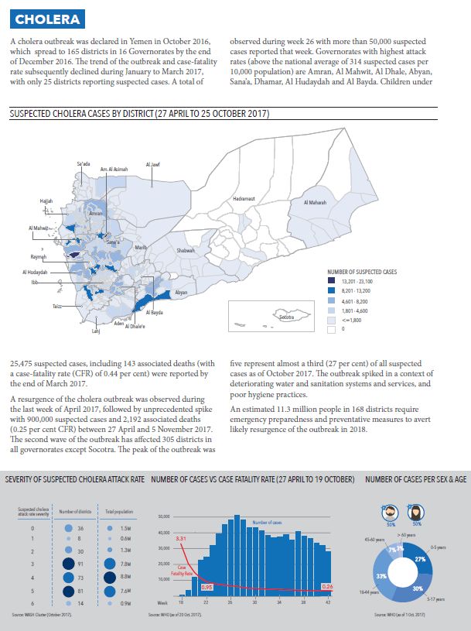
Intersectoral analysis of needs – Cholera
Health and WASH clusters
Prioritize districts with high cholera attack rates (27 Apr to 25 Oct) for cholera prevention (longer term)
Mainly useful for WASH cluster
Other district priority lists continued:
Response: last 3 weeks highest AR, confirmed cases
Prevention through OCV and basic WASH (separate risk assessment done by WHO / epicenter)
District prioritization criteria:
Cholera attack rate

Slide 20
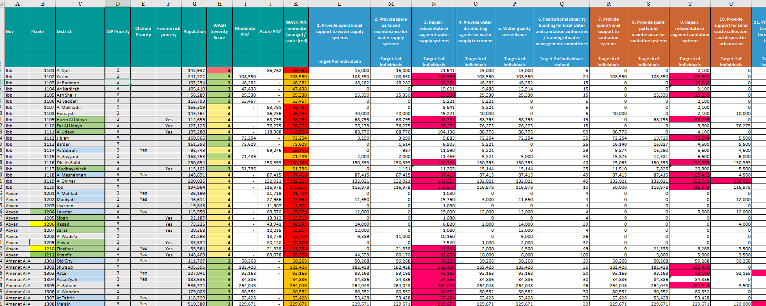
Linking HNO to HRP

Slide 21
Linking HNO to HRP
Challenges:
District can only have moderate OR acute PIN - there is no district with both acute and moderate PIN
Should partners target moderate severity needs districts / moderate PIN districts?
What if IDP / Famine / Cholera priority district is considered moderate severity need for overall WASH scoring?
What if partners targets are higher than PIN?

Slide 22
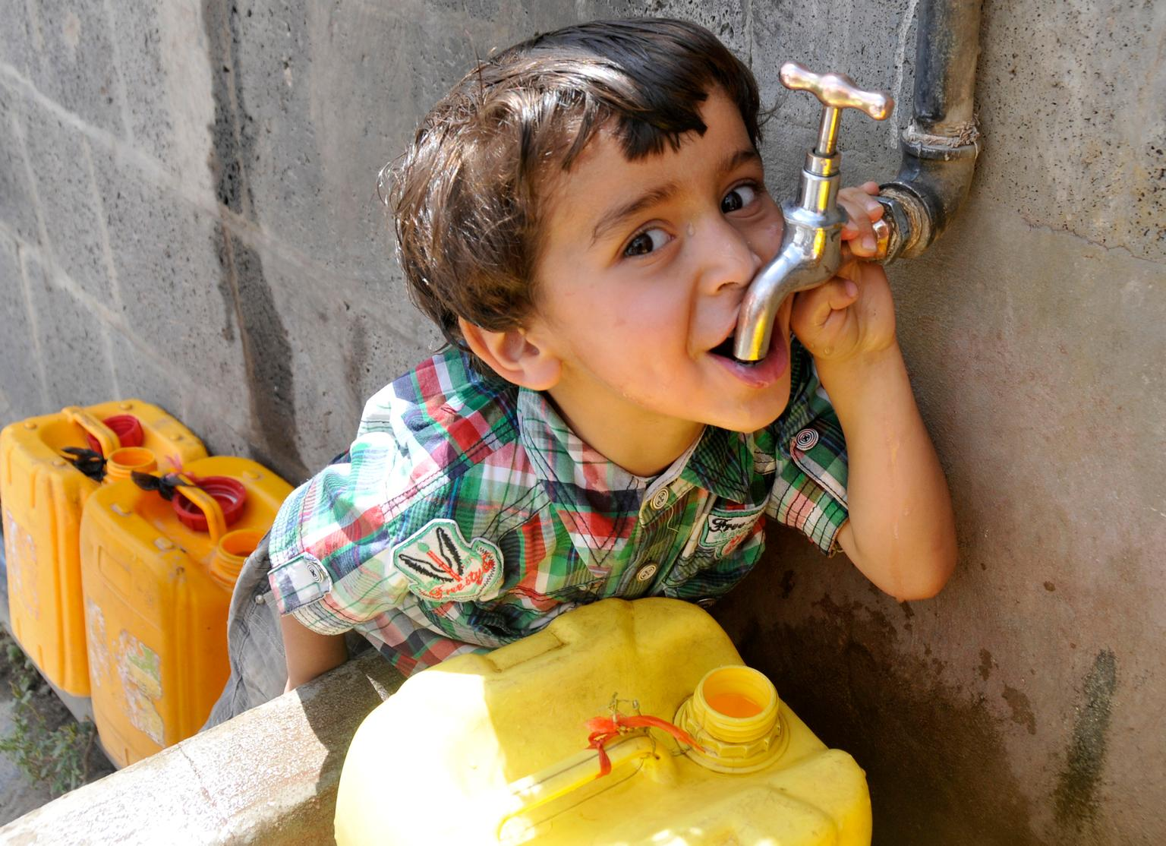
Lessons from YWC 2018 HNO
Start early (maybe even before OCHA!)
Link HNO to SoS, SDR, WASH cluster core indicators, coordinated assessments etc.
Mobilize partners to do assessments that can inform HNO
Use data from other clusters / surveys whenever possible
Make the HNO a useful process / document for partners and donors – it should inform strategic prioritization
Spend time orienting partners on how to use HNO data for planning
There are many different HNO methodologies – choose the one that fits your context most (depending on data availability, type of emergency, caseloads etc)

Slide 23
Shukran!

