Slide 1
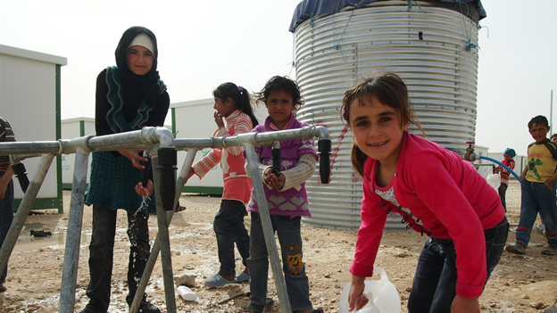
WASH Sector HNOs (2015-2019)

Slide 2
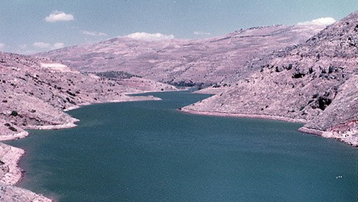
Some Facts about Pre-Crisis Syria
Syria was a middle-income county with a GDP per capita of USD 4,685 in 2012.
There was an excellent education system, health system, and complex large-scale water distribution system for domestic use. Access to improved water source was 87%, with 80% of dwellings having inside tap of water, and use of improved sanitation facilities was 97% (MICS 2006)

Slide 3
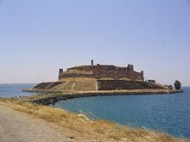
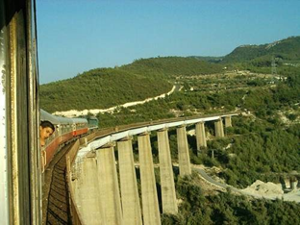
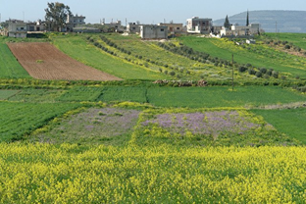
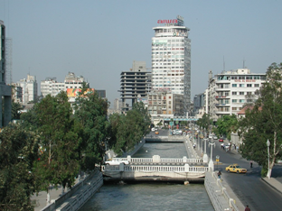
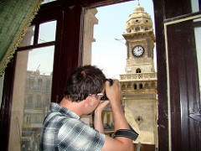
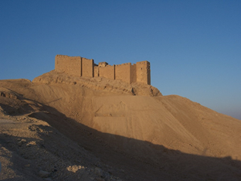
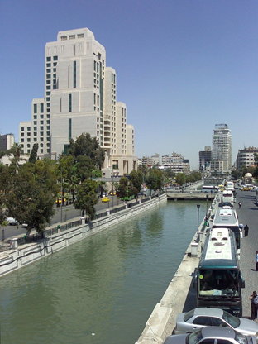
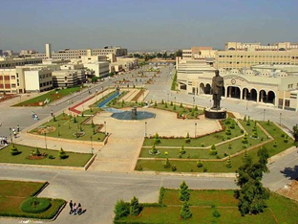
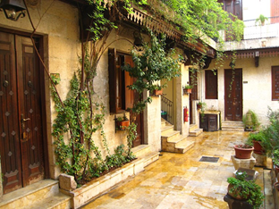
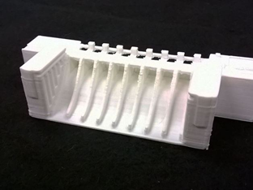
Some glimpses from the past!

Slide 4
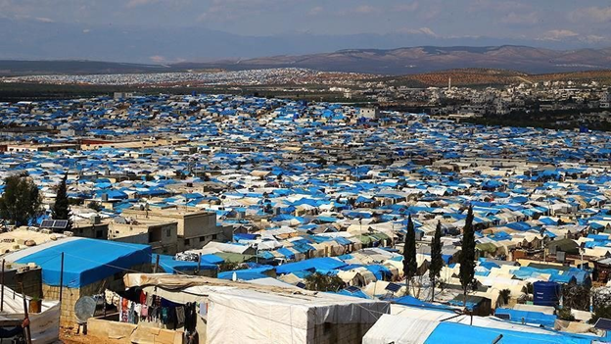
Facing the reality!
Syria is a complex emergency by definition. However, it's really complex due to the fact that not only regional powers are involved, but also the global powers are on the ground.
A series of airstrikes, besiegement and ground battles in the country not only resulted in internal displacement, but also created waves of refugees.

Slide 5
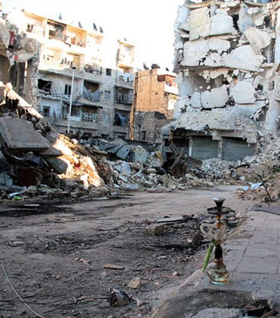
WASH Sector in early 2014
Back in 2014, the WASH Sector did not have any strategy, tools or means for assessing the WASH situation in Syria, in a comprehensive manner, to highlight the priorities and focus areas for intervention.
The available information was based on partners' assessments, in context of ongoing conflicts resulting in displacements or baseline surveys for specific programs, in limited geographical areas.
The government data was also limited in scope.

Slide 6
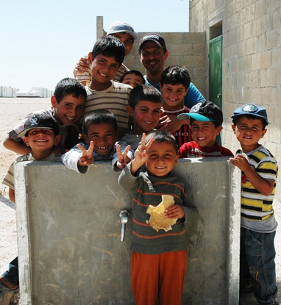
...and then moving forward!
By the end of 2014, the Whole-of-Syria (WoS) WASH Sector coordination team (including 3 hubs: Amman, Damascus, Gaziantep) realized that they had to conduct needs assessments in a coordinated manner. They agreed on the following key steps:
Harmonized WASH Assessment tool that can be adopted for various methodologies and situations.
Partners assessment would incorporate the core harmonized WASH Assessment questions.
Engagement with assessment specialist agencies i.e. REACH, IOM-DTM, WASH Sector Partners
Collating information from all these sources to figure out situation inside Syria.

Slide 7
But the million-dollar question "What do we need to know?"
The secondary data reviews on available data sets shows that there is an overall decay in social-service-infrastructures, including WASH infrastructure.
This set a course of discussion for "what we need to know" and "what we already know."

Slide 8
Developing Indicators
The indicators were divided in two broad groups by source:
1. Primary Data: The WASH Sector assessments
2. Secondary Data: The WASH Sector related data
The WASH Sector agreed on the following core indicators:
% of households accessing a low risk main water source
% of households accessing an adequate/sufficient quantity of water
% of households engaging in negative coping strategies to compensate for water insufficiency
% of households facing difficulty accessing or affording one/multiple hygiene items
% of households facing severe environmental hygiene problems (solid waste and wastewater)
% of households not accessing hygienic/functioning latrine/bathing facility

Slide 9
What if HH level assessment is not possible?
Plan B: We proposed community level proxy indicators and observation at community level
i.e. Proxy indicators at community level: % of communities accessing low risk main water source.
Plan C: Proxy observation at community level: source of water available for community (and if possible, identify main water source)

Slide 10
Secondary Sources
The multi-sectoral (or non-WASH specific) assessments provided these indicators:
• Newly displaced people and/or returns (< 3 months and incl. IDPs in sites)
• % of IDPs and returnees versus host population
• Intensity of conflict
• WASH-related morbidity data (EWARN)

Slide 11
Secondary Data Review:
Besides the second group of data, the WASH Sector had an extensive Secondary Data Review (SDR)
Criteria was developed for secondary data, so that it can be used with some sort of certainty to inform all the above indicators at sub-district level.
The report/information deemed more reliable if: it had clearly defined methodology; the assessment tool are available, and the dataset is accessible to some extent/or verifiable at minimum. A reliability scale was developed for that.
However, most of the data was coming from RNAs or thematic assessment (EMMA etc).

Slide 12
Assessment Tools
Keeping in mind the constraints of access, security, and capacity, various assessment tools were developed to collect the core indicators:
1. Household-level Questionnaire
2. Community level Questionnaire
3. Community level Observation Guidelines

Slide 13
Severity Scale
The truth is that the severity scale evolved over the past years. The most recent changes happened in May 2018.

Slide 14
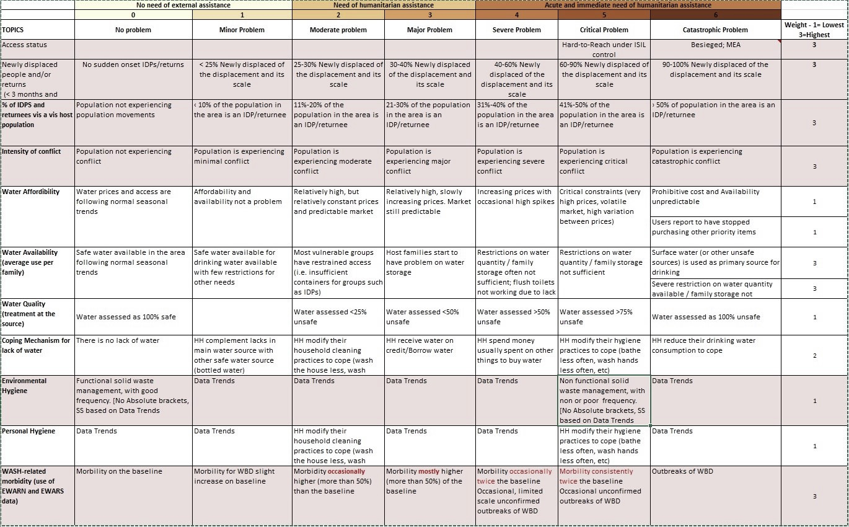

Slide 15
Translating assessment results into PIN and final severity score!
PiN Calculation (at sub district level):
% of host population using high risk water + Most Vulnerable Population Group (IDPs, People in besieged areas, Returnee)
** tip: to avoid double counting**
Final figures are cross validated and adjusted by expert opinion from field.

Slide 16
The Database!

Slide 17
The Indicators

Slide 18
SS PiN Calculation

Slide 19
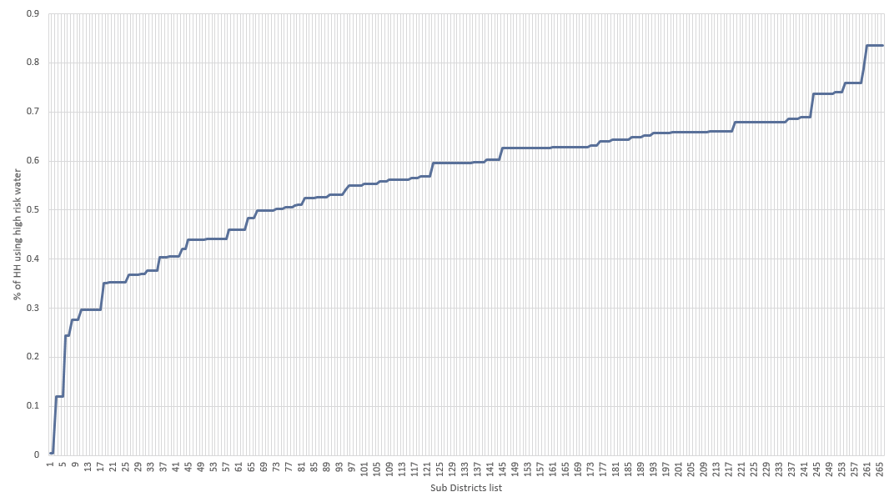
Severity Scores

Slide 20
Assessment Ranking

Slide 21
Where are we standing!
WASH Sector is equipped with standard indicators
Improved primary data set, over years (Size / Quality)
Improved secondary data (NPM/Urban Profiling/EWARN/Improved SDR)
Built more partnerships with technical organization (REACH/IMMAP/IOM/WASH Partners)
Some in depth analysis was done for sector, the products are available at this link

Slide 22
Ok! What about HNO 2019 and beyond?
The Syrian conflict will decide the course
The opportunities for information gathering will remain challenging.
The secondary data i.e EWARN, will improve overtime
The exit strategy - involvement of the government

Slide 23
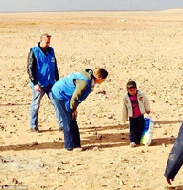
At last!
Marwan!
Click on the dots to read the heartbreaking story of one little boy in a very vast desert ...

