Slide 1
Overview: Humanitarian context and Coordination Structure in Somalia
Chronic Emergency
Conflict
Disease outbreak
Floods (seasonal)
Drought (seasonal)
Very Strong Non-state actor
Limited Govt. Influence outside capital
Restricted Humanitarian Access
Clan Dynamics
Weak Capacity of WASH cluster partners
Country: Somalia, Presenter: P. Laurent

Slide 2
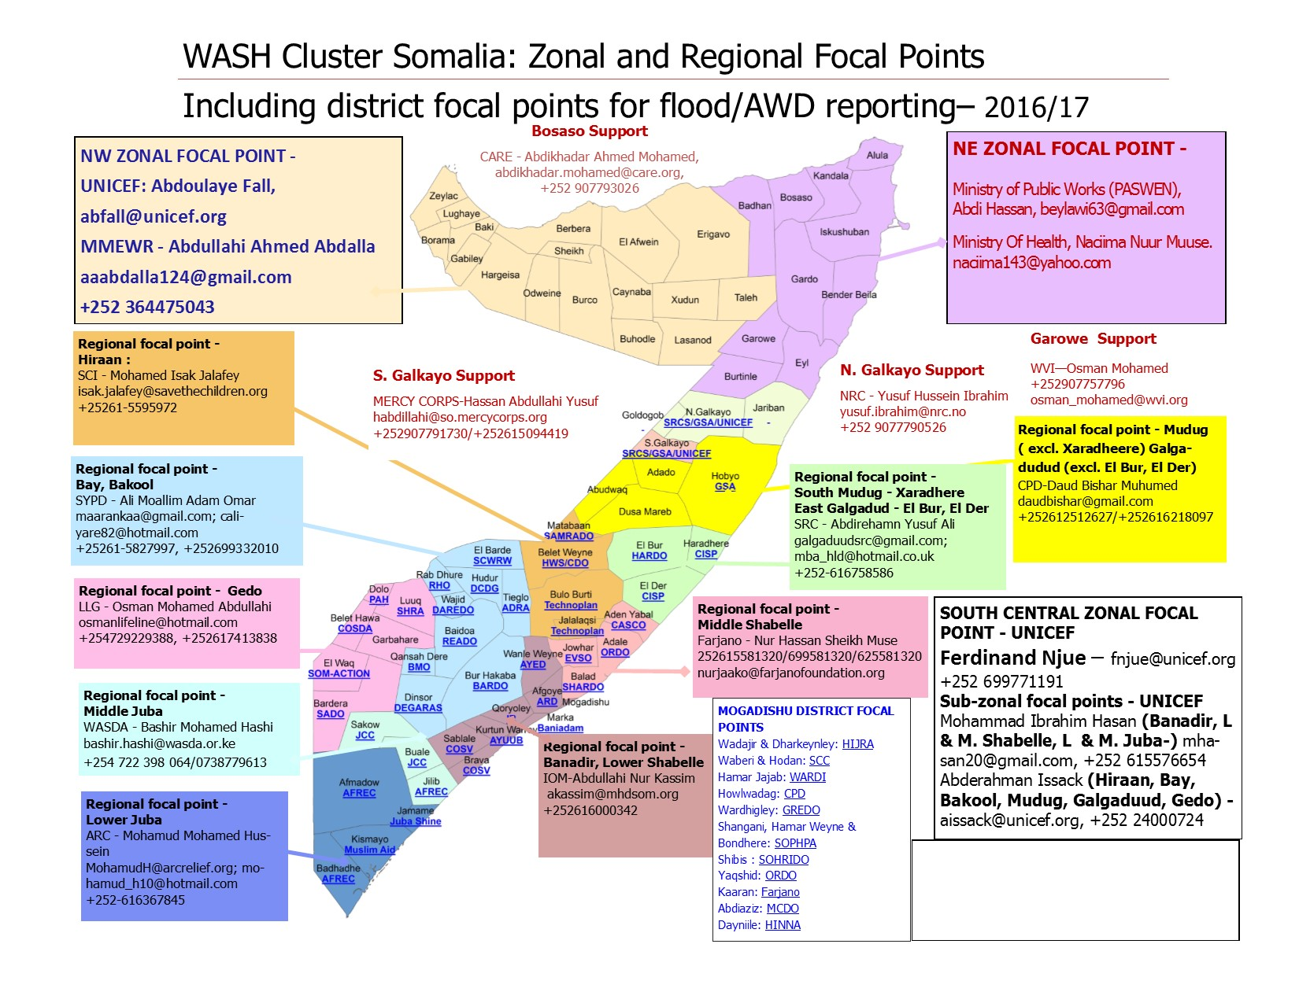

Slide 3
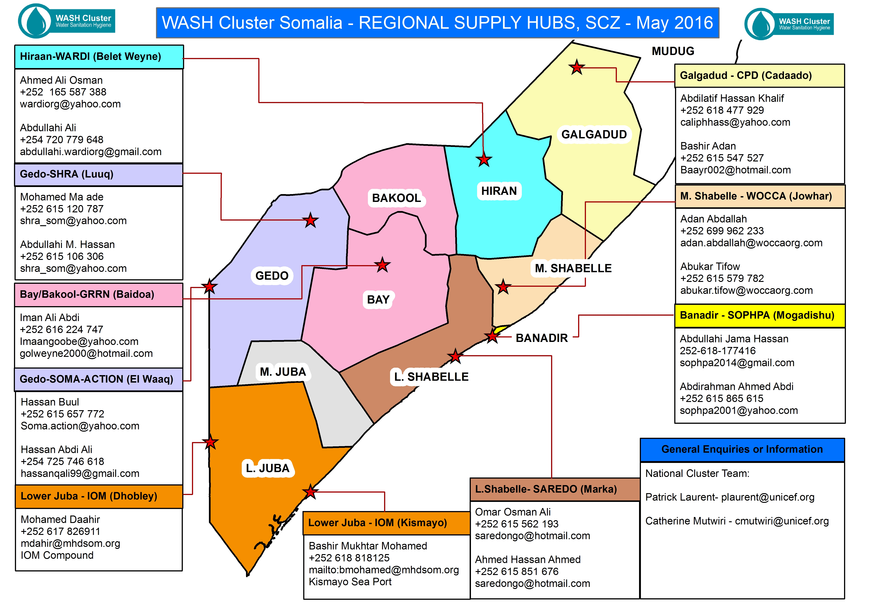
Preparedness: What we’ve done

Slide 4
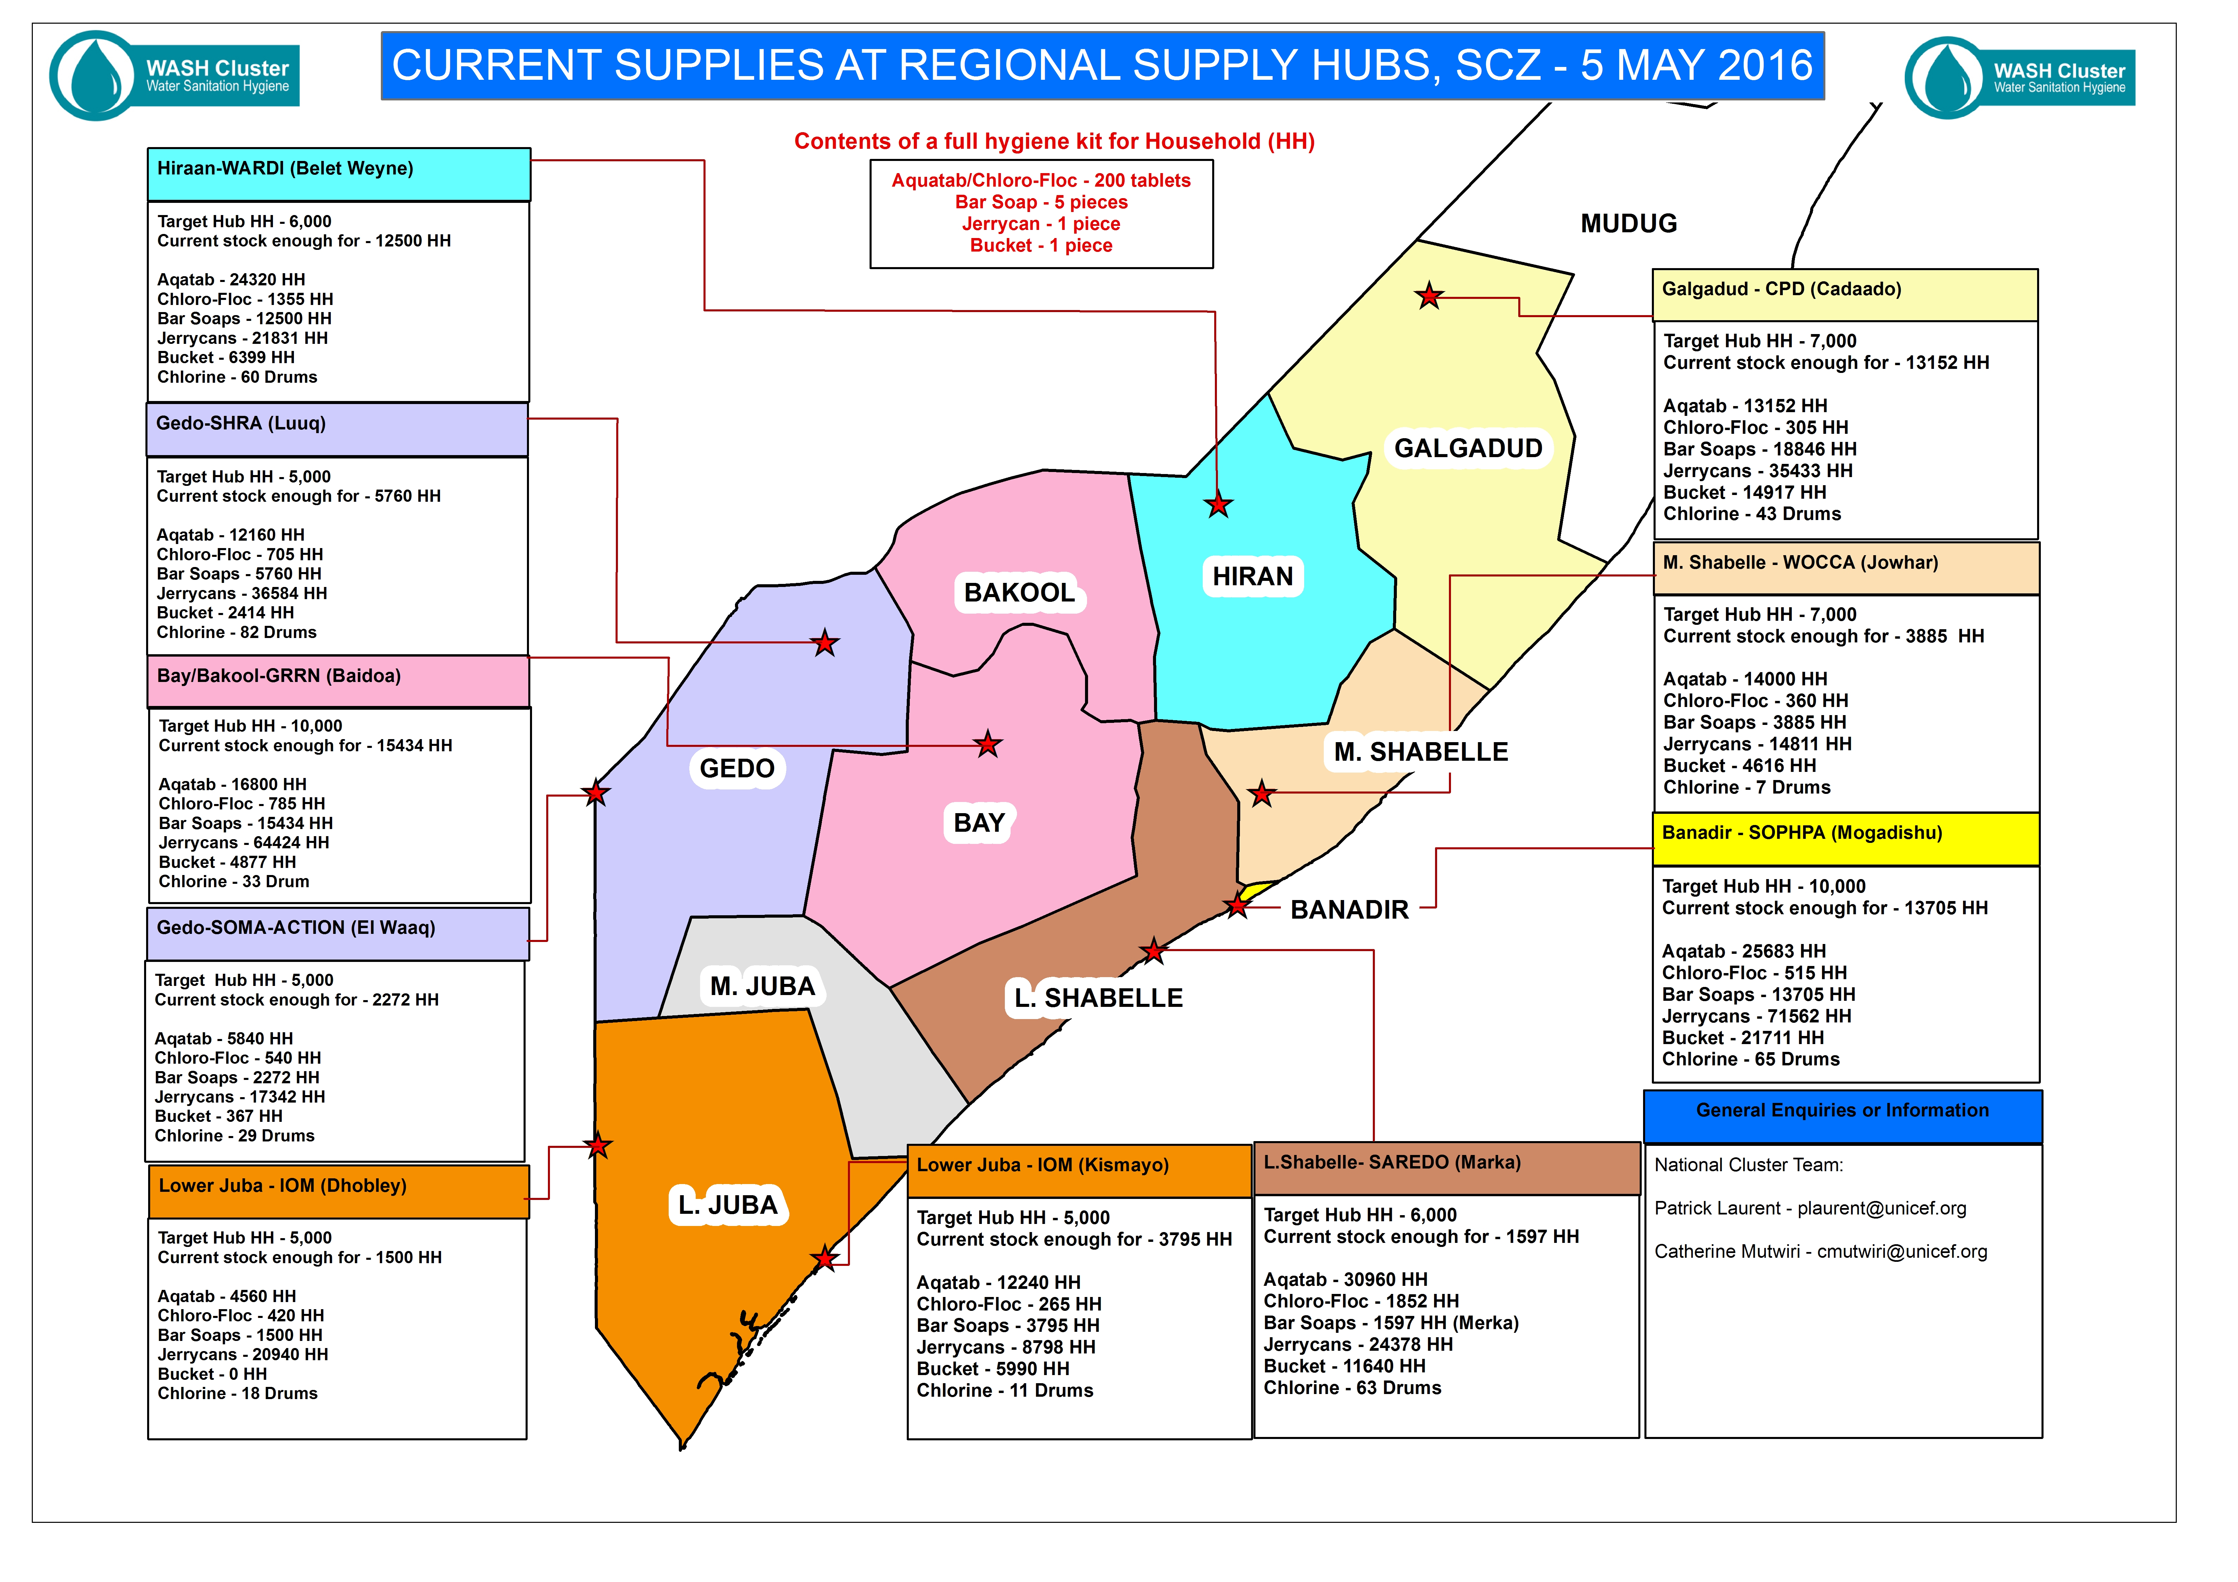
Preparedness: What we’ve done
Country: XXXXXXXX, Presenter: XXXXXXXXX

Slide 5
Preparedness: What we’ve learnt – Good practice
Platform for increased collaboration between WASH cluster / WASH Programme
Evidence of impact of RSH on emergency Nutrition and Health interventions (discharge packages)
72 Hrs. response time to critical response
IPSAS compliance: Supplies out of UNICEF warehouse.
Country: Somalia, Presenter: P. Laurent

Slide 6
Delivered to RSH Partner
UNICEF Responsibility
RSH Process
Supply procured by UNICEF
Cluster Assessment of needs
Cluster approval of distribution
UNICEF and Cluster monitors distribution
Cluster reports on distribution
RSH Partner distributes to cluster partners
WASH Cluster Responsibility

Slide 7
Preparedness: Challenges and way forward
Humanitarian access remains the biggest challenge
Difficult to carry out rapid / comprehensive needs assessments
Real time monitoring is difficult – 3rd party verifiers / monitors constantly engaged.
Trend to limit the response to the Hygiene kit distribution
Donor fatigue
Review of the hygiene kits content
Potential extension to other sectors (Nutrition, Health) and in the Northern Zones
Capacity building of RSH partners – training on warehouse/stock management
In light of the changes in the political context of Somalia, increased involvement of government authorities in humanitarian interventions.
Explore: private sector/traders to stock the bulky supplies like buckets, jerry cans, soap
Country: Somalia, Presenter: P. Laurent

