Slide 1

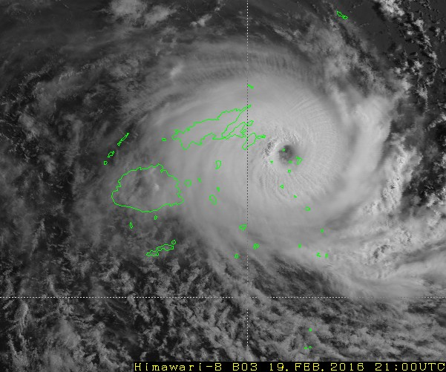
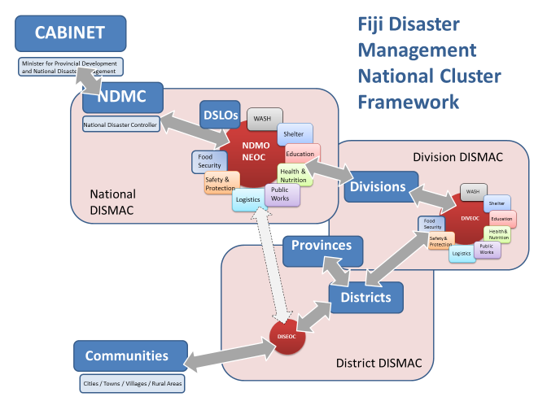
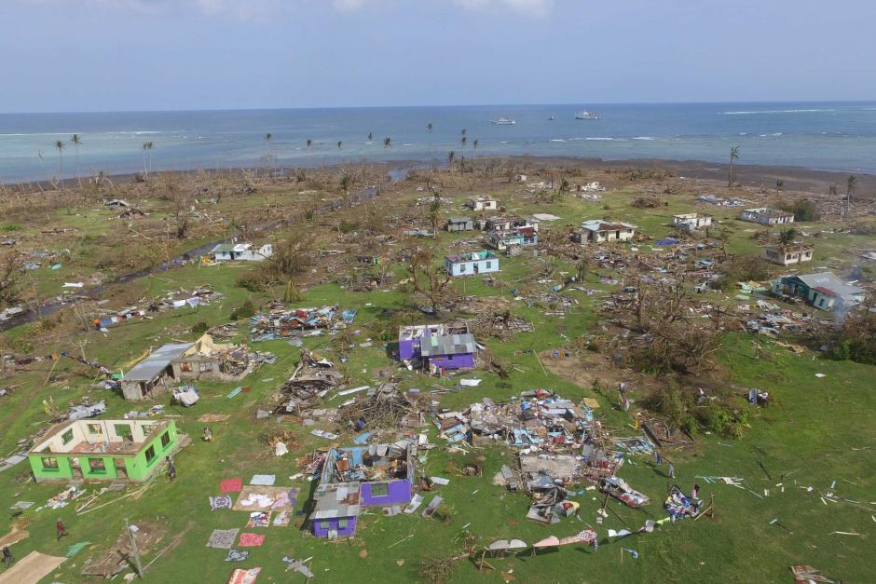

Overview: Humanitarian context and Coordination Structure
Country: Fiji, Presenter: Suli Batikawai
Notes:
Bula Vinaka
Welcome and Introduce yourself!
My presentation covers the experiences on humanitarian preparedness and response for the WASH Cluster in Fiji.
Fiji is an island group in the Pacific ocean with a population of about 800,000 people. There are over 300 different islands and the total land mass is about half the size of Switzerland.
As you may know, Fiji got hit by the strongest recorded Tropical Cyclone in the Southern Hemisphere ever on 19 February 2016 which caused 44 deaths and over 250,000 people being affected.
I will make this presentation with references to what the Fijj WASH Cluster did before, and after, the cyclone, ending with some lessons learned and recommendations.
The Fiji WASH Cluster was established in xxx….
SULI PLEASE CONTINUE…..

Slide 2
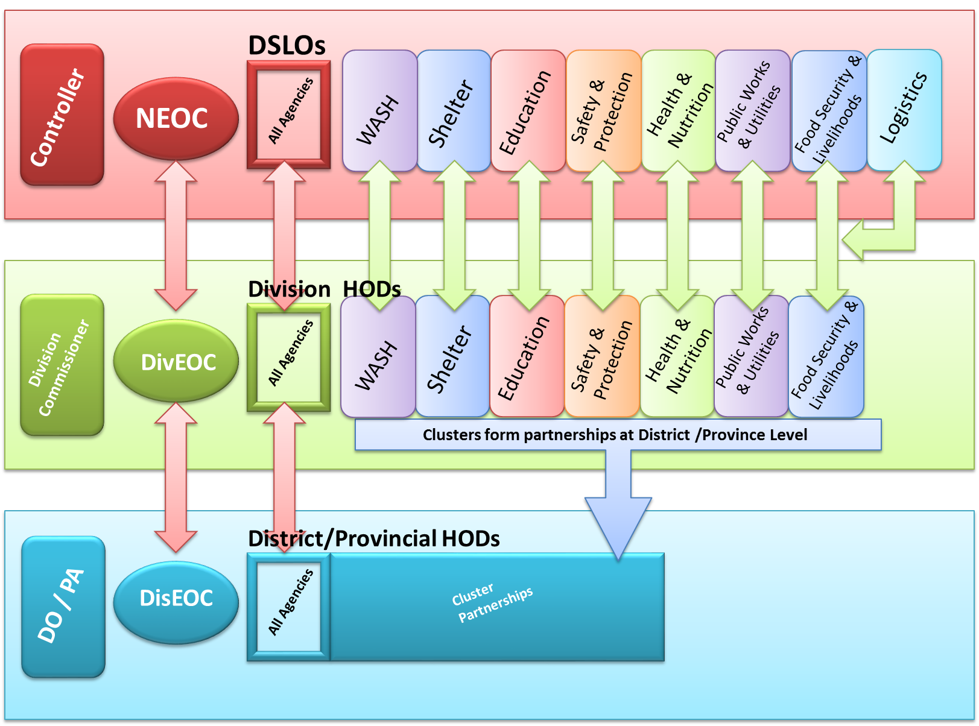
Overview: Humanitarian context and Coordination Structure
Notes:
The Disaster Controller who is the Permanent Secretatry for NDMO is the central coordinator of all the relief effort including the coordination of the cluster at National Level.
At Divisional Level, we have the Commissioners for the four division where divisional cluster contact are based. Cluster systems exists at the national level, but yet to trickle down to division and district level.
DSLO stand for Disaster service liaison officer. Each essential service agencies (e.g. Health, Water, Power, Education, etc.) have their DSLO.
2012 following TC Evan, government trialed cluster system and saw the advantages in increasing coordination.
Cabinet paper submitted and endorsed for adoption of cluster system, but yet to be captured in existing legislations and policies. NDMO currently in the process of doing this.
TWG – depends on disaster and type of response
Memberships – Open – anybody can join
Type of agencies - WASH, Shelter, Education, Protection, Agriculture, Health, Nutrition
International partners partner with local CSOs (e.g OXFAM Fiji and PCDF, CARE Australia and LLEE)

Slide 3
Preparedness: What we’ve done (Pre-Winston)
Establish a common goal: “improve the efficiency and effectiveness of WASH interventions in emergencies by ensuring effective system-wide preparedness, providing the ability to deliver an immediate and appropriate response and participating in actions to facilitate early recovery”
Agree on Cluster Terms of Reference
Established a WASH Cluster Strategy and Implementation Plan linked to the Health Emergency and Disaster Management Plan
Developed a common Initial Rapid Assessment form for WASH with WASH Cluster members
Develop Humanitarian Action Plans for Tropical Cyclone Evan, the El Niño Drought and Tropical Cyclone Winston
Secure employment of a dedicated emergency WASH officer (supported by UNICEF)
Train Environmental Health Officers and cluster members in the use of mobile phone mapping tools for assessments, evaluation and distribution tracking (Akvo)
Training of cluster members on WASH Cluster Coordination (supported by UNICEF)
Evaluate use and satisfaction of WASH Kits with recipients post-Cyclone
Develop Contingency Plans for: Floods; Tropical Cyclones and Drought
Secure pre-positioning of supplies and agree on Standardization of Items

Slide 4

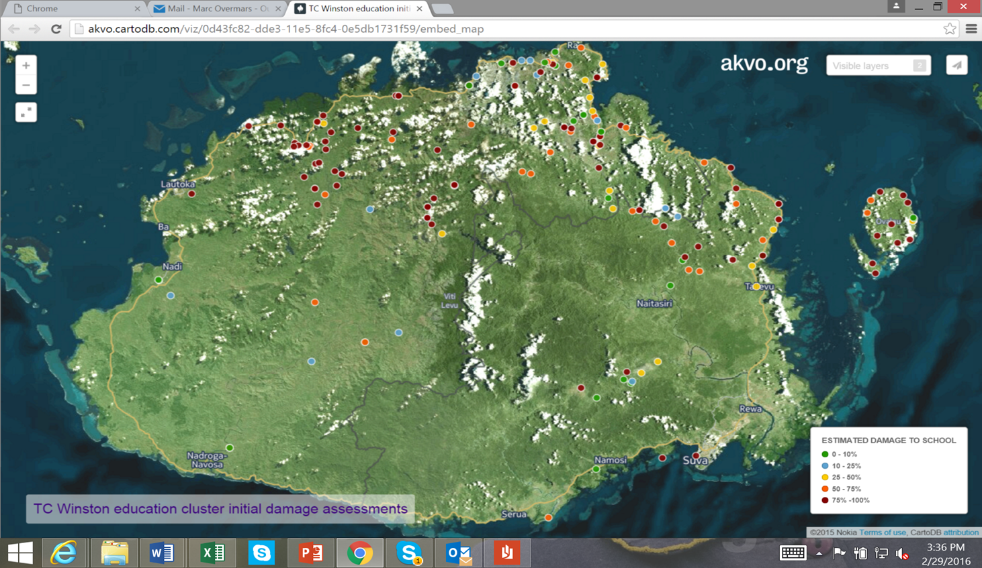
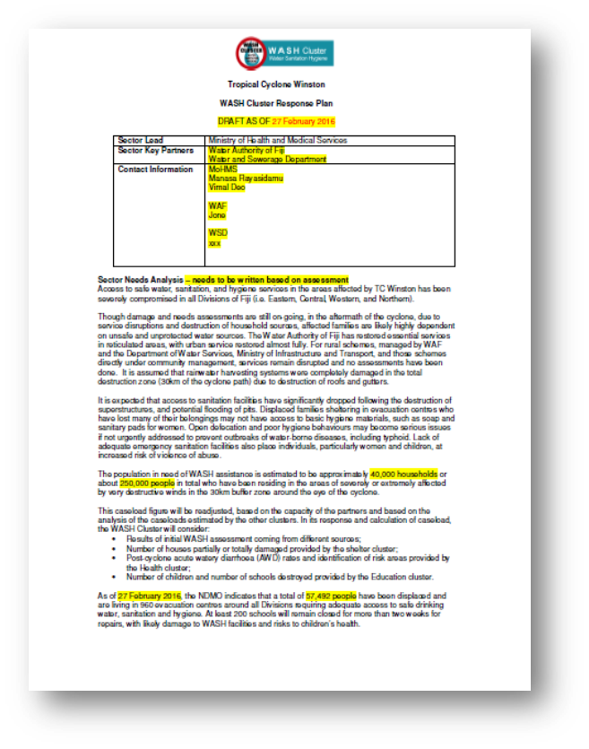
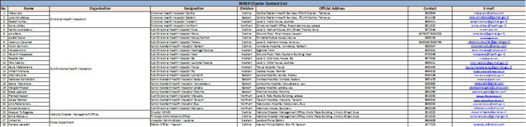
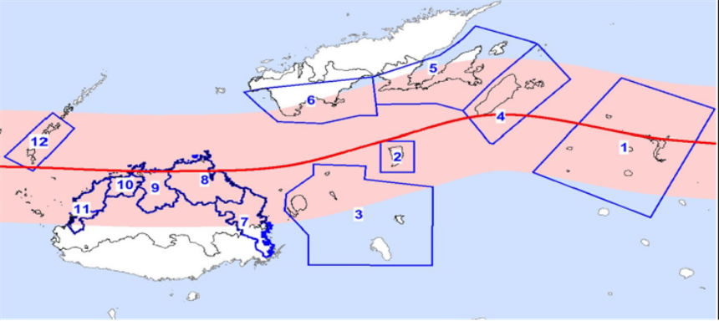
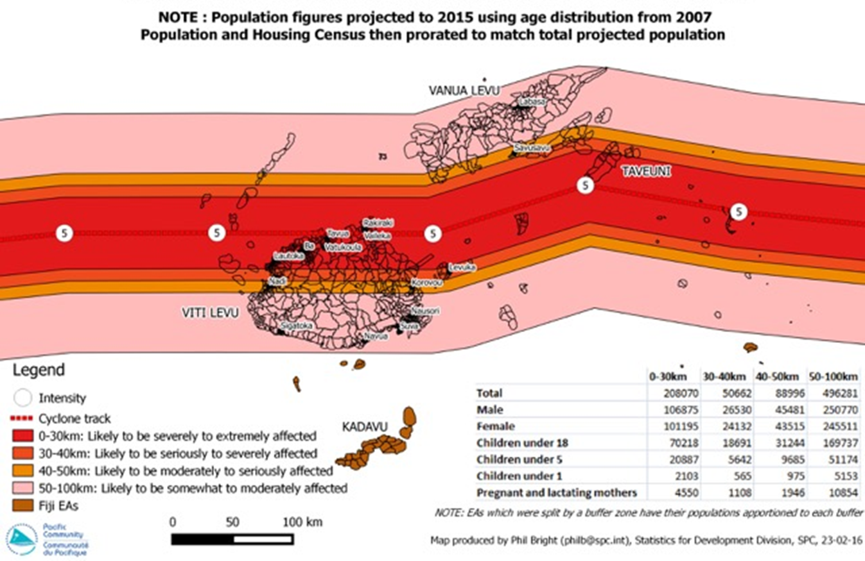
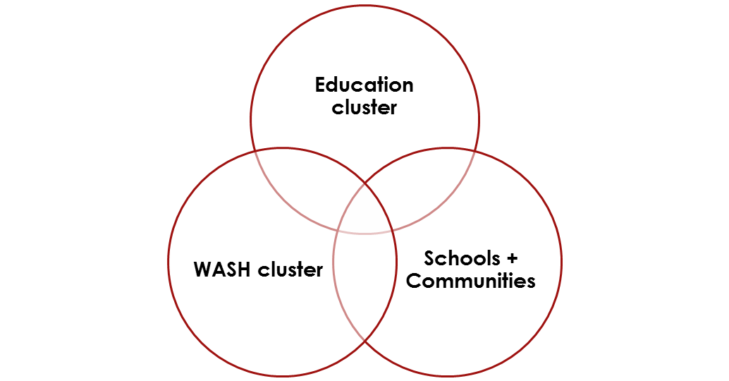
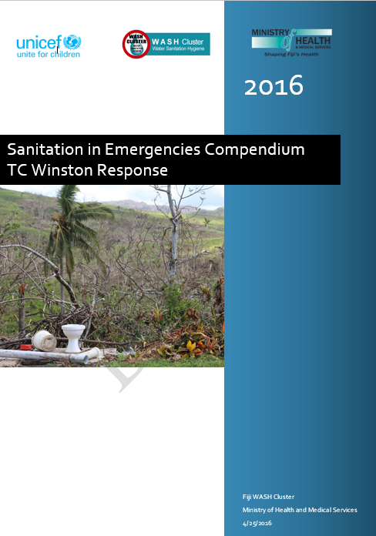
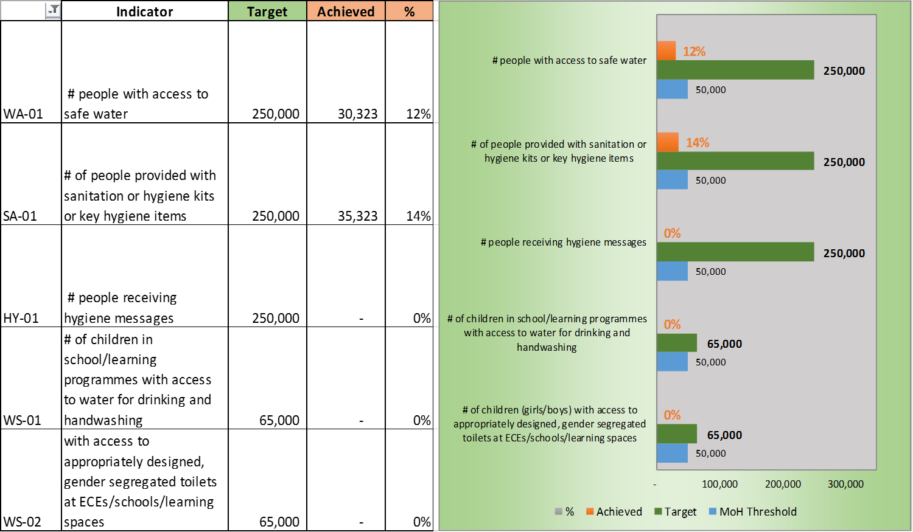
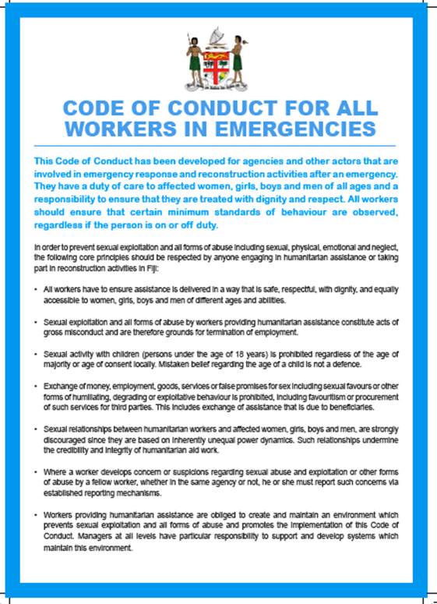
Preparedness: What we’ve learnt – (Post-Winston)
GIS Mapping of IRAs
WASH Humanitarian Action Plan
Priority Areas and Case Loads
WASH Cluster Contact List
WASH in Schools
Inter-Cluster Working Group and Action Plan
WASH Safety Planning Guidance
Drinking Water Quality Monitoring and Health Surveillance
Agreed Indicators and Tracking of Priority Actions
Code of Conduct
Sanitation Compendium
Notes:
Talking about best practice from preparedness perspective. The Fiji WASH Cluster established the following prior to the disaster;
Contingency planning for each disaster
Assessment and reporting tools used in assessments
Establish/strengthen partnerships and buy in from key government stakeholders
Develop Cluster Response Plan with relevant objectives
In addition these are lessons learnt from the recent Cyclone response;
IRA trained EHOs to go out with mobile phones but lacking time to complete and return forms – not all EHOs trained? – logistics? – Etc?
Humanitarian Action Plan drafted by WASH Cluster but not mandated by MoH or NDMO initially – later on MoH PS requested a HAP for WASH and Health but no other cluster did so – xxx
WASH Cluster Contact List established but many new people from Govt (40% estimate?) and Devt Partners (60% estimate?). How many people now on the list and how many agencies in total from a) Govt; b) NGOs; c ) Donors and other Development Partners (SPC MFAT DFAT, UN etc)
Initial figures taken from PRISM/PCRAFI (census and catastrophic risk assessment databases) to determine case load with sex and age disaggregation.
Later GoF identified priority areas and actions (1) Shelter 2) Food 3) WASH. Later Education became a priority (see WinS)
Inter-Cluster Working Groups were established on WinS; Hygiene Promotion and Sanitation with involvement of other cluster leads and co-leads. The WinSiE WG agreed on priority actions and coordination for WASH in Schools immediate response and recovery
Drinking Water Safety Planning guidance was provided to interested partners building on Fiji best practices to allow for building-back-better.
HAP included agreed indicators for monitoring and reporting by all cluster members in proposals, actions or reports. 4W tracking results for each of the priority action areas
Code of Conduct for humanitarian workers was shared and members of the protection cluster provided guidance on gender mainstreaming and child protection issues.
Inclusion of cross cutting issues such as disabilities, gender inclusion.
The Sanitation Technical Working Group (Shelter and WASH) provided guidance on appropriate design standards for temporary and more permanent latrine construction
The National Drinking Water Quality Committee developed a framework for community risk assessments to prevent the outbreak of water borne diseases such as Typhoid and Leptospirosis through a combination of drinking water quality monitoring and waterborne disease surveillance. A pilot approach with Govt agencies (WAF, WSD, MRD, MHMS) will support community actions, household water treatment, engineering, and health priority actions for high risk areas through a ‘crack team’ approach. Typhoid is endemic in Fiji and is affecting more than 500 people annually with one of the highest prevalence rates globally. Water-borne disease cases are typically rising within 2 months of a flood, cyclone or drought.
Compilation of a water treatment technology compendium for Fiji.

Slide 5
Preparedness: Challenges and way forward
Legislation and Policy to govern the Cluster System
Cluster system is only active at National Level but not at divisional level where most of the operation are conducted
Information Management
Standardization (assessments, reporting, guidelines, standards)
Strengthening Linkages
Cluster Training
Notes:
Legislation and Policy to govern the Cluster System
Currently there is no policy or legislation in place to govern the activities of any of the clusters under the national disaster management arrangements, particular in the area of preparedness, response & recovery, and information management this could further strengthen the coordination between clusters and with higher level decision makers. The line Ministry PSs heading National Clusters met with the PM for daily and weekly briefings during the first weeks of the response.
Cluster system is operational at National Level but not (yet) at divisional level
Divisional level implementation is not informed by the cluster system and the relevant decisions made by Commissioners largely by-passing clusters established at the national level with line Ministries. This also affects reporting mechanisms, as in the current structure divisional level reporting takes precedence over cluster reporting.
Information Management
Lack of information gathering, needs analysis and standardization at district and community level. This leads to poor identification of priorities and compromises adequate reporting and capturing of activities implemented at district and community levels.( Information Management Tools that we have are 4W, NFI tracker, NDMO central Website, WASH Cluster Website)
Strengthening Inter-Cluster Linkages
Need to strengthen inter cluster coordination to ensure key cross-cutting issues are captured in planning and implementation. Strengthening inter-cluster coordination and interaction between clusters and the NDMO are required to improve overall coordination. (e.g. NDMO organized inter-cluster meeting but core priorities were not identified and critical issues remained unaddressed. This was partly compensated by inter-cluster working groups that were established out of individual cluster concern and interest with little or no facilitation by the NDMO.
Cluster Training
Need to train partners and government agencies in cluster approach and coordination activities for better preparedness and response. As new partners are entering the WASH field in Fiji and the region, not only as implementing organization but regional coordination offices (e.g. OXFAM Fiji and OXFAM Pacific).

