Slide 1
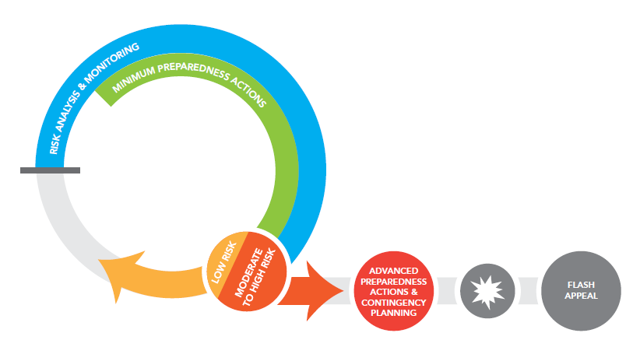
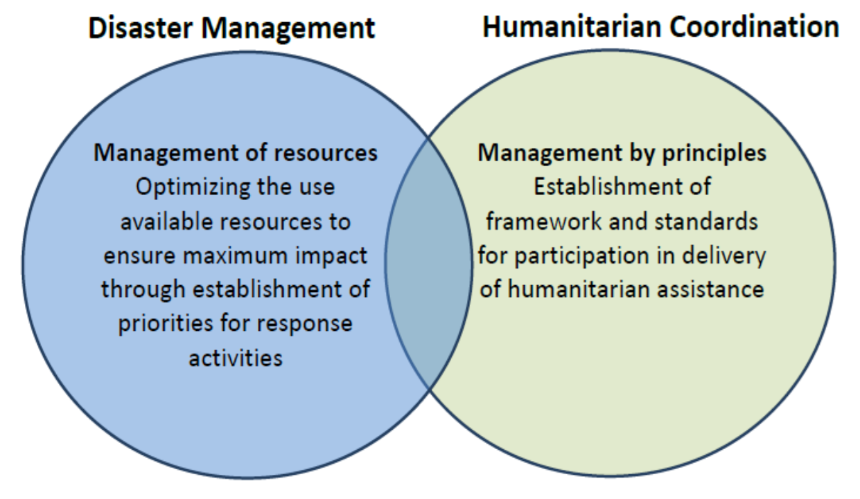
Emergency Preparedness - Coordination of the WASH sector
Emergency preparedness is the knowledge and capacity developed by governments, organizations, communities and individuals to anticipate, respond to and recover from the impact of potential, imminent or current hazard events, or emergency situations that call for a humanitarian responses
WHY THE WASH CLUSTER AND SECTOR SHOULD BE LEADING SECTORAL PREPAREDNESS PLAN?
FRAMEWORK OF COORDINATED EMERGENCY PREPAREDNESS
A concept from the IASC approach :
Risk assessment, analysis and monitoring
Hazard mapping and risks analysis
Expected impact WASH access, services and use
Coordination & Management Arrangement
Humanitarian principles
WASH Coordination structures arrangement
Developing scenarios
Risk monitoring and early warning systems
Information Management, needs assessment and response monitoring
Inter-sector coordination arrangement
Designing the Emergency WASH Response Plan
Context and gaps analysis
Response strategy
Centrality of protection
Policies, Standards and technical guidance
Community Engagement
Cross cutting issues
Accountability to Affected population
Operational Capacity to Deliver
Mapping actors (partners, private sector…)
Supply of key items and WASH services
WASH human resources
Resource mobilization
Logistical arrangement
Building the capacity of the sector to respond to emergencies
Minimum Preparedness Actions
Community preparedness in high risks areas
Capacity building plan of the WASH sector
Advocacy
Knowledge management and lessons learnt
Simulation of the emergency response plan
Process
Level of participation, decision making process and consultative process
Minimum Linkages with other platforms
Information Management for the Emergency Response Preparedness Planning process
ERPP cycle
Approach to coordination
Six core functions of a cluster at country level are :
GAPS
To support service delivery
To inform the HC/HCT’s strategic decision-making
To plan and implement cluster strategies
To monitor and evaluate performance
To build national capacity in preparedness and contingency planning
To support robust advocacy
1
2
3
Stay safe, be prepared :
4
Who is involved?
How does the GWC
proceed?
Where the process take place?
National
Regional
Community
International
Intersector coordination
Governments
National WASH humanitarian coordination platform
Other clusters
Communities
Academia
National/local media
GWC, with FST support
Based on scenario
Knowledge management
Diagnosis of level of preparedness in the prioritized countries
Support and Expertise
Capacity mapping tools
Dashboard
Checklist
Framework / concept
Provides general guidance
5
6
State of Palestine case:
Coordinated emergency preparedness programming
This case study illustrates the importance of emergency preparedness including minimum preparedness actions.
The Designated Emergency Shelters (DES) are part of the Inter Agency/ Cluster Contingency Plan (IACP) and aimed at upgrading of the schools and shelters to protect people fleeing increasing violence, destruction of shelters; mainly internally displaced peoples (IDPs) in Gaza if the emergency is declared. DES will ensure that an appropriate environment is provided to the affected population. Each one is planned for 1,000 to 2,000 persons.
Ensuring basic WASH services is required in the first 24h and therefore preparedness is crucial to meet this objective. Since March 2016, the WASH sector is highly involved in supporting this collective preparedness plan. Intersector coordination is an essential step for the success of the plan and key sectors: Education, CCCM, Shelter and WASH task forces meet on regular basis to establish standards, updates on progress, share and adress challenges.
70 schools will be equipped for which several organisations are implementing emergency preparedness programs. Programs includes infrastructures as WASH facilities amongst others, for example installing permanent water tanks to ensure 2 days storage capacity for the number of expected people. It also includes training for potential staff on monitoring WASH indicators, Hygiene Promotion, and designing IEC materials.
The WASH Task Force have therefore:
Undertake joint in depth assessment of schools to identify needs per schools
Develop a roadmap to identify tasks, roles and responsibilities to be undertaken to achieve the common objectives
Develop a dashboard for resource mobilisation
Design information management tools and systems
Develop a Strategic Operational Framework specific to this actions which includes
Mapping of WASH actors
Standards
M&E framework
Example of standards
Sufficient quantity of good quality water will be provided for IDPs during and post emergency to ensure that all IDPs have the safe and equitable access to water.
To ensure that IDPs have an adequate number of toilets to allow them rapid, safe and acceptable access at all times of the day and night
Promote good personal and environmental practices to prevent WASH related diseases in order to protect health by conducting hygiene sessions and campaigns
22nd Annual Global WASH Cluster Meeting / 22nd – 23rd November in Kathmandu, Nepal

