Slide 1
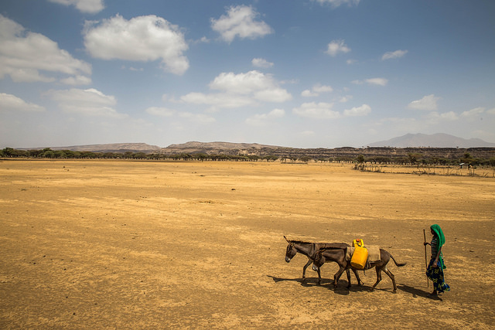
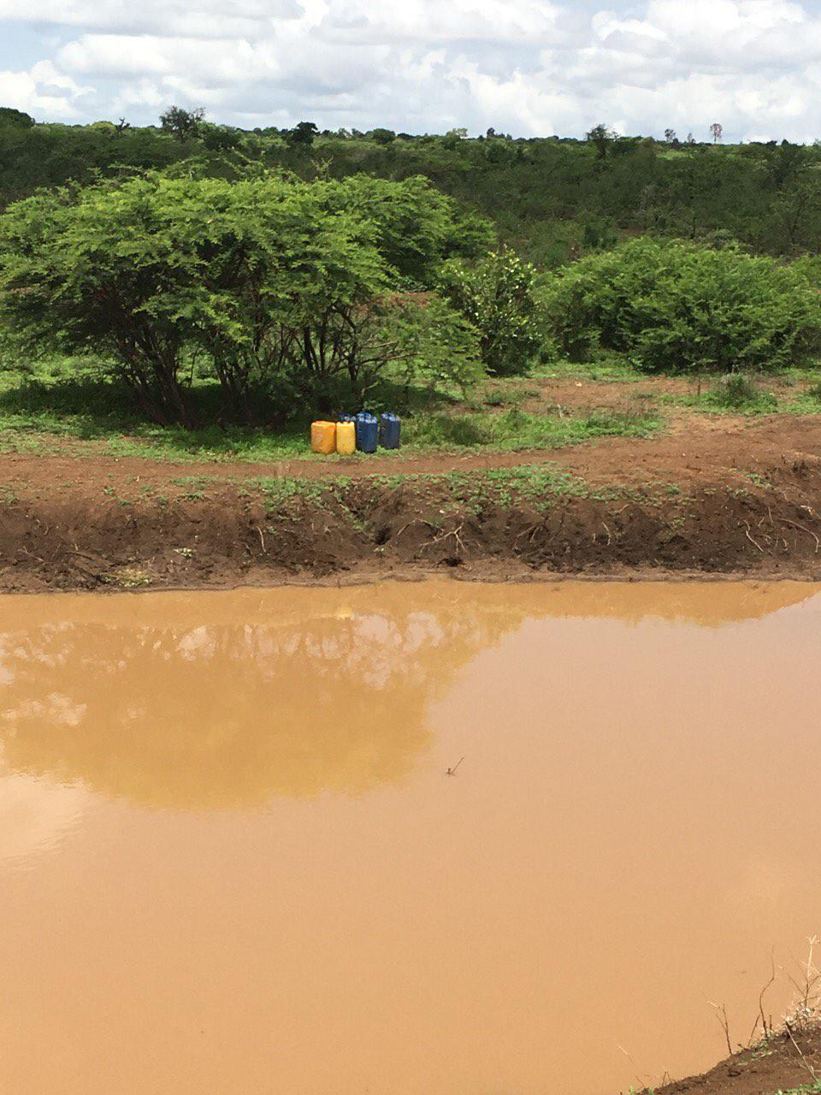
2015/16 Elnino Induced Emergency in Ethiopia

Slide 2
Background
Worst drought in decades – El Niño Triggered
Projections of how the impacts would be felt: Started in August 2015
Multi Sectoral annual assessments November 2015
Strategic Objective 1: Save lives and reduce morbidity of drought affected people
Contribute to saving lives and reducing morbidity in drought affected areas through the provision of emergency WaSH services.
Strategic Objective 2: Prepare for and respond to other humanitarian shocks - natural disaster / conflict / displacement
Contribute toward saving lives and reducing morbidity among conflict and natural disaster displaced population through the provision of emergency WaSH services

Slide 3
PROJECTIONS OF Populations in Need
 | Region | Woredas | Populations In Need
 | SNNPR | 24 | 506,276
 | Afar | 15 | 246276
 | Tigray | 21 | 669958
 | Amhara | 48 | 1523128
 | Oromia | 50 | 1771547
 | Somali | 48 | 867390
 | Gambella | 2 | 15000
 | B.Gumuz | 3 | 20,450
 | D Dawa |  | 125,789
 | Total | 211 | 5,745,814
 | Flood Contingency Plan |  | 104,150
 | Grand Total |  | 5,849,964

Slide 4
Projections of areas to be affected

Slide 5
WASH Host spot Woredas
** Currently being Revised

Slide 6
WASH Overview
Affected Regions: Afar, Amhara, Tigray, Somali, Oromia and SNNPR
Total People Affected – 7.5mill
Cluster Targets – 5.85mill
Total Requirements – US$73.5 mill

Slide 7
Water-related Disease Burden
Acute Watery Diaahreo (AWD): Reported 457 cases in Somali (Moyale and Hudet), 334 cases in Oromia (Moyale and Galana) and 662 cases in SNNPR.
AWD task forces have been activated in all affected areas and meeting in regular basis.
WASH interventions including emergency water supply (Water trucking), water supply maintenance and distribution of household water treatment products is ongoing.
Scabies: Total 77 Woredas in Amhara, Tigray and Oromia affected with an estimated 770,000 cases recorded
WASH Interventions in these cases/ areas focuses on prioritization of safe water supply & awareness raising on transmission and prevention.

Slide 8
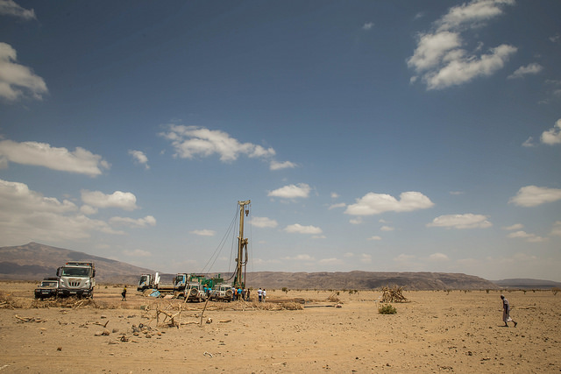
Emergency Intervention Strategy
Rehabilitation and upgrade of existing Water supply schemes
Provision of Household water treatment chemicals/disinfection of community water sources
Sanitation and Hygiene awareness messaging
Water Trucking
Expanding Deep Borehole drilling

Slide 9
Real-Time Monitoring Program
4 Months, 6 Regions, 16 Zones, 34 Woredas
Akvo Flow app on phones and basic internet

Slide 10
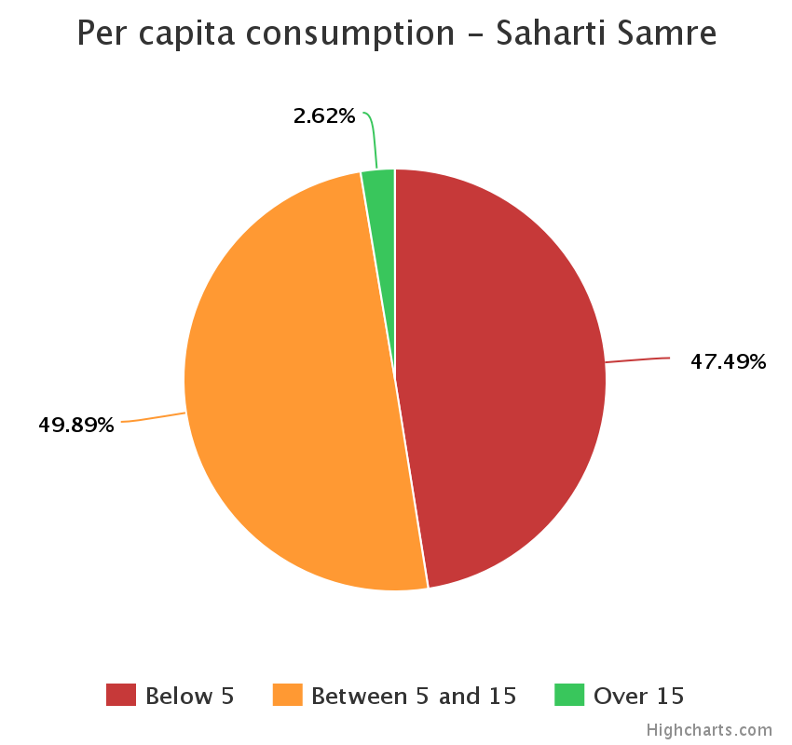
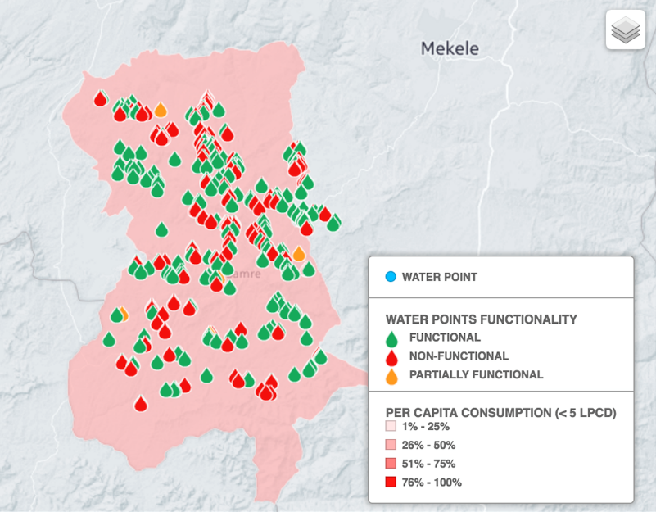
Real-Time Monitoring Results
Phase 1 monitoring results have shown that:
45 per cent of respondents use less than 5 liters/person/day,
40% of improved water sources have dried up or are non-functional.
66% of households are walking in excess of 1 hour (return trip) to access water, with field reports indicating up to 10 hours of walking per day in some cases
Response: Emergency Water Trucking Support & water sources for rehabilitation
Sample Woreda Data

Slide 11
Flood Preparedness and Response
Government Led Multi Agency Flood Task Force- Flood Alert in March 2016 based on NMA weather outlook- above normal Rainfall
95 districts in 7 Regions including Dire Dawa/Harar are prone to flooding with an estimated 488,850 people projected to be affected
With increased Surface water availability an estimated 3 million people are in urgent need of water treatment chemicals across the country.

Slide 12
Framework
Hazards and Vulnerability Mapping
Estimation of numbers
Strategy
Prepositioned Stocks
Long Term Agreements –LTA’s

