Slide 1
Supporting Inter-Cluster field information management around the HPC
Global Food Security Cluster IM Training
16 May 2018

Slide 2
HPC.tools Overview
Response Planning Module (RPM)
Projects Module (new OPS)
Financial Tracking Service (FTS)
KoBoToolbox and DEEP

Slide 3
Real-time data transforms coordination
Continuous strategic decision-making based on real evidence
Improve transparency
.
Field-driven demand
OCHA mandate:
Inter-agency coordination
Strengthen evidence base
Stakeholder feedback
Coordinate approaches
Support
decisions

Slide 4

Planning and monitoring the response
New tools and services which integrate planning and monitoring
Needs & Situation Monitoring*
Response Planning & Monitoring
Financial Tracking
Project Planning & Implementation Tracking
* TBC

Slide 5
Sector and inter-sector mandates
Clear division of responsibilities to avoid reporting duplication
OCHA RPM
OCHA
Strategic Objective
Narrative
SO INDICATOR
Target
Result
Cluster Objective
Outcome Indicators
CO INDICATOR
Target
Result
Cluster Activity
ACTIVITY INDICATOR
Target
Result
FUNDING
OCHA FTS
PROJECTS
Project Activity
Narrative
OCHA OPX
Project Activity
ACTORS
Activity indicator
Target
Result
Impl. Partn.
Clusters, eg eTOOLS
OCHA H.ID?
non aligned

Slide 6
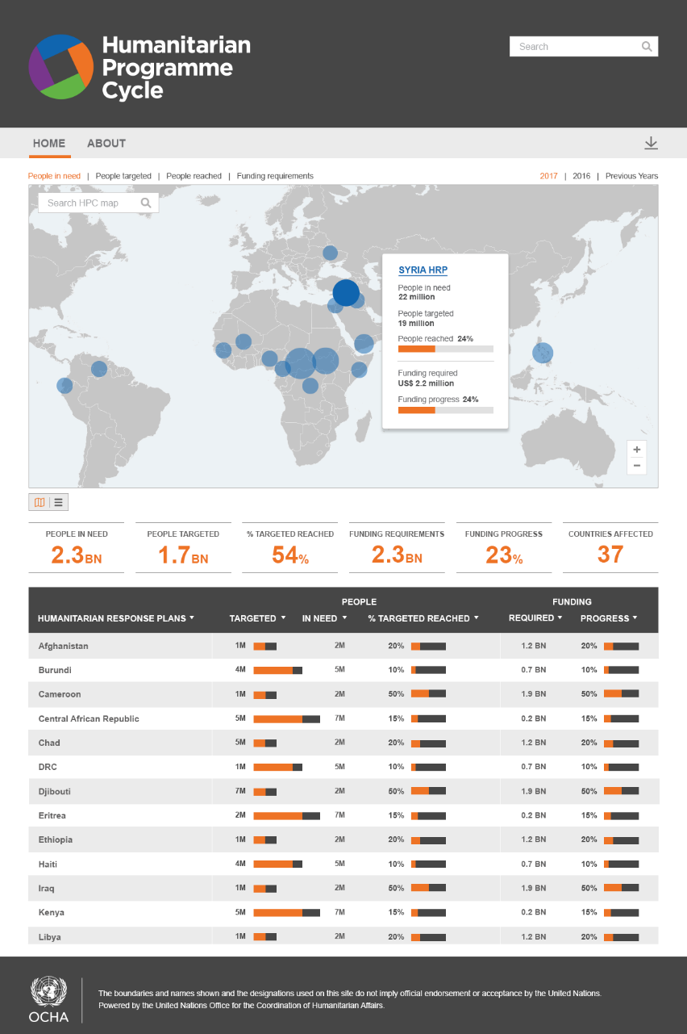
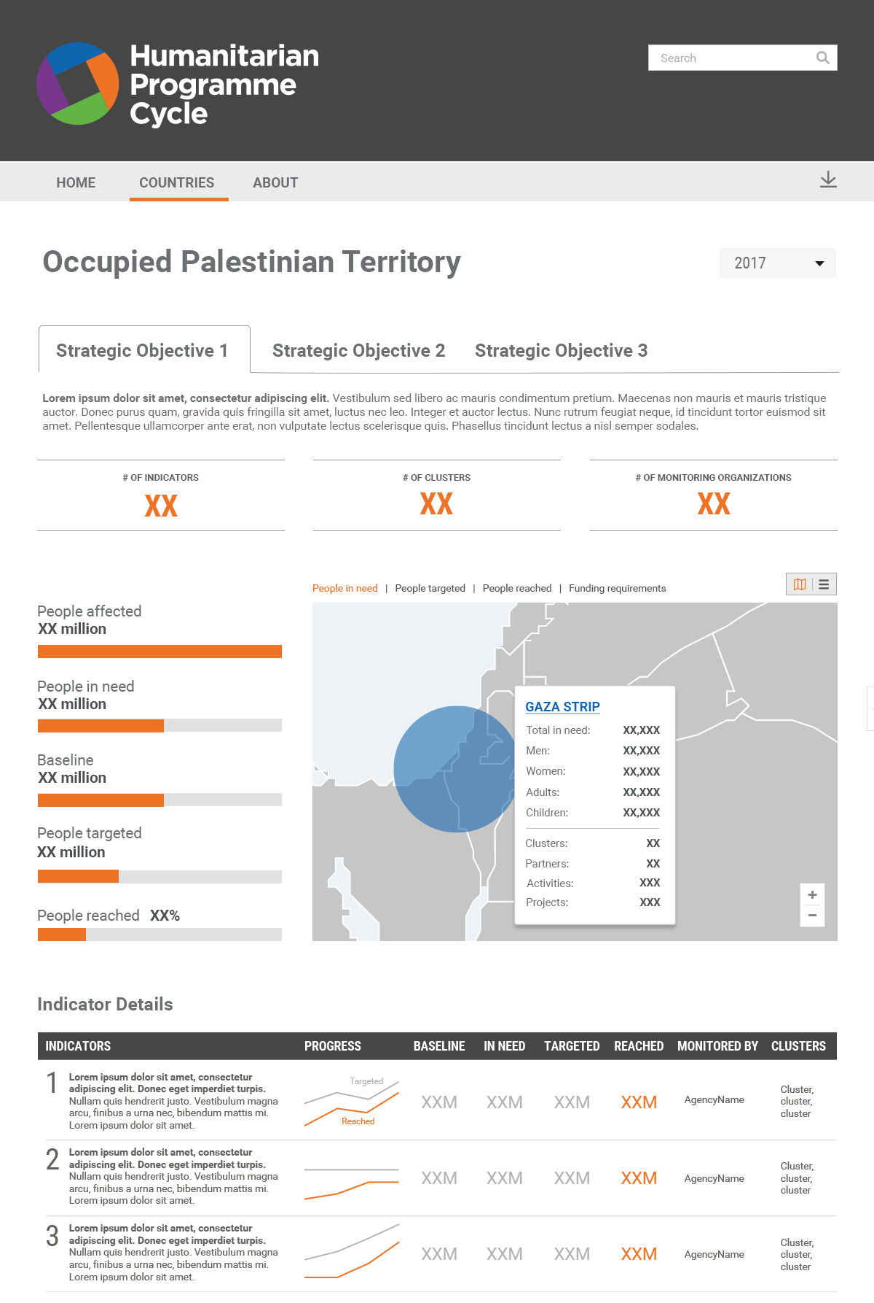

Slide 7
A common architecture for HPC data
Interface modules provide data into a database, which serves consumers

Slide 8
HPC.tools Overview
Response Planning Module (RPM)
Projects Module (new OPS)
Financial Tracking Service (FTS)
KoBoToolbox and DEEP

Slide 9
The Response Planning and Monitoring tool (RPM)
Creation, management and monitoring of the HRP strategic framework
Define and manage all elements of the framework at strategic and cluster levels
Flexibly attach and monitor indicators (chosen from indicator registry wherever appropriate), caseloads and costs
Empower clusters to manage their own framework elements

Slide 10
How the RPM will help
The tool helps to lighten and streamline HPC processes
✓
Reduce data management workloads
Minimise / eliminate duplicate reporting
Do more with your data
Empower decision-makers
Transfer skills
✓
✓
✓
✓

Slide 11
Development and rollout timeline
Consultation and field piloting support continuous iterative development
Initial consultations: stated user needs
‘Agile’ development of initial version
Field piloting 2015-16 : revealed user needs
Continuous development
Sequential global introduction
1st wave of adopters 2017
Continuous development
Each field rollout is an integral part of the consultative process to establish what users want and need.
2nd wave of adopters 2018
Continuous development

Slide 12
HPC planning and monitoring process
Differences depending on costing methodologies and level of detail
PLANNING
MONITORING
Strategic planning
(inter-cluster)
Cluster-level (or multi-sectorial) planning
Activity-based costing (cluster-level)
Financial (FTS)
Project registration and approval
(clusters & partners)
Activity-level (clusters)
Project-based costing
Project-level (partners & clusters)

Slide 13
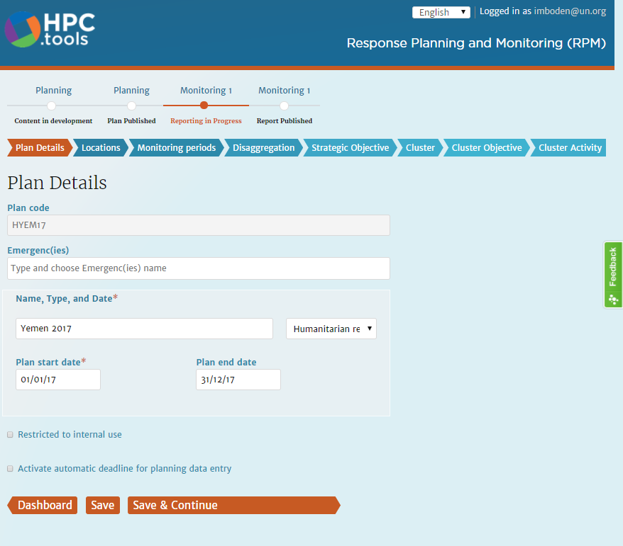
RPM Demo

Slide 14

Impact of new tool on existing workflows
RPM matches Excel template for data entry on caseloads and indicators
Inter-cluster level
Cluster level
Excel reporting templates
RPM tool
Soft launch:
business as usual for clusters
OPTION 2:
Clusters use tool directly
consolidation and aggregation (offline)
Cluster data platforms, tools and repositories
Other data

Slide 15
Future integrated workflows
RPM exchanges data in both directions with cluster monitoring platforms
Inter-cluster level
Cluster level
RPM tool
API
Cluster data platforms e.g. eTools, ActivityInfo
Consolidation and aggregation (online)

Slide 16
HPC.tools Overview
Response Planning Module (RPM)
Projects Module (new OPS)
Financial Tracking Service (FTS)
KoBoToolbox and DEEP

Slide 17
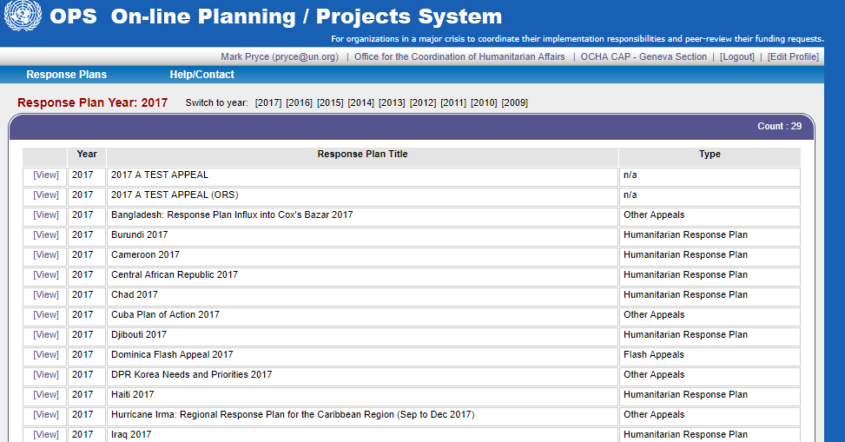
The Online Project System (OPS)
Facilitating project planning, approval and publication since 2009

Slide 18
Why are we replacing OPS?
A modern platform designed for today’s field realities and user needs
Flexible
  Enables context-specific planning
  Better reflects real-world projects (multi-plan/multi-cluster/multi-year)
  Will have additional uses, e.g. marketplace and 3W
New HPC.tools Projects module
Easy to use
  Lightens and speeds up the HPC process
  Supports non-technical users
  Old OPS was dated and hard to use
Integrated
  Links projects to frameworks (RPM) and funding (FTS)
  Will connect to e.g. Unicef e-Tools (PRP) or pooled fund GMS and other standardized cluster tools
  Reduces duplication of data entry

Slide 19
Project-based planning and costing
Robust planning process with greater oversight and accountability
Facilitates cost estimation per sector, per org, and for entire plan
Approval process (vetting) empowers clusters/sectors
Enhances visibility, credibility and accountability for included projects
Facilitates correct attribution of reported funding via FTS
Helps to identify gaps and duplications before implementation begins
✓
✓
✓
✓
✓

Slide 20
Timeline for the new Projects module
Phased approach allows consultative user-focused development
Phase 1: 2017 | Phase 2: 2018
Replacement of old OPS → field pilots in Libya and Chad New user interface Greater flexibility and customisation Link projects to plan framework Pilots support 2018 plans | Iterative development of new features → global rollout Feedback on pilots Additional consultations in field and HQ Prioritisation of new features Global rollout for 2019 plans

Slide 21
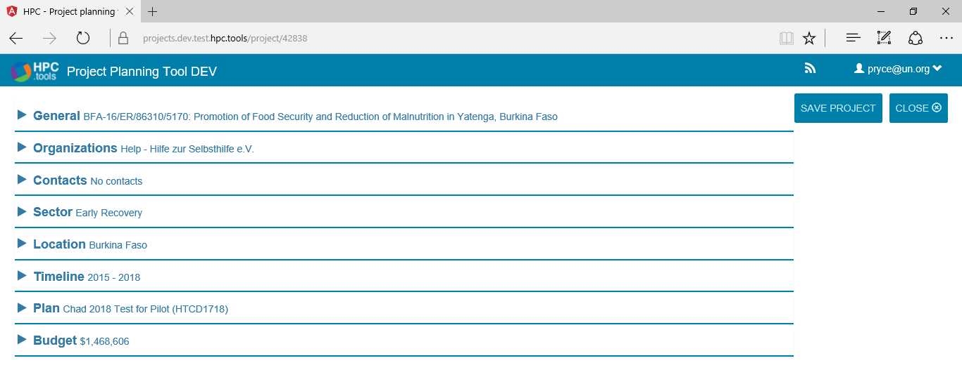
HPC.tools Projects module
A very brief demonstration

Slide 22
HPC.tools Overview
Response Planning Module (RPM)
Projects Module (new OPS)
Financial Tracking Service (FTS)
KoBoToolbox and DEEP

Slide 23
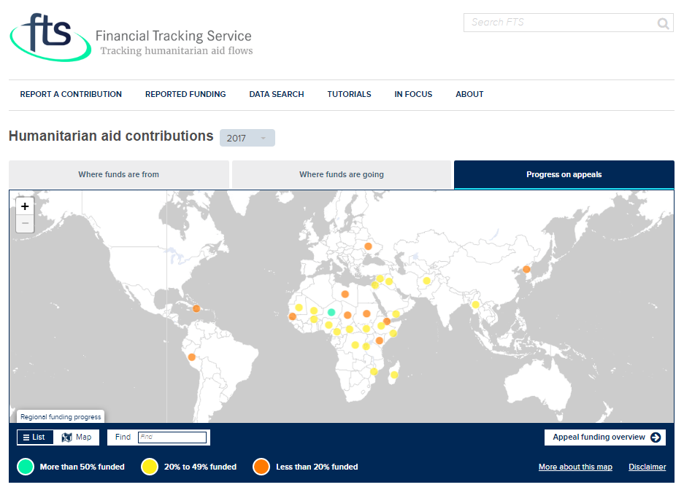
Making data more accessible and easy to use

Slide 24




Why we need FTS
Providing a unique service for the humanitarian community since 1992
Provides globally comparable data
Continuously updated to support coordination and decision-making
Curates data, verifying its accuracy, triangulating and cross-checking
Tracks how funding is allocated and used, particularly for inter-agency response plans

Slide 25
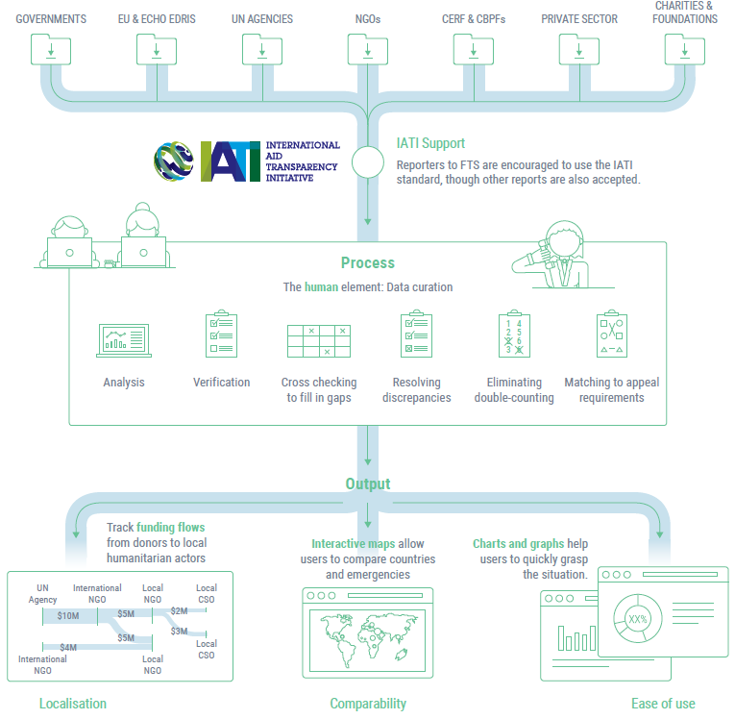
How FTS works
Reports are received from many sources and in many formats
Data is analysed, verified and matched against plan requirements
Data is published on website

Slide 26
Overview of changes to FTS
New technical capabilities to meet WHS and Grand Bargain commitments
Transparency
Multi-year planning and financing
Management costs
Localisation
More regular and comprehensive reporting, facilitated by support for the IATI reporting standard
Tracking of pass-through funding to improve traceability and measure funding to local actors
Reduce earmarking
Use of cash
Categorisation of donor contributions by level of earmarking
Identification of use and type of cash transfer programming
Better tracking of multi-year requirements in HRPs, and multi-year donor contributions
Greater visibility on overheads wherever possible
Improved visualisation and accessibility of data

Slide 27
FTS now supports IATI
Key differences and complementarities
IATI
A standard reporting format
Used by reporters to make their reports more standardised and machine readable
Why IATI needs FTS:
On its own, using IATI doesn’t (yet) create a bigger picture of funding flows without manual processing and curation
FTS
A standard data platform
Assembles reported data into a bigger picture of funding flows. Manually curates, verifies and cross-checks data
Why FTS needs IATI:
Receiving reports in the IATI format makes it easier for FTS to process them – no manual transcription required, and curation is facilitated.

Slide 28
The new FTS flow model
Database architecture reflects full complexity of humanitarian funding
Response plan
The basic tracked element is a ‘flow’, representing the movement of resources from a source to a destination
Sources and destinations can be organisations, funds, countries, plans, activities, clusters, projects, etc.
Donors
UN Agency
UN country office
Int’l NGOs
Carryover
Un-ear-
marked
Allocation
Pass-
through
Management cost
Local NGOs
Pooled fund
Donors
Contributions
Allocations
Management cost

Slide 29
HPC.tools Overview
Response Planning Module (RPM)
Projects Module (new OPS)
Financial Tracking Service (FTS)
KoBoToolbox and DEEP

Slide 30

Supporting tools to enable HPC-related work
Developed in partnership with agencies and NGOs
DEEP
Primary data collection Using smartphones, tablets, computers Question library – standardise questions Online training module | Secondary data management and categorisation Facilitates analysis – in right hands Still under development

Slide 31

Coordinated approaches to needs assessment
Improve both process and output of primary data collection
Decrease
fragmentation
Use common indicators and libraries
Share information
Harmonize approaches
In partnership with

Slide 32
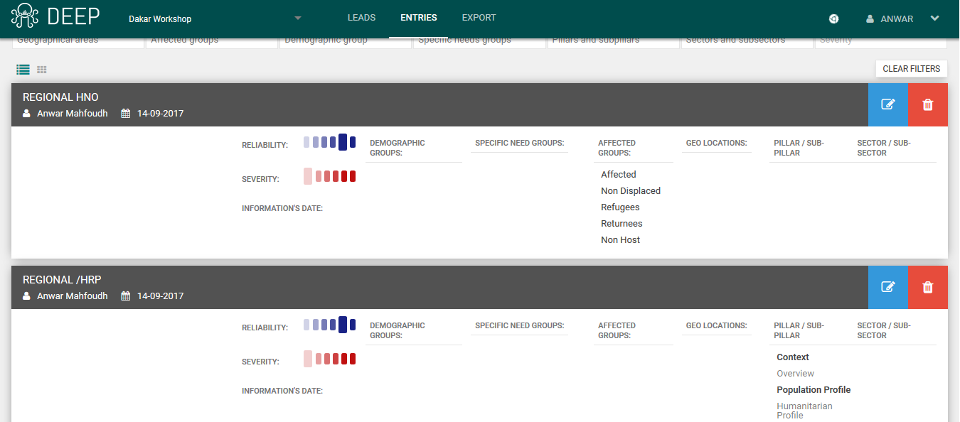

Coordinated approaches to joint analysis
Collaborative secondary data review and analysis with shared framework
DEEP
In partnership with

Slide 33
Get in Touch
All platforms supported directly by field IMOs working closely with MPTS
Platform | Data | Key Contact | E-mail
Financial Tracking Service | Financial requirements, contributions, IATI, feedback and support | Laura Calvio FTS Manager | calvio@un.org
 |  | FTS Support | fts@un.org
HPC tools : OPS (New + Old), RPM, | Project planning, Cluster-level reporting, Inter-Cluster 3Ws, OPS feedback and support | Nick Imboden Project Manager | Imboden@un.org
 |  | Anwar Mahfoudh RPM Lead | mahfoudh@un.org
 |  | HPC tools Support | ocha-hpc@un.org
KoBoToolbox | Primary data collection feedback and support | Anwar Mahfoudh Project Manager | mahfoudh@un.org
 |  | KoBoToolbox Support | support@kobotoolbox.org
DEEP | Secondary data review and analysis feedback and support | Fawad Hussain DEEP Support | fawadhussain@un.org

Slide 34
HPC.tools overall project timeline
Staged approach: pilots, feedback and iterative improvement

