Slide 1





ACCOUNTABILITY &
QUALITY ASSURANCE INITIATIVE
MEASURING WHAT MATTERS
GLOBAL WASH CLUSTER 25th Annual Meeting
Satellite Events | 26-30 April 2021
Notes:
Introduction to the initiative

Slide 2
1. BACKGROUND
Notes:
Introduction to the initiative

Slide 3
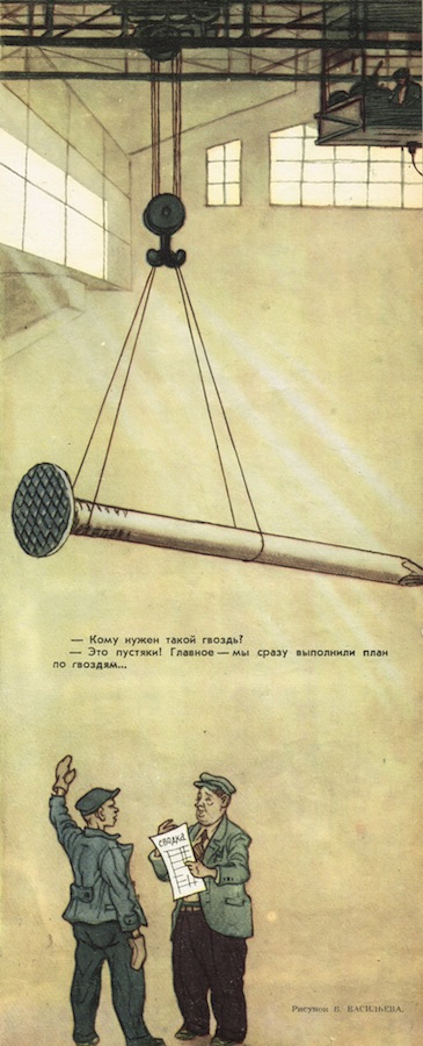
WHAT GETS MEASURED…
GETS MANAGED
“That’s our monthly quota achieved”
Notes:
Once upon a time, there was a factory in the Soviet Union that made nails. Unfortunately, Moscow set quotas on their nail production, and they began working to meet the quotas as described, rather than doing anything useful. When they set quotas by quantity, they churned out hundreds of thousands of tiny, useless nails. When Moscow realized this was not useful and set a quota by weight instead, they started building big, heavy railroad spike-type nails that weighed a pound each.

Slide 4
WHY ACCOUTABILITY AND QUALITY ASSURANCE?
Context
Monitoring
Accountability
      Increasingly complex operating environment
      Demands to improve quality and AAP
      Repetitive quality issues across contexts
      M+E systems designed for upwards accountability, not quality management
      Technology enables large volumes of data collection, overwhelming analysis capacity
      Field-level information is rarely used to improve decision making
      Participation and accountability under-prioritised
      Voices of those affected by crisis are under-represented agency and cluster level
      Responses are often blind to different needs and vulnerabilities
Notes:
Context slide

Slide 5
WHY ACCOUTABILITY AND QUALITY ASSURANCE?
Context
      Existing monitoring and evaluation approaches are limited. Whilst they collect a lot of data, they focus on tracking activities rather than understanding what is working for whom.
      Reporting requirements are often prioritised, using vanity metrics that evidence our strengths but fail to address our weaknesses.
      Opportunities for improvement are being missed, resulting in programmes that are falling short in terms of quality.
      Response metrics should balance our accountability to both donors and those affected by crisis.
Notes:
Context slide

Slide 6
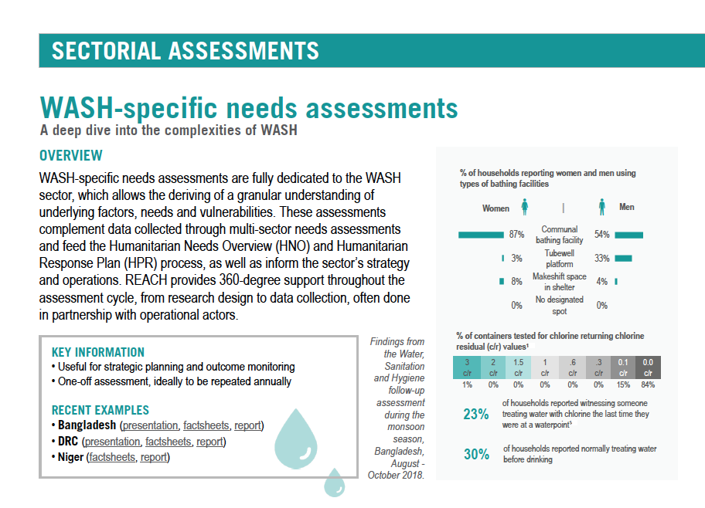
RESPONSE MONITORING
Needs assessments
      People in need
      Who? Where? How many?
      Priority needs, vulnerabilities and risks
Notes:
What is missing?

Slide 7
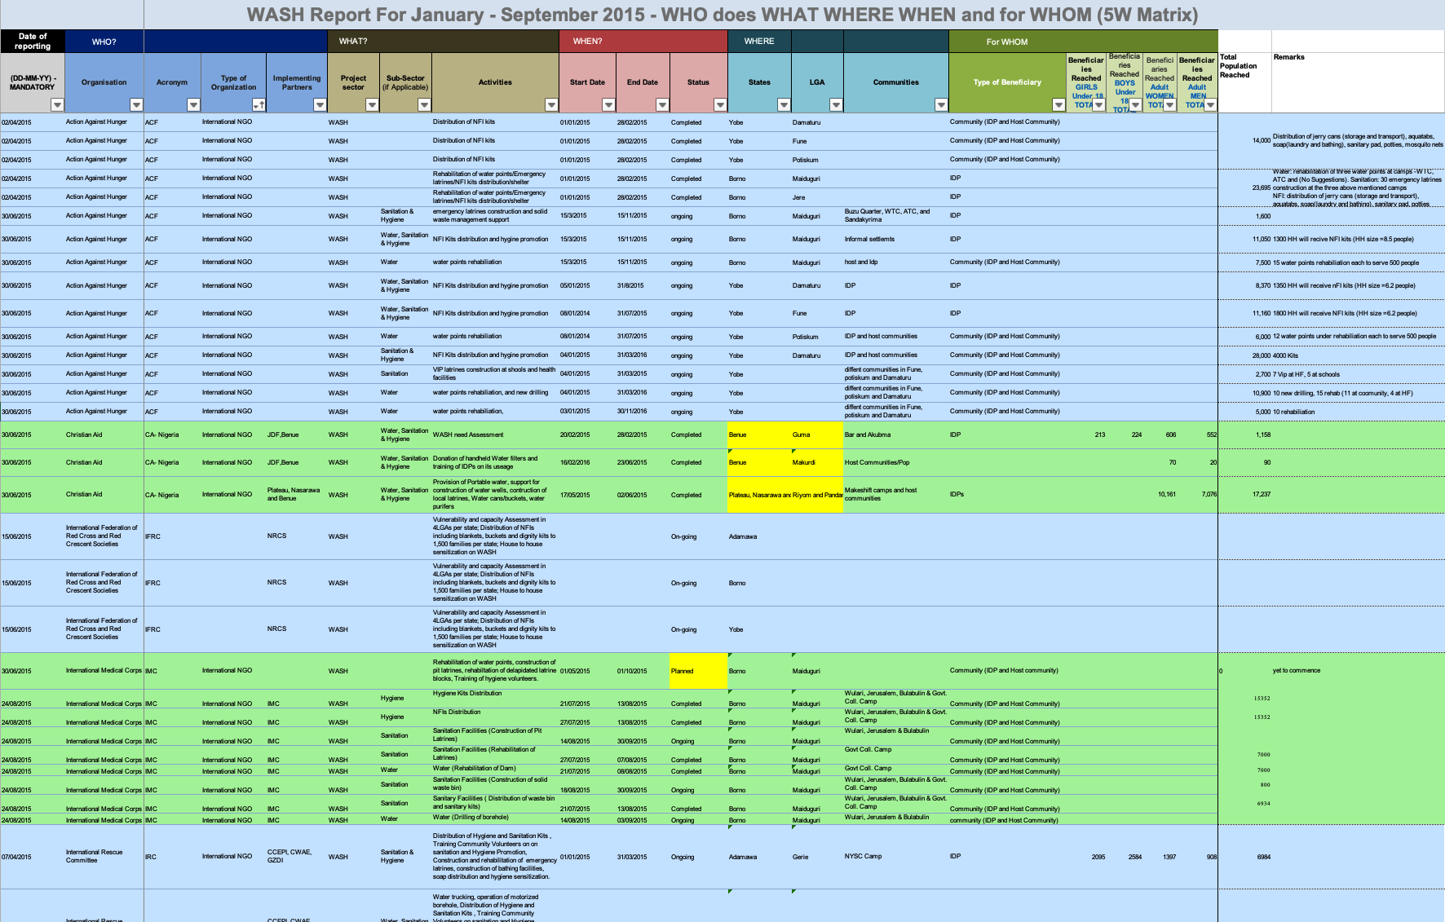
RESPONSE MONITORING
3/4/5Ws Matrix reporting
      WASH Organisations
      Who, Where, Doing what?
      Geographic gaps and overlaps
Notes:
What is missing?

Slide 8
RESPONSE MONITORING
Notes:
What is missing?

Slide 9
RESPONSE MONITORING
QUALITY MONITORING
      Activities meeting needs?
      Objectives being achieved?
      Standards being met?
Notes:
What is missing?

Slide 10
WHAT MATTERS?
Vanity metrics:
“What we’re doing”
Actionable metrics:
“How well is it working?”
Number of people reached
Number of latrines built
Number of hygiene kits supplied
% of people accessing safe water
% of people using latrines
% of people satisfied with hygiene kits
Notes:
Story with a

Slide 11



WHAT DO WE MEAN BY QUALITY?
Achieves objectives
Avoids doing harm
Satisfies
The response is effective at providing WASH services and addressing public health risk
Avoids harm, and promotes the safety and dignity of people affected by crisis and other engaging in the response
People are satisfied that the response meets their priority needs in an appropriate and timely way
Notes:
Story with a

Slide 12
WHAT NEEDS TO CHANGE?
Standards
Active engagement
Adapt and improve
Humanitarian crises are complex and chaotic – we need to collectively set clear standards for quality and hold ourselves accountable.
We must engage with those we seek to help, to understand our work from their perspective, measuring ourselves against their expectations and adapting our programmes accordingly.
We need metrics that show where to improve so that course corrections can be made in time to be effective.
Notes:
Story with a

Slide 13
2. THE AQA INITIATIVE
Notes:
Introduction to the initiative

Slide 14
THE AQA INITIATIVE
Challenge
Issues that affect the quality and accountability of humanitarian WASH response are not systematically picked up by existing monitoring approaches in time to be used as a trigger for change.
Objective
Empower partners to strengthen the quality of their work by measuring what matters, whilst emphasising the voice of those affected by crisis.
Audience
The tools are designed to be used routinely and collectively at the national coordination level, with a focus on small, achievable actions.
Notes:
Context slide

Slide 15

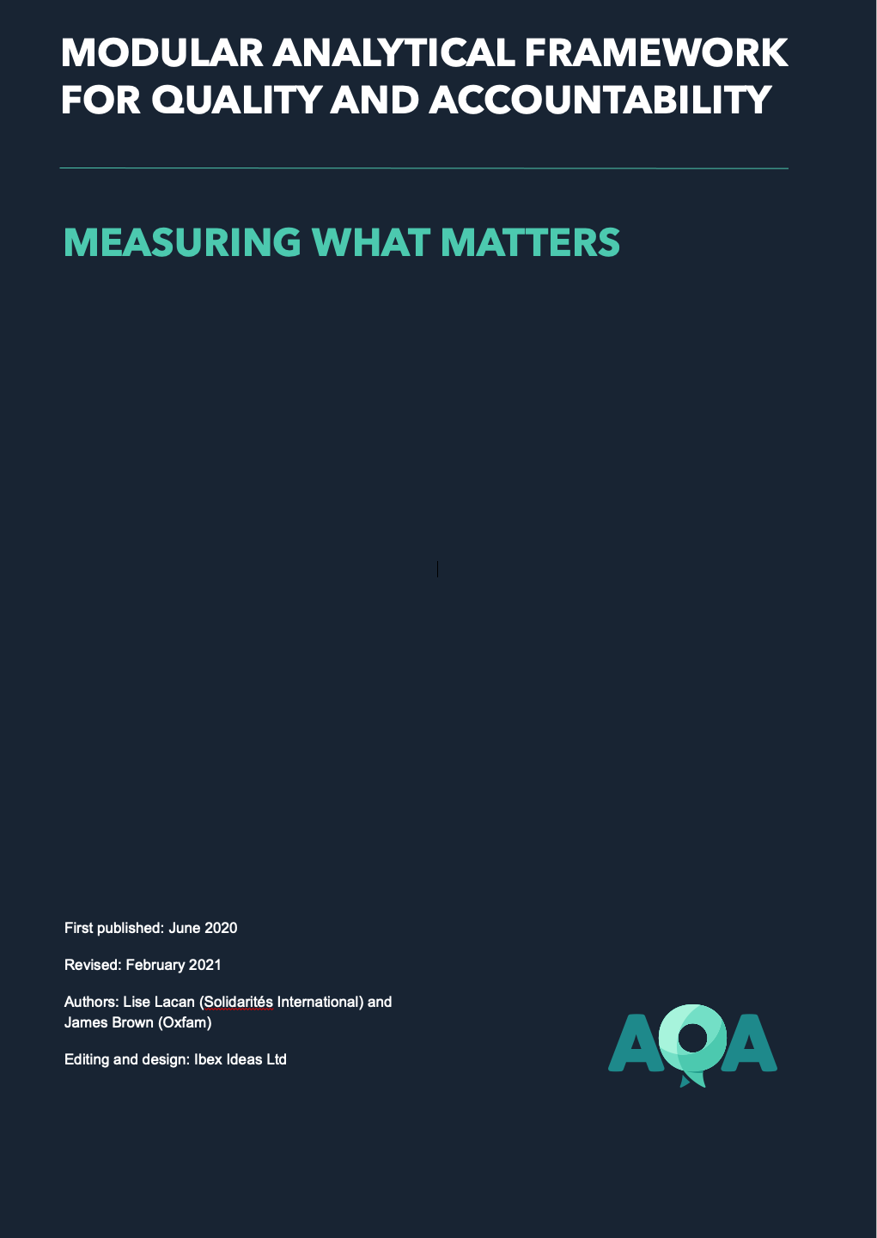


AREAS OF FOCUS
Guidance & frameworks
Direct support
Global engagement
Notes:
Context slide

Slide 16
GUIDANCE & FRAMEWORKS
Notes:
Context slide

Slide 17
GUIDANCE & FRAMEWORK
Guidance note
Step-by-step guidance on the AQA process
Aimed at coordination platforms for collective implementation
Notes:
Context slide

Slide 18
GUIDANCE & FRAMEWORK
Modular analytical framework
Compiles existing standards, indicators and approaches for monitoring quality and accountability
Modules can be selected, prioritised and adapted to context
Process, Outcomes and User satisfaction
Notes:
Context slide

Slide 19
3. THE AQA PROCESS
Notes:
Introduction to the initiative

Slide 20
THE AQA PROCESS
Notes:
Context slide

Slide 21

1. DEFINE
Collectively DEFINE standards, objectives and approaches. The Modular Analytical Framework is used to set Key Quality Indicators (KQIs) and
benchmarks appropriate to the context. The timing, approach and roles for data collection, reporting and analysis are agreed.
Notes:
Context slide

Slide 22

2. MEASURE
Collect data as set out in the Modular Analytical Framework and produce regular Quality Snapshots to support further analysis.
Notes:
Context slide

Slide 23

3. ADAPT
WASH partners jointly analyse the information in the Quality Snapshot, develop action plans based on the quality gaps identified and adapt programmes to mitigate risks and continuously improve.
Notes:
Context slide

Slide 24

4. LEARN
The LEARN stage is a periodic opportunity to take
stock of lessons learned, to realign priorities and
to identify and address course corrections on a
longer timescale.
Notes:
Context slide

Slide 25
AQA & HPC
Notes:
Context slide

Slide 26
4. THE MODULAR ANALYTICAL FRAMEWORK
Notes:
Introduction to the initiative

Slide 27







PRINCIPLES
Processes
Outcomes
Satisfaction
No re-invention
Adaptable
Different viewpoints
Notes:
Context slide

Slide 28
MODULES
‘Foundations’
Response-specific
People Centred Programming
Public Health Risk
WASH Services
Satisfaction
Safety
Participation
Inclusion
Feedback
Water quantity
Water quality
Sanitation
Handwashing
Water supply
Sanitation
Hygiene
Menstrual hygiene
WASH in health care facilities
Market based programming
Risk communication and community engagement
Notes:
Context slide

Slide 29
5. EXPERIENCE
Notes:
what was happening before
what changed and what is next?
What were the easy steps, what was more difficult?

Slide 30

AQA Pre-existing set up Myanmar WASH Cluster
Sunny Guidotti | Regional WASH Specialist LAC (Former Myanmar WASH Cluster Coordinator)

Slide 31



Pre-existing AQA set up in Myanmar
Cluster Team AAP visits – GENDER*
Monitoring (4W/site-based matrix)
Gap Analysis
Partners’ feedback mechanism
Quality dashboard, weekly update, quarterly newsletter
Cluster-level review of Monitoring & AAP/feedback
Financial tracking
Breakdown for local vs int’l partner
Gender & Protection Profile Action Plans
Advocacy efforts
AAP Agenda item
Multi-year SOF with yearly review
Ways of Working, Handover Guidelines
HRPs, SAG, TWGs
40+ contextualized standards
3rd Party Strategy Evaluations & Studies
Joint Technical Assessments
Innovation Pilots
Accountability Reviews
Direct cluster support to partners (balance capacity)
Capacity building program
Action Plan
Notes:
Collective standards, engagement, and flexibility to change
2018 4W & snapshot summary: https://drive.google.com/open?id=1huyPP9ax2-M1gwuiSbM4_72ZgzlP6Brj
2018 funding matrix: https://drive.google.com/open?id=13zHEp3zElxjFfyMm_aDWqCowbxMUPEhE
Newsletter: https://drive.google.com/open?id=0B_b4O8K5B0rKV2NjRVdkWFQyclE
Emergency matrix (contingency stock, HR capacity, focal points): https://drive.google.com/open?id=1QQidiXrPinzTwWywWeyKDNsbpRhmqwoi
Guidance/standards: https://drive.google.com/drive/folders/0B_b4O8K5B0rKS0l6Y3BXSW9WTTg and IECs: https://drive.google.com/drive/folders/0B_b4O8K5B0rKVmpZejhlSkpPamM
SOF: https://drive.google.com/open?id=1yR__L0lTyi_JU2RLDL70U9JcMkThD7yG
HRP: https://drive.google.com/open?id=0B_b4O8K5B0rKdG43WUVVYmdmanM
Gap Analysis data: https://drive.google.com/drive/folders/0B_b4O8K5B0rKbXRpcmQ2VFZiWXM
Qualitative data (Studies, PDMs, KAP survey, etc): https://drive.google.com/open?id=1qFC0WGwB1TcQP1DCRJbIXBxgjRTdUw9T
WASH Cluster team field visit reports: https://drive.google.com/drive/folders/0B_b4O8K5B0rKSzcxWnV2dG5xUkE
3 additional items not available on the website:
Weekly updates: I send weekly updates to the cluster as per sample attached. This one includes the recent Oxfam Tiger Worm Toilet Manual which comes from the experience in Rakhine IDP camps.
Camp closure: following WASH Cluster advocacy to HCT, there’s been HCT workshops and a protection sector position paper – all currently under discussion, so ongoing developments.
Draft Newsletter not published yet (needs editing)

Slide 32
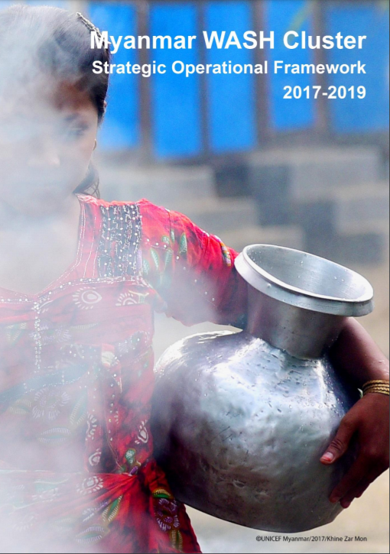
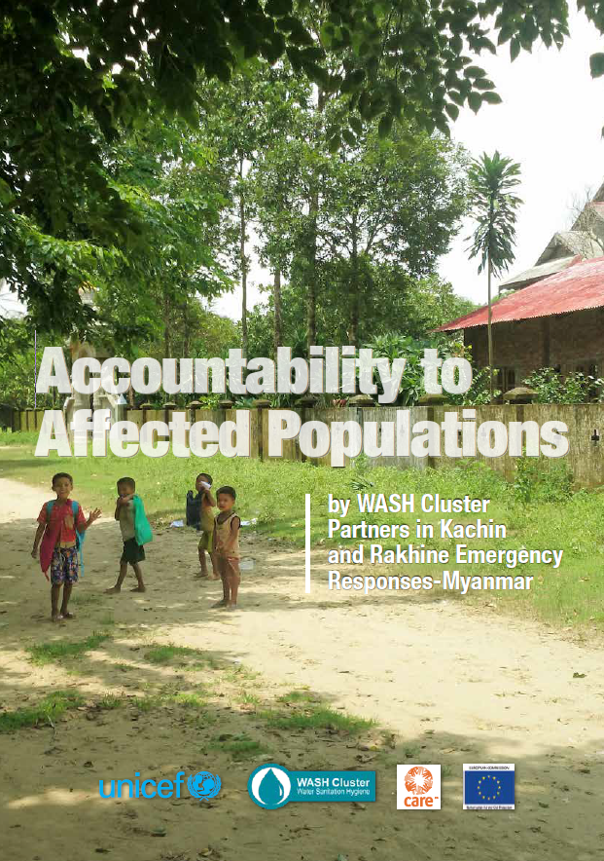
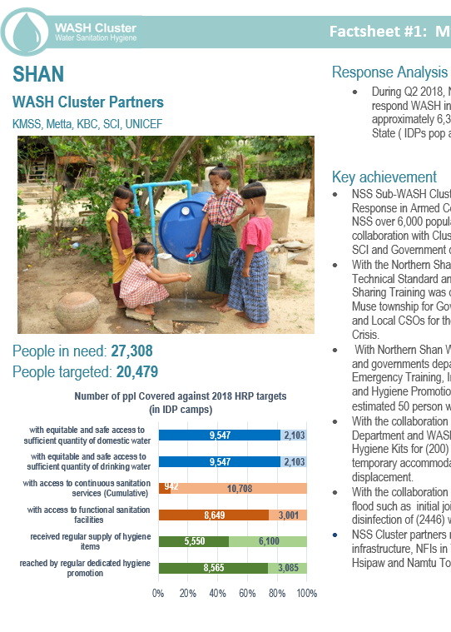
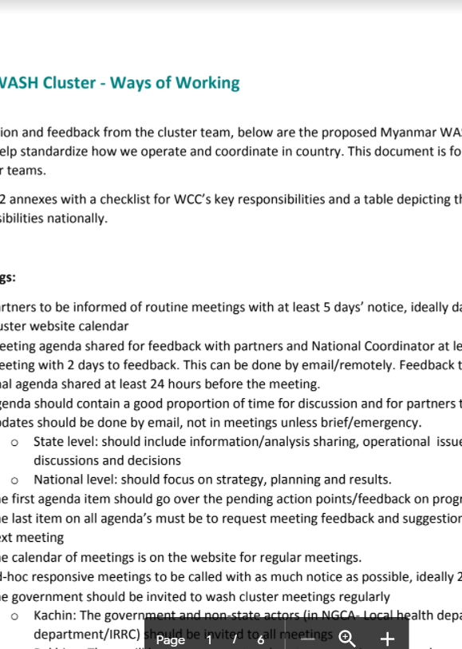
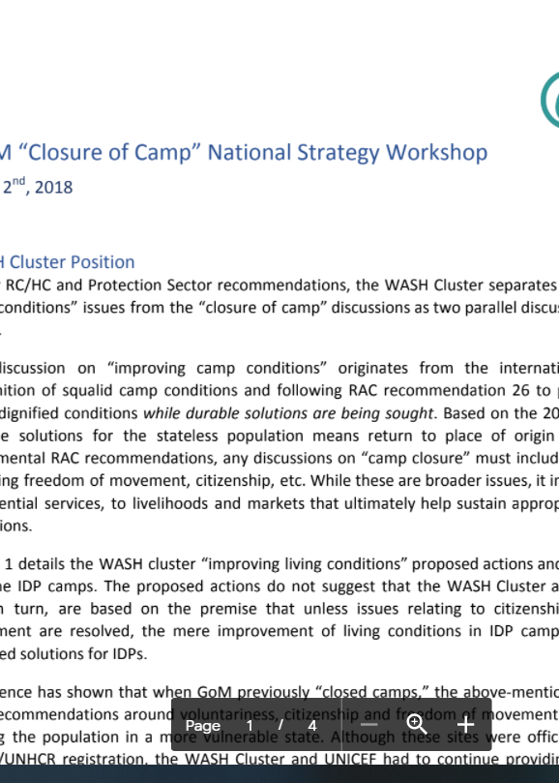
On paper
Notes:
SOF
AAP Review
Newsletter with response, gaps, funding to local and international, feedback from community
Ways of working to ensure accountability from coordination team trickled down
Advocacy to reflect feedback and interest of affected population

Slide 33
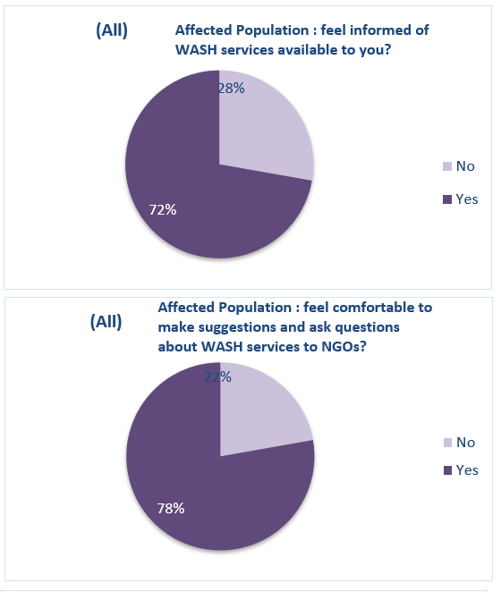
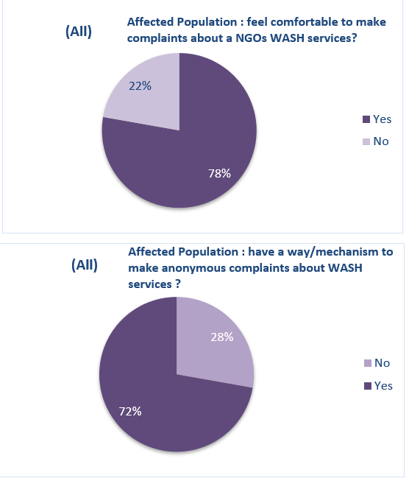
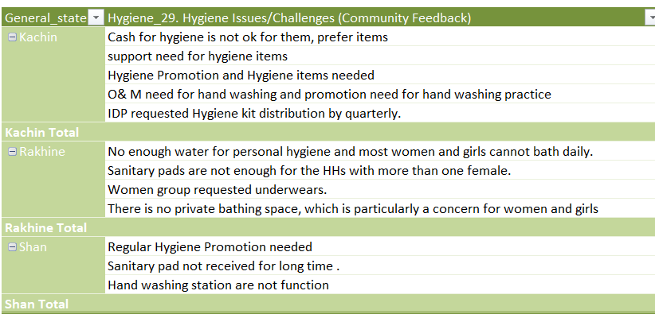
Regular AAP Consultation
Cluster Team independent visits
(gender balanced team)

Slide 34
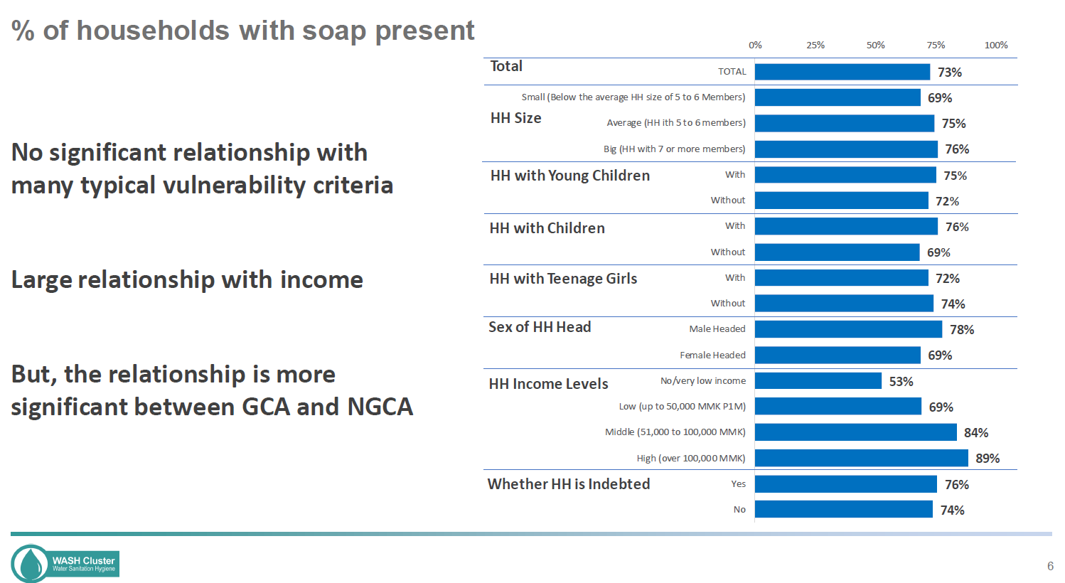
Cluster-wide assessments
Notes:
Rapid review of soap and sanitary pad for IDPs in KAchin

Slide 35
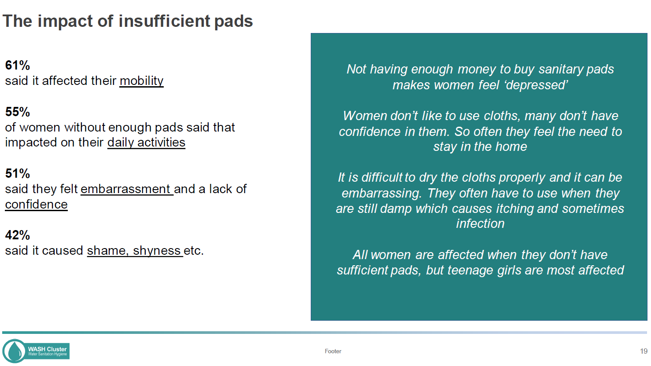
Cluster-wide assessments
Notes:
Rapid review of soap and sanitary pad for IDPs in Kachin
HELPED to make advocacy note and fundraising advocacy to donor community

Slide 36
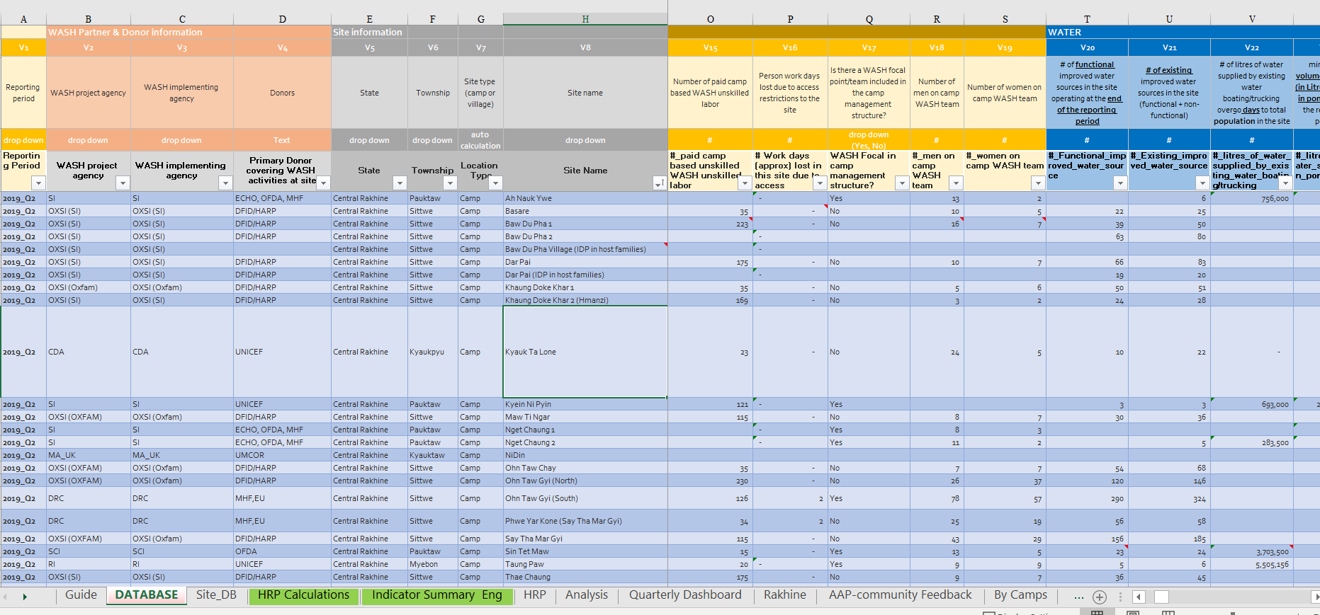
Monitoring Framework
Some examples of the insights that site specific + AQA indicators can provide
| Myanmar WASH Cluster
Notes:
Some examples of the insights that site specific + AQA indicators can provide

Slide 37
Site Specific + AQA Indicators
How is it changing over time?
Which sites are worst?
Site | Av/days
Kyauk Ta Lone | 30
Basare | 21
Say Tha Mar Gyi | 21
Ohn Taw Gyi (South) | 20
Phwe Yar Kone (Say Tha Mar Gyi) | 15
Sin Tet Maw | 1
Targeted Attention & Action
© UNICEF/PHOTO CREDIT
| Myanmar WASH Cluster
Notes:
WHAT

Slide 38
Principle / Why
WHERE are the main needs
Site Specific Reporting
AQA Metrics
WHAT are the main needs
WHAT is the quality of the response
© UNICEF/PHOTO CREDIT
| Myanmar WASH Cluster
Notes:
WHY

Slide 39
How
423
Unique Sites
Quarterly reporting (protracted stable situation)
Sub-national analysis
Traditional activity based 3W/4W used for first phase response in fluid scenarios as an interim short-term solution to report on what/who/where until it is known which sites people will remain in the medium term
© UNICEF/PHOTO CREDIT
| Myanmar WASH Cluster
Notes:
HOW

Slide 40
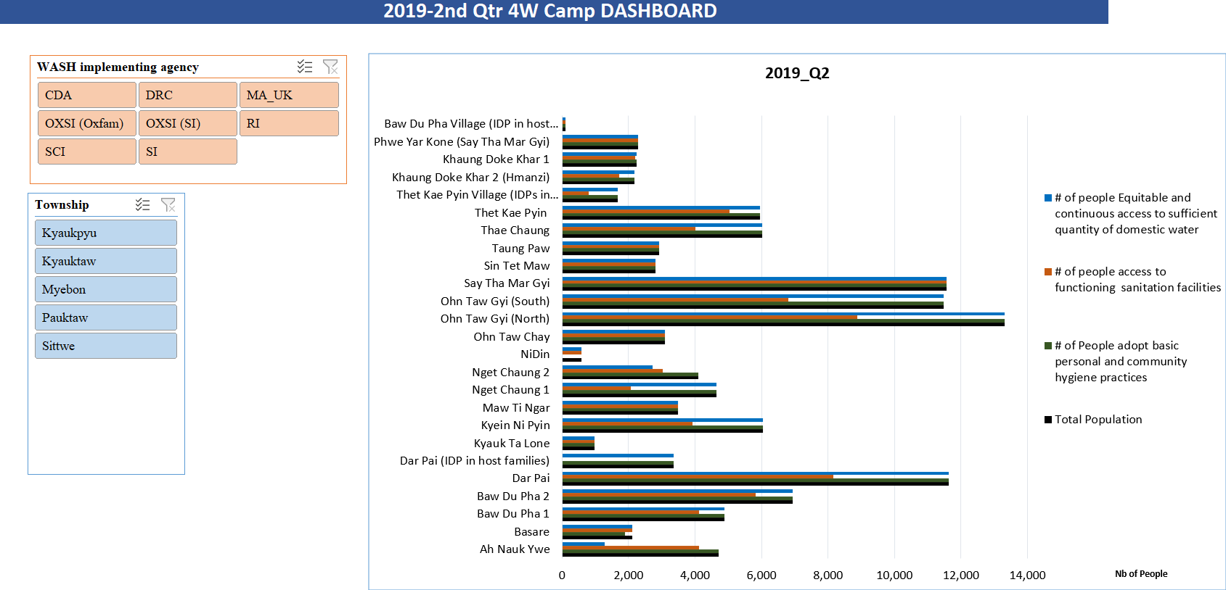
Site Specific
How is it changing over time?
Which sites are worst?
Targeted Attention & Action
© UNICEF/PHOTO CREDIT
| Myanmar WASH Cluster

Slide 41
Coupled with community feedback
Community Feedback (Q2-2019) from Cluster Team Monitoring
State | WATER_17. Water issues/challenges (Community Feedback)
Rakhine | Water storage container is not enough for the population.
 | Water shortage issue
 | Far from water sources
General_state | Sanitation_23. Sanitation issues/challenges (Community Feedback)
Rakhine | No enough water for latrine cleaning. SI hired the cleaner for cleaning latrines and they worked two days per month. The community requested to do latrine cleaning more frequently.
 | Water is not availabe near the latrines and most of the IDPs do not use latrines.
 | Water is not available near latrines and hand washing stations are not also available.
 | All latrines are built on low land at the bottom of a slope and therefore quickly flooded when it rains. When there is heavy rain, the pits tends to overflow. There are no handwashing facilities.
 | There is no additional space for digging new pits. The host family (religious leader) has plan to construct the latrines with concrete structure and the pit has been done. They don't have enough money and materials to construct superstructure and requested to organizations if they can support!
General_state | Hygiene_29. Hygiene Issues/Challenges (Community Feedback)
Rakhine | No enough water for personal hygiene and most women and girls cannot bath daily.
 | Sanitary pads are not enough for the HHs with more than one female.
 | Women group requested underwears.
 | There is no private bathing space, which is particularly a concern for women and girls
Targeted Attention & Action
© UNICEF/PHOTO CREDIT
| Myanmar WASH Cluster

Slide 42
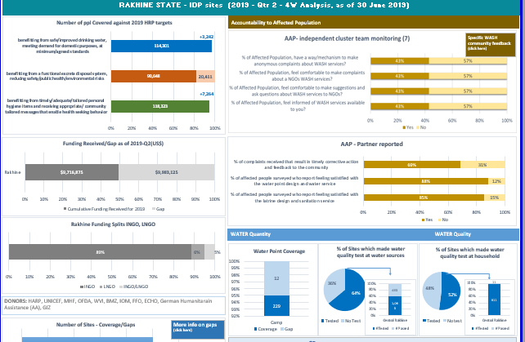
QUARTERLY ANALYSIS DISCUSSION
ACTION

Slide 43
Water Point & Sanitation Functionality
How is it changing over time?
Which sites are worst?
© UNICEF/PHOTO CREDIT
Targeted
Attention & Action
| Myanmar WASH Cluster

Slide 44
Water Point Repair Times
How is it changing over time?
Which sites are worst?
Site | Av/days
Kyauk Ta Lone | 30
Basare | 21
Say Tha Mar Gyi | 21
Ohn Taw Gyi (South) | 20
Phwe Yar Kone (Say Tha Mar Gyi) | 15
Sin Tet Maw | 1
Targeted Attention & Action
© UNICEF/PHOTO CREDIT
| Myanmar WASH Cluster

Slide 45
AQA Recommendations Myanmar WASH Cluster
Sunny Guidotti | Regional WASH Specialist LAC (Former Myanmar WASH Cluster Coordinator)
Notes:
what was happening before
what changed and what is next?
What were the easy steps, what was more difficult?

Slide 46



3 KEY RECOMMENDATIONS
Feedback “back” to community
Change of some AQA indicators
Link to yearly HPC
Notes:
Water Quantity: % of affected population using a sufficient quantity of water for drinking, cooking, cleaning and personal hygiene
Water Quality: % of affected population using water for drinking and cooking that is acceptable quality
Excreta Disposal: % of affected population disposing of their faeces safely every time they defecate
Handwashing: % of affected population washing their hands with soap at key times
Water Supply: % of affected population with access to drinking water services, by level of service (JMP ladder)
Sanitation: % of affected population with access to sanitation services, by level of service (JMP ladder)
Hygiene: % of affected population with access to handwashing facilities, by level of service
Menstrual Hygiene: % of affected women/girls of menstruating age with access to menstrual hygiene services
Satisfaction: % of affected population who are satisfied that WASH services meet their priority needs in an appropriate and timely way
Inclusion: % of affected population who feel that WASH services are accessible to all those in need
Safety: % of affected population who report feeling safe using WASH services at night and during the day, by service
Participation: % of affected population who feel that they are able to influence the way that assistance is designed, implemented and monitored
Feedback: % of affected population who feel that they have a safe, accessible and responsive channel for providing feedback to WASH partners

Slide 47

REFLECTIONS
01.
Well established + tweaking
02.
Balancing capacity & resources
03.
Temporary vs established sites
04.
Client focused approach
© UNICEF/UN0274927/Panjwani
© UNICEF/UN0306241
| Myanmar WASH Cluster
Notes:
We had already an established AQA system. This helped to inform the AQA project initiative and on the other hand, allow for concrete recommendations for tweaks that could be made to improve
Sharing operational burden. While there were less indicators, there were still more back end indicators, so the cluster needs to absorb that burden. We already had a way to support the more localized subclusters in kachin and shan, so upstream that for the AQA actions
Site based works well with stable or protracted crisis where sites are established. New displacements, we use 3W that is not site based because you dont know how long people will be there, they might move, it might be more local partners, more fluid, no P code for the site, not established.... In those sites, none of the AQA and it wasn’t possible to do it.
Client focused approach both from cluster team to partners, and from partners to affected population. It’s a mind set shift that easier to do with your own team, but can be done when you lead a cluster through systems and tools that transpire that and pushes partners to move towards that direction

Slide 48
6. WHAT’S NEXT?
Notes:
Introduction to the initiative

Slide 49
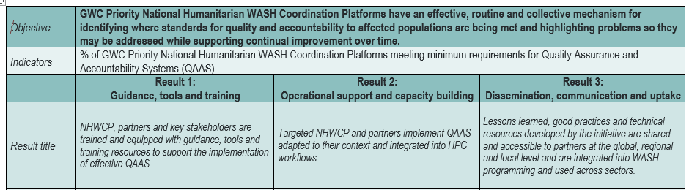
Operationalization phase
Target :
10 to 15 countries in 4 Regions
(WAC / EAC / SEA / LAC)
Dissemination, training and adaptation of guidance and tools
Field and remote support to NHWCP
Learning and consolidation
© UNICEF/PHOTO CREDIT
49 | Title of Your Presentation
Notes:
Level of funding and status + timeframe

Slide 50
Operationalization phase
Key objectives
To transform the AQA into a systematic framework that is predictably rolled out across the humantiarian sector (and grounded into the IASC/cluster, donor agencies etc.) to ensure sustainability
Key challenges
On boarding all WASH stakeholders : various scope, capacities and resources – Need to harmonize vision (National TWG)
Data & information management: disaggregation, representativeness, weighting, capacities –Third Party Monitoring
Feedback to communities
Integration in the strategical cycle of coordination platforms and partners
Creating synergies and coherence in the implementation of the initiatives at various level (Global with CAST and the Global AQA TWiG - the governance structure, regional and national/local) – Roles and responsibilities of NCCs, partners, Governments, UNICEF as CLA, FST and donors
Linkages with other Road Map Initiatives (WASH Severity Index Classification – Integration and coordination of Public Health Emergencies, etc.)
Integration of the system in the “new shape” of the coordination model (Localisation, Partnership, Area-based coordination, HDN, etc.)
Going beyond the WASH sector
50 | Title of Your Presentation

Slide 51

THANKYOU
http://washcluster.net/QAAI
Notes:
Introduction to the initiative

