Slide 1
Developing and using Core Indicators and Questions
Geneva, Switzerland
5 December 2017

Slide 2
How did we come to talk about this?

Slide 3
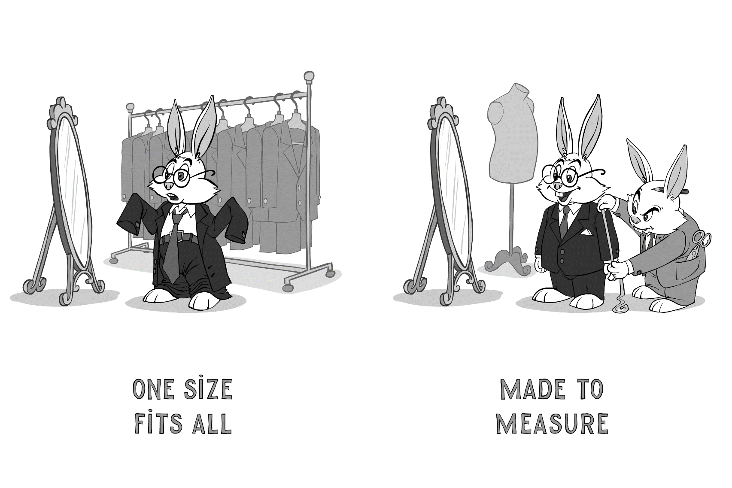
One size fits all
Notes:
Recent years have witnessed the multiplication of indicators and tools. This proliferation has allowed exploring alternative ways of collecting data, and improve data collection techniques.

Slide 4
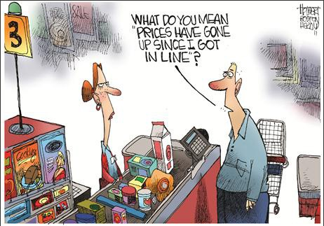
Indicator/tools inflation
Notes:
This has however led to a generalized inflation with the multiplication of indicators, tools, questions banks, etc.

Slide 5
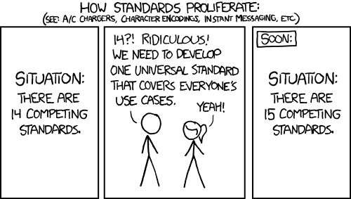
Standardization
Notes:
The there is now the need of harmonisation and standardisation.

Slide 6
Why it is needed? Key issues:
Various assessment formats collect data that are:
Incomparable
Mixed quality
Difficult to consolidate
This situation leads to:
Limited data coverage
Duplication of efforts
Squander of resources
Putting a burden on people
Notes:
Why we need standardisation? To promote best practices, enhance comparability of data within and across humanitarian crises, and perhaps more importantly to save resources and not to bother the people we are meant to serve. Let me quote the GB here “the proliferation of uncoordinated needs assessments leads to duplication, wasted resources and putting a burden on affected populations”. Not easy an easy process, but a much needed one: the key indicator list is a way to promote this important process at the country level.

Slide 7
What are we talking about?
A country list of indicators/questions that is
Designed to collect the minimum amount of data to assess WASH needs, vulnerabilities and service provision
Flexible enough to be included in all data collection initiatives by all organizations
It is not a prescriptive golden standard that would fit all assessment needs nor a finalized questionnaire
Notes:
Flexible enough: idea for the tools is that they should be flexible enough to be “inserted” into any type of WASH assessment, whether that is a rapid IRNA, multisector assessment, WASH assessment or KAP survey. It should also be included in, or at least aligned with, multi-sectoral assessment tools such as the ones IOM, HCR or OCHA usually have in country.

Slide 8
Key features
Short and concise to collect the bare minimum amount of data we need
Up to 10 indicators and 20 questions
Developed both at KI and HH level
KI and HH questions should be as much aligned as possible to collect comparable data
Consensual and accepted by all members
The process of developing the list should be as participatory as possible to develop ownership

Slide 9
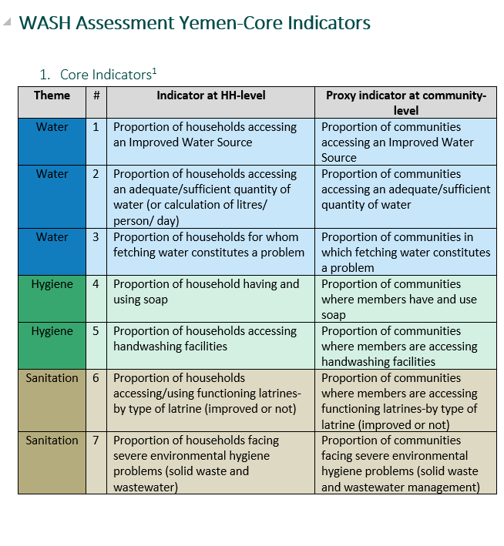
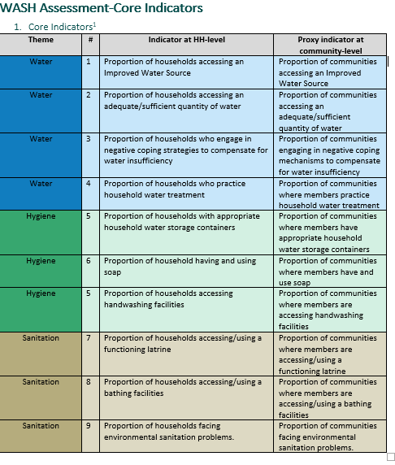
Examples of Core Indicators/Questions
Yemen
Bangladesh
Notes:
Here I will ask the coordinators to give a brief overview of their core indicators and questions (including what was the focus that was adopted, which parts have been prioritize and why, what was decided to keep out, etc.). I will also prepare a synopsis document where BGD and YEM indicators can be compared to hand out to the participants.

Slide 10
Designing Core Indicators/Questions
Experience-sharing on process and challenges
YEMEN |  | BANGLADESH
STEPS | CHALLENGES | STEPS | CHALLENGES
Notes:
Here I would just facilitate the process between Y/B for them to recall the main steps both in designing the indicator list and including them in the main dc initiatives – and related challenges. I will note down in real rime – then open the discussion to collect additional feedback from the participants.

Slide 11
Next steps?
Mainstream the core indicator approach in the different countries
Release the GWC Indicator and Question Bank (IQB)
Review the IQB mid-2018 to ensure:
Alignment with tools used by other data collection initiatives (DTM, etc.)
Compliance with reviewed standards (Sphere)

